Slide 1
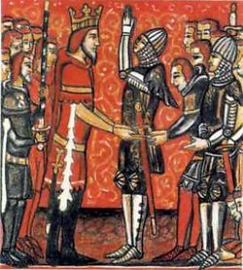
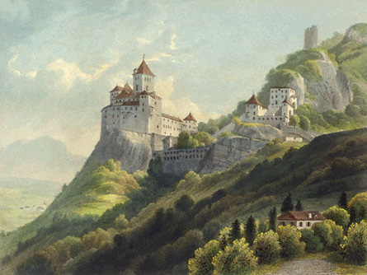
Feudalism & the Manor Economy

Slide 2
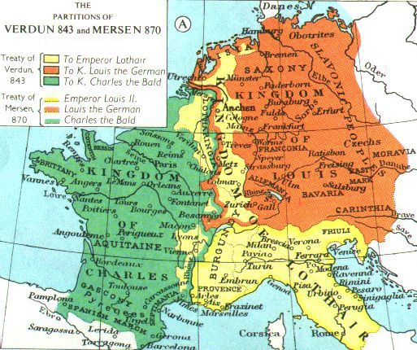
Problems in Europe
The destruction of Charlemagne’s empire led to widespread CHAOS in Western Europe

Slide 3
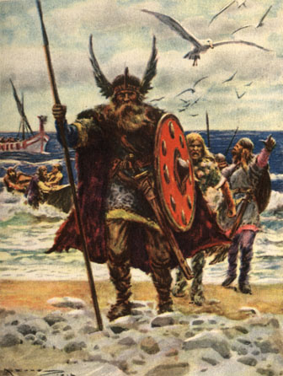
Problems in Europe
Political turmoil, economic decline, enemy invasions & constant warfare

Slide 4
Problems in Europe
Invaders attack!
Vikings, nomads, Muslims
Central authority was powerless to protect people from this chaos
So who did Europeans look to for protection?
Wealthy landowners (aka Lords)

Slide 5
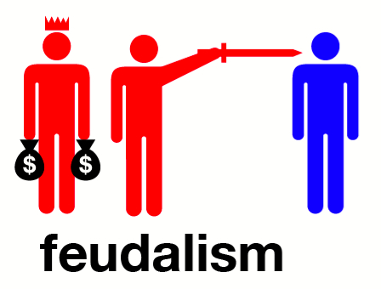
Emergence of Feudalism

Slide 6
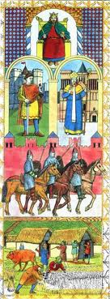
Emergence of Feudalism
Led to a new system of governing & landholding
Feudalism:
A political, economic, & social system based on mutual obligations between lords & vassals

Slide 7
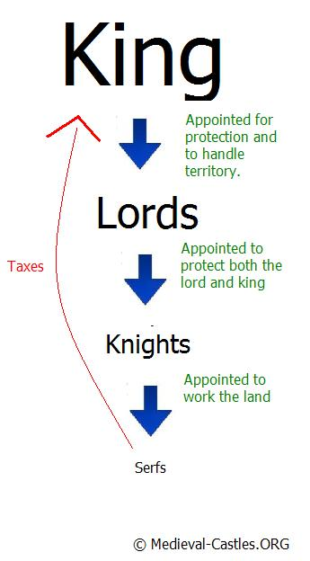
STATUS | OBLIGATION
Lord | Protection & land for his vassals
Knight | Loyalty to his lord & defense of his lord’s land in exchange for a fief (land grant); could be wealthy or poor
Vassal | Loyalty to his lord (military service, payments & advice) in exchange for a fief; could be wealthy nobles or serfs (peasants)
Notes:
As Monarch, the King was the top of the pyramid: he owned land.
He could allocate land, and control of the people who lived on the land to the nobility. These were important families, believed to be of important birth OR having shown incredible loyalty to the King.
Lords granted land called a fief
The person receiving a fief was called a vassal
Vassals provided the lord with protection
How? Knights! – mounted horsemen who defended lord’s land
Peasants comprised a majority of the population
Most peasants were serfs (a peasant who is bound to the land)
Could not be bought or sold
All peasants owed the lord certain duties

Slide 8
Social Classes
Medieval feudal system classifies people into 3 social groups:
Those who fight: nobles & knights
Those who pray: monks, nuns, leaders of Church
Those who work: peasants

Slide 9
Social Classes
Social class is usually inherited; majority of people are peasants
Most peasants are serfs – people lawfully bound to place of birth
can’t be bought/sold
can’t leave the land without permission
what they produce belongs to their lord

Slide 10
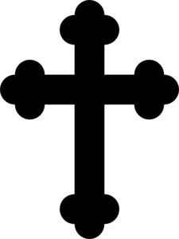
(LORDS, BARONS, BISHOPS)
(SERFS)

Slide 11
The Feudal Pyramid
Discussion Questions:
How was your social class determined?
Could a lord also be a vassal?
Why is there a cross at the top of the pyramid?
What was the role of the peasants?
How were serfs different from slaves?

Slide 12
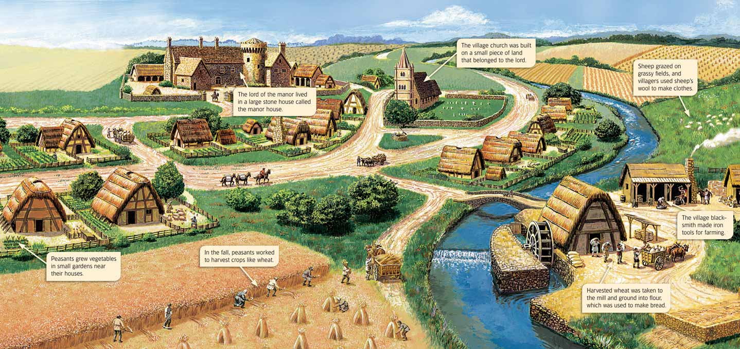
Manorialism

Slide 13
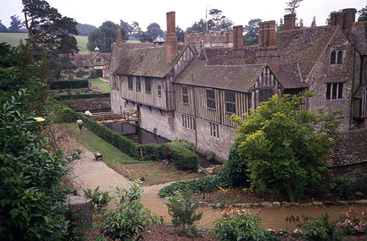
The Medieval Manor
Manor:
The lord’s estate
Manorialism:
The economic side of feudalism

Slide 14
The Medieval Manor
Manors varied in size & included:
the lord’s house
pastures & fields
forested areas
a church
a village where peasants lived
The goal of every manor was to be SELF-SUFFICIENT;WHY?

Slide 16
Harsh Manor Life
Peasants pay tax to use mill & bakery
Pay a tithe to the priest
Tithe: Church tax – is equal to 1/10th of a peasant’s income
Notes:
The lord provided the serfs with housing, farmland, and protection
The serfs tended the lord’s lands, cared for his animals, and paid taxes and tithes

Slide 17
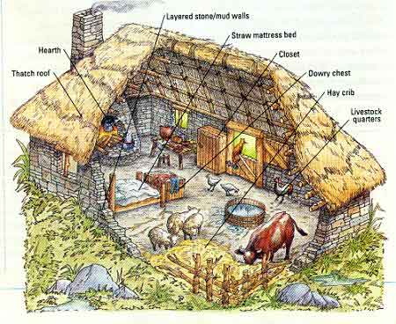
Harsh Manor Life
Serfs live in crowded cottages with dirt floors, straw beds
Daily life consists of raising crops, livestock; feeding & clothing family
Notes:
The lord provided the serfs with housing, farmland, and protection
The serfs tended the lord’s lands, cared for his animals, and paid taxes and tithes

Slide 18
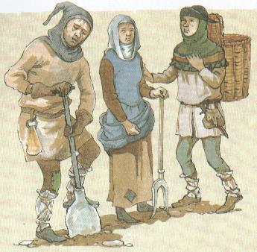
Harsh Manor Life
Poor diet, illness, malnutrition make life expectancy 35 years
Serfs generally accept their lives as part of God’s plan
Notes:
The lord provided the serfs with housing, farmland, and protection
The serfs tended the lord’s lands, cared for his animals, and paid taxes and tithes

Slide 19
Review
http://www.youtube.com/watch?v=HCPp7XWZfHo

Slide 20
Anatomy of a Castle

Slide 21
Anatomy of a Castle
Due to the lack of a strong central authority, warfare was VERY common during the Middle Ages
Why were castles, or fortified manor houses, needed?

Slide 22
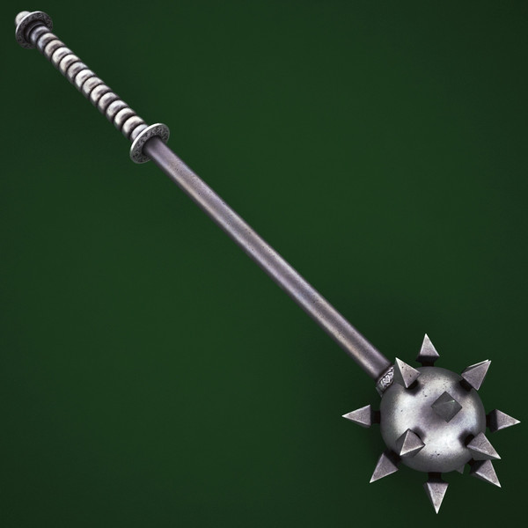
Anatomy of a Castle
Medieval castles were designed in response to the weapons they had to withstand

Slide 23
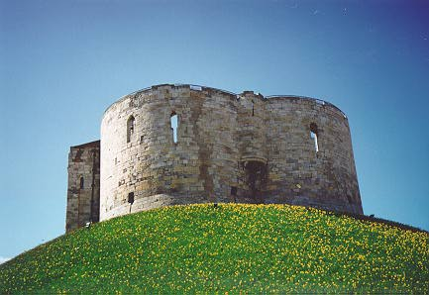
Anatomy of a Castle
Common Features:
Stone, thick walls, rounded towers, reinforced doors, moat & keep

Slide 24
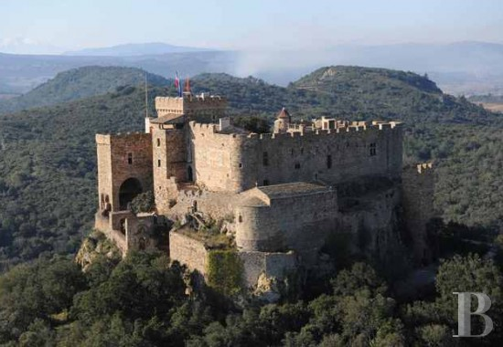
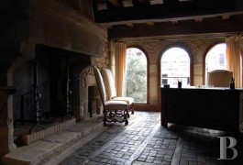

Slide 25
The World of Nobles

Slide 26
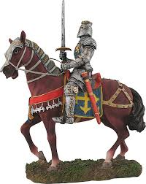
The World of Nobles
Warfare was a way of life
Constant battle for power between nobles
From boyhood many nobles were trained to become knights

Slide 27
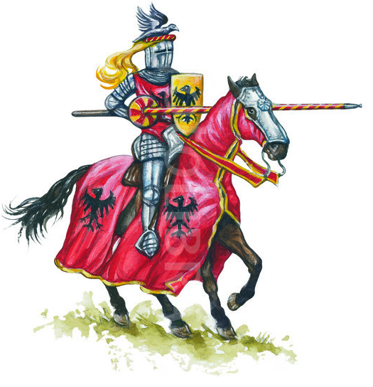
The World of Nobles
Feudal lords raised private armies of knights
Knights rewarded with land, which provides income
Other activities help knights train for battle

Slide 28
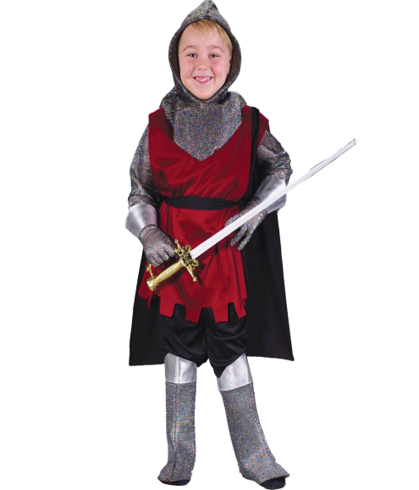
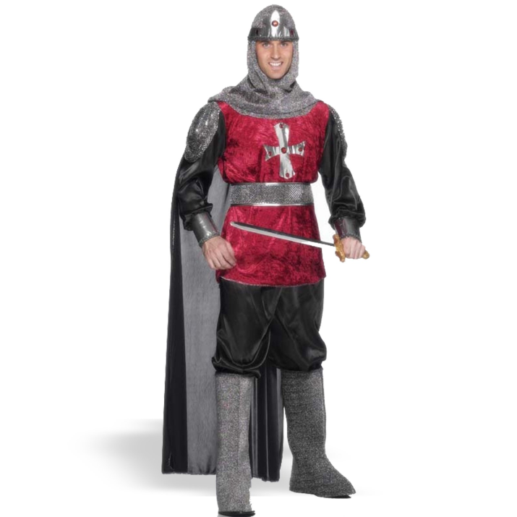
Knighthood
Age 7 (PAGE):
Sent to the castle of a lord
Trained in weaponry, riding & fighting

Slide 29
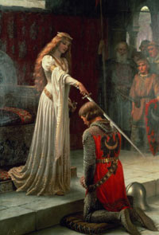
Knighthood
Age 14 (SQUIRE):
Became a knight’s servant
Age 21 (KNIGHT):
Full-fledged knighthood

Slide 30
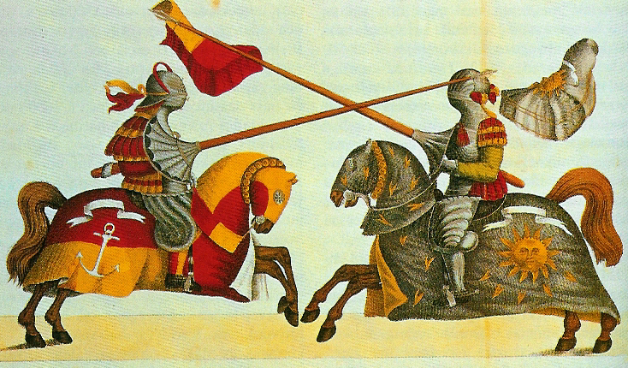
Knighthood
Knights compete in tournaments:
Mock battles characterized by fierce competition
Gain experience

Slide 31
Knighthood
Warfare:
Battles generally fought near castles
Boiling water, hot oil, molten lead & crossbows served to deter enemy soldiers

Slide 32
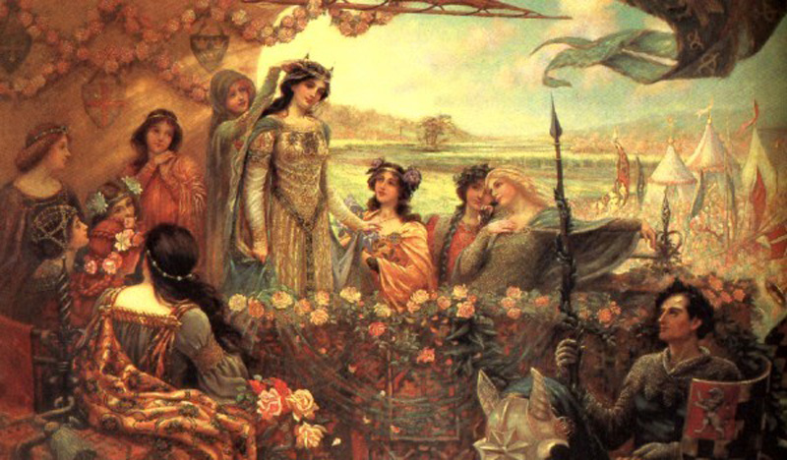
A Code of Chivalry

Slide 33
A Code of Chivalry
Chivalry:
A code of conduct followed by knights; a set of ideals for behavior
Required knights to be brave, loyal & honest

Slide 34
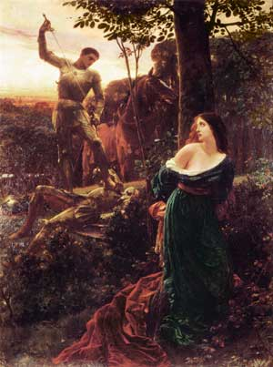
A Code of Chivalry
Fight fairly
Treat captured enemies well & with respect
Defend the Church
Protect & cherish women

Slide 35
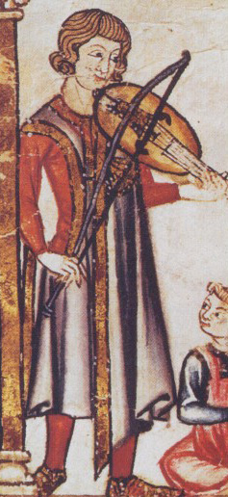
A Code of Chivalry
Troubadours adopted this view of women
Wrote & performed love songs/poems that praised women
Traveled & also recited/performed epic poems about heroes and their adventures

Slide 36
Noblewomen
Lady of the Manor:
While husband was at war, women supervised vassals, managed the household
They could inherit land, defend the castle, or send knights to war on the lord’s request

