Slide 1
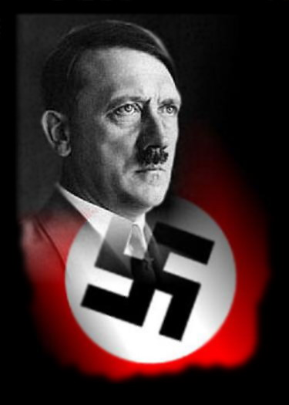
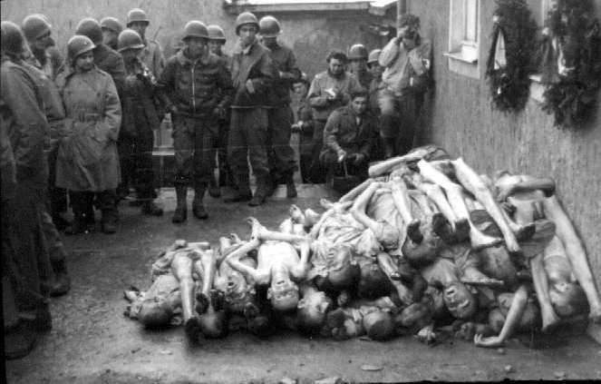
The Holocaust
Steps to Genocide
1933 to 1945

Slide 2
What was The Holocaust?

Slide 3
holocaust (noun):
Greek word meaning “sacrifice by fire”
The Holocaust (proper noun):
The Holocaust was the systematic, bureaucratic, state-sponsored persecution and murder of approximately six million Jews by the Nazi regime and its collaborators

Slide 4
Genocide (noun):
The crime of destroying a group of people because of their ethnic, national, racial, or religious identity

Slide 5
Genocide was NOT the first step!
Concentration Camp:
Upon their ascent to power on January 30, 1933, the Nazis established concentration camps for the imprisonment of all “enemies” of their regime
Sentences could be a few months or a few years

Slide 6
Nazi Target Groups
Ethnicities: Jews & Gypsies (Roma),
Nationalities: Slavs (Poles & Russians)
“Degenerates”: Homosexuals, The Mentally & Physically Disabled
Political rivals: Communists & Socialists
Religions: Jehovah Witnesses & Jews
Asocials: Anybody else who opposed the Nazis

Slide 7
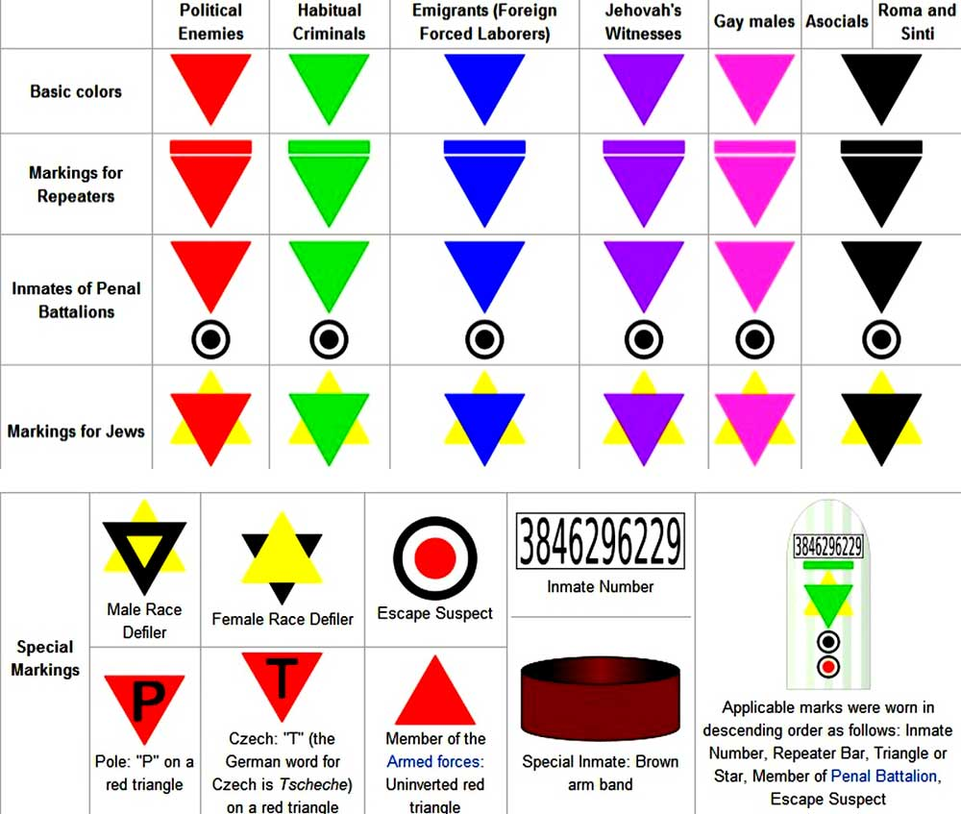

Slide 8
First they came for the Communists,
and I didn't object
- For I wasn't a Communist;
Then they came for the Socialists,
and I didn't object
- For I wasn't a Socialist;
Then they came for the labour leaders,
and I didn't object
- For I wasn't a labour leader;
Then they came for the Jews,
and I didn't object
- For I wasn't a Jew;
Then they came for me
And there was no one left
to object. Martin Niemoller, (1892-1984 )
German Protestant Pastor, & Nazi Political Prisoner from 1937 to 1945

Slide 9
Notes:
Concentration camp prisoners wearing triangles and inmate numbers.

Slide 10
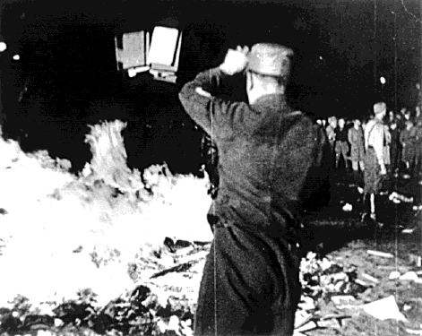
Three Steps to Genocide of Jewish People
You cannot live among us as Jews
You cannot live among us
You cannot live
Burning of Jewish books, including the Torah, 1934

Slide 11
Escalation of Hate
Institutionalized, government sponsored racism
Genocide
Discrimination
Prejudice
Stereotyping

Slide 12
Step 1: You cannot live among us as Jews

Slide 13
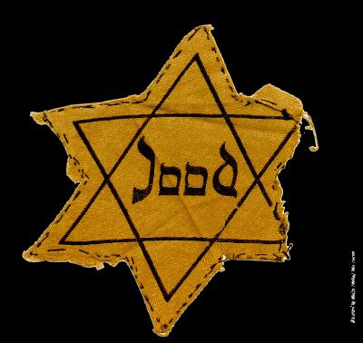
You cannot live among us as Jews.
Prejudiced Attitudes: Stereotyping
Discrimination & Harassment
Systemic Racism

Slide 14
Step#1: You cannot live among us as Jews.
Europe has a long history of Anti-Semitism
Anti-Semitism (noun):
Hostility toward or discrimination against Jews as a religious, ethnic, or racial group
Notes:
Hitler’s minister of propaganda Joseph Goebbels, links love of Germany with hatred of the Jews
Eugenics:
Based loosely on early 20th century understanding of the science of genetics, eugenicists believed that people should be bred as farmers breed animals: deliberately weeding out “inferior” traits through genetic selection. The Nazis believed that they could create a “a master race”.

Slide 15
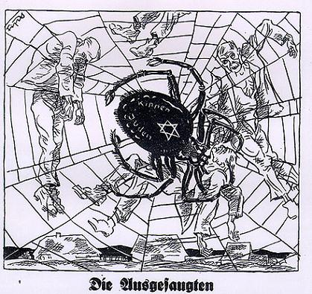
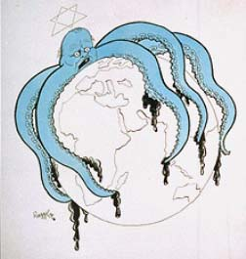
Step#1: You cannot live among us as Jews.
The personification of the devil as the symbol of all evil assumes the living shape of the Jew ~ Adolf Hitler
Notes:
Hitler’s minister of propaganda Joseph Goebbels, links love of Germany with hatred of the Jews
Eugenics:
Based loosely on early 20th century understanding of the science of genetics, eugenicists believed that people should be bred as farmers breed animals: deliberately weeding out “inferior” traits through genetic selection. The Nazis believed that they could create a “a master race”.

Slide 16
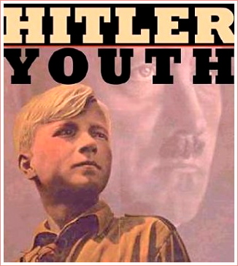
You cannot live among us as Jews.

Slide 17
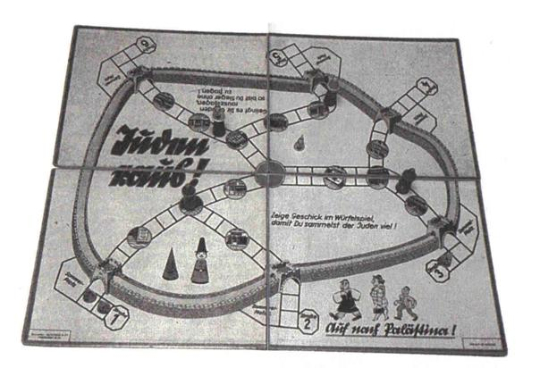
You cannot live among us as Jews.
Above: “Juden Rause” (“Jews Get Out”), Nazi children’s board game
A group at exit 2 are “off to Palestine”

Slide 18
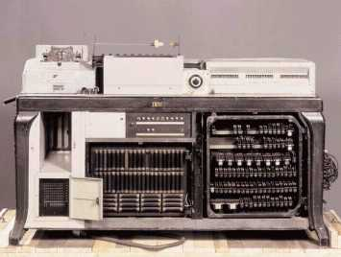
You cannot live among us as Jews.
How did they know who was Jewish?
November 1935 German churches begin to collaborate with Nazis by supplying records indicating who is Christian
State of the art data processing was used to take a census in all German territory. Early on the Nazis included questions on religious heritage
The machine allowed Nazi officials to tabulate huge amounts of data very quickly
Notes:
German Hollenith Machine – a subsidiary of IBM

Slide 19
You cannot live among us as Jews.
In 1934, Nazi scientists developed this kit
Contained 29 samples of human hair
Samples were used by geneticists, anthropologists, & doctors to determine ancestry
Hair color also became a means to prove the supposed superiority of Aryans and the inferiority of Jews, Gypsies, and those of “mixed breeds”

Slide 20
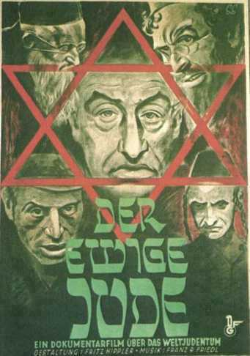
You cannot live among us as Jews.
Notes:
“The Eternal Jew” – a degenerate-art exhibition in Munich opened on November, 1937. The largest prewar anti-semitic exhibit produced by the Nazis, it depicted Jews as vile, subhuman creatures.

Slide 21
You cannot live among us as Jews.
Notes:
The exhibit featured photographs pointing out the typically “Jewish” traits. The Jew was stereotyped as having a large hooked nose, enormous lips and sloping forehead.

Slide 22
You cannot live among us as Jews.
Germans were suspicious of Jews who were seen as conspiring
(with the help of communists) to take over the world

Slide 23
You cannot live among us as Jews.
On April 1, 1933, Hitler declared a one-day boycott of Jewish shops
Many German citizens voluntarily participated

Slide 24
You cannot live among us as Jews.
May 1933, Jewish books were burned in public bonfires

Slide 25
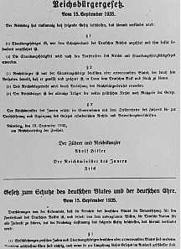
You cannot live among us as Jews.
“The Nuremberg Laws” turned prejudice & discrimination into systemic racism
Examples:
1935: Jewish Newspapers could no longer be sold
1936: Jews lost the right to vote
1938: Jews had to surrender drivers’ licenses & car registrations
The Reich Citizenship Law and the Law for the Protection of German Blood and Honor, Germany, September 15, 1935.

Slide 26
You cannot live among us as Jews.
The Nuremberg Laws also classified “degrees “ of Jewish blood
One use for this classification was to permit or to deny couples the right to marry (and thus to reproduce)
One proposed “solution” to the Jewish problem was sterilization

Slide 27
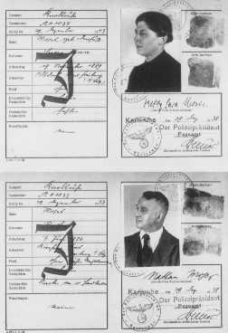
You cannot live among us as Jews.
By 1938, all Jews were required to carry identification cards
Jewish passports & papers were marked with a “J”
By 1941, Jews were required to wear yellow “Star of David”

Slide 28
You cannot live among us as Jews.
Nov 9-10, 1938: Kristallnacht (Night of the Broken Glass)
Nazis attack Jewish homes, businesses & synagogues
Jews killed, injured and arrested

Slide 29
Step 2: You cannot live among us

Slide 30
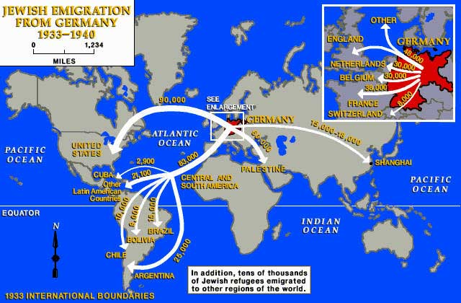
You cannot live among us.
Jewish Refugees:
Nazis try to force Jewish emigration
After admitting tens of thousands of Jewish refugees, France, GB, and the U.S. close their doors

Slide 31
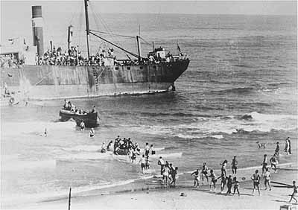
You cannot live among us.
British officials arrested 850 European Jewish immigrants and interned them in a detention center near Haifa
Similarly, in 1939 the German refugee ship St. Louis attempted to find safe harbour for its Jewish passengers in Cuba & the US. Most end up back in Belgium & the Netherlands
In 1939, 850 Jewish refugees attempt to enter British-controlled Palestine illegally.

Slide 32
You cannot live among us.
Jewish Ghettos:
After emigration plan failed to get rid of all of the Jews, Hitler ordered Jews in all countries under his control to be moved to designated cities
Ghettos: segregated Jewish areas

Slide 33
You cannot live among us.
Evacuating the Jews from Germany, the Nazis created compulsory “Jewish Quarters” in most Polish cities and towns. The ghetto was a section of a city where all Jews from the surrounding areas were forced to reside, surrounded by barbed wire or walls.

Slide 34
Nazi ghettos were a preliminary step in the annihilation of the Jews. Ghettos became transition areas, used as collection points for deportation to concentration & death camps.
You cannot live among us.

Slide 35
You cannot live among us.
By spring of 1941, conditions inside Poland’s Warsaw Ghetto were hellish: Food was scarce, clothing consisted many of old rags, and medical supplies were virtually non-existent. Child mortality rates skyrocketed.
Left: Orphan sleeping in Warsaw ghetto, 1941

Slide 36
You cannot live among us.

Slide 37
You cannot live among us.

Slide 38
You cannot live among us.
In 1941, German Jews were taken into “protective custody” and deported to concentration camps, built in eastern Germany & Poland.

Slide 39
You cannot live among us.
Jews carried their few remaining possessions to train stations. They were then transported in freight and cattle cars. Not only were there no chairs, but the trains also lacked sanitation, food, water, and air.

Slide 40
You cannot live among us
In 1941, Romania also began to deport its Jews. Fewer than half the 2500 Romanian Jews on the Lasi train survived the eight day train journey. Death due to exhaustion, starvation, dehydration, and suffocation was common on the train transports.

Slide 41
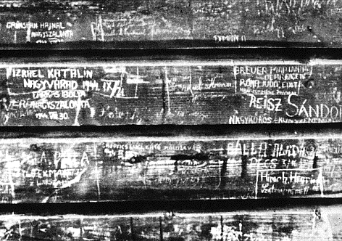
You cannot live among us.
Concentration Camps
Camps were built on railroad lines for efficient transportation
On arrival, all are given numbers- some have this tattooed on their wrist

Slide 42
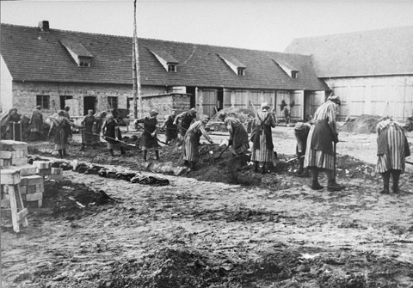
You cannot live among us.
WHY HAVE THE CAMPS?
Essential to Nazi’s systematic oppression and eventual mass murder of enemies of Nazi Germany
Slave labor moved them towards their ultimate goal- “annihilation by work”
What was taken from Jews was used to provide goods for the German People

Slide 43
Step 3:
You cannot live

Slide 44
You cannot live.
The Final Solution:
The code name for the planned genocide of the Jews of Europe
Jews were rounded up & sent to concentration/labor camps
By 1942, Nazis built extermination camps (“death camps”) with gas chambers that could kill as many as 6,000 people a day

Slide 45
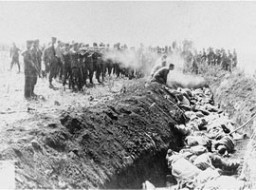
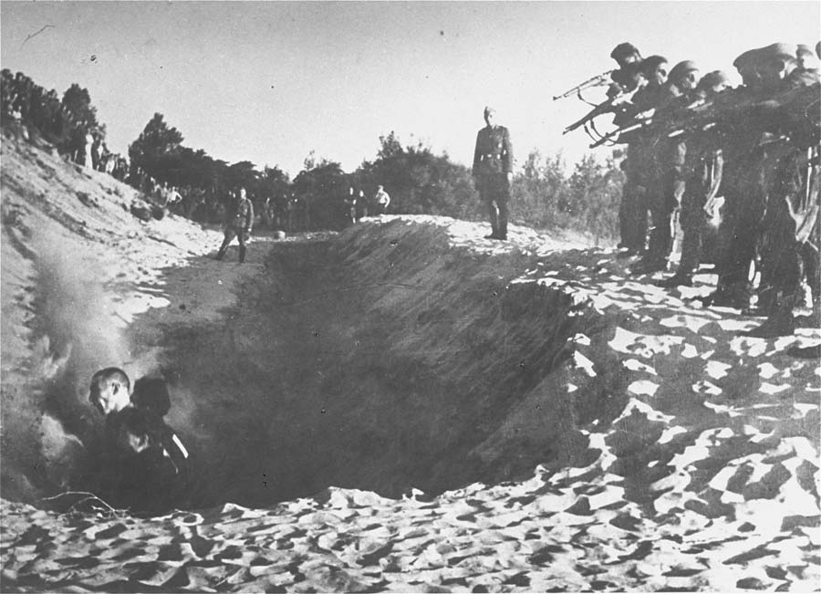
Step #3: You Cannot Live
Einsatzgruppen
Mobile killing units had began killing operations aimed at entire Jewish communities in the 1930s
Thought to have killed as many as 1 million people in six months
Vigorous participation of local police helped facilitate the killing

Slide 46
You cannot live.
1941 Ukraine, members of Einsatzkommandos and local Ukrainian nationalists murdered 25 000 Jews in huge open pits. Mass shootings and graves in Estonia and Poland were inefficient and demoralized German soldiers.
The Germans began to seek a more permanent solution to the Jewish problem.

Slide 47
You cannot live.
On January 20, 1942, 15 high-ranking Nazi Party and German government officials gathered at a villa in the Berlin suburb of Wannsee to discuss and coordinate the implementation of what they called the "Final Solution of the Jewish Question." Nearly all knew about the deportations and killings already in progress.

Slide 48
You cannot live.
At the Wannsee Conference, SS Officer Adolf Eichmann (1906 - 1962) was given the task of implementing the “Final Solution”
Eichmann organized the round-ups and the train convoys to the extermination camps
Eichmann observed that poison gas was already being used to exterminate the mentally handicapped
He devised the gassing procedures and set the death quotas in the extermination camps
Notes:
Eichmann fled Germany for Buenos Aires after the war.
In the 1960, the Israeli government found him, kidnapped him, tried him in Israel, and hanged him.

Slide 49
You cannot live.
The SS were put in charge of the day-to-day operations of the death camps.
Ten days after the meeting, on January 30, 1942, Hitler proclaimed that “the results of this war will be the total annihilation of the Jews.”

Slide 50
You cannot live.

Slide 51
You cannot live.
The Germans deported the Dutch Jews east starting in mid-1942
Most believed they were going to labor camps
Few believed the death camps even existed

Slide 52
You cannot live.
The sign over the entrance to Auschwitz said “Work makes one free.” However, Auschwitz was NOT a labor camp. It was actually the largest of the death camps.

Slide 53
You cannot live.
Inmates of a death camp
Many who were not immediately taken to the gas chambers, died more slowly from malnutrition & overwork

Slide 54
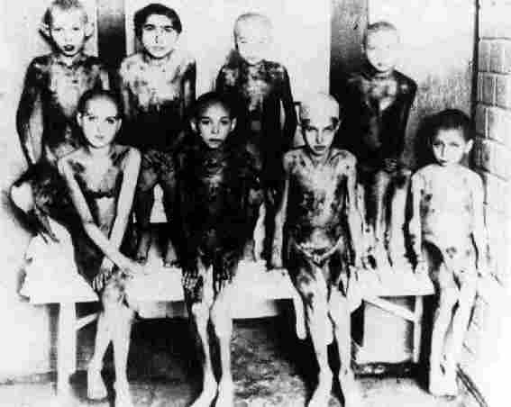
You cannot live.
Nazi doctors did high pressure experiments (left) and radiation experiments (below)

Slide 55
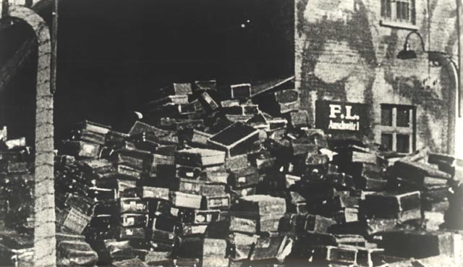
Once selected, you began the process of extermination Your luggage would be left for collection later
You cannot live.

Slide 56
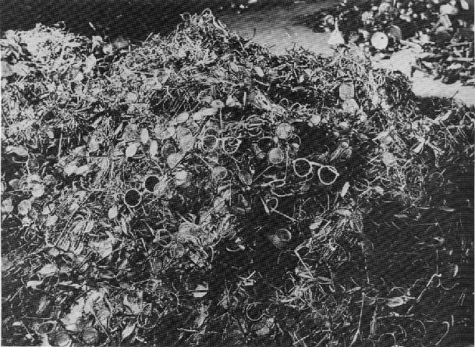
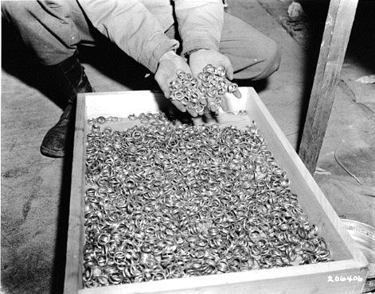
First you removed your valuables
You cannot live.

Slide 57
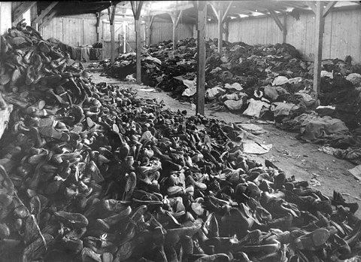
Then you removed your shoes and clothes
You cannot live.

Slide 58
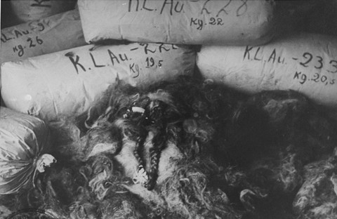
Then they removed your hair
You cannot live.

Slide 59
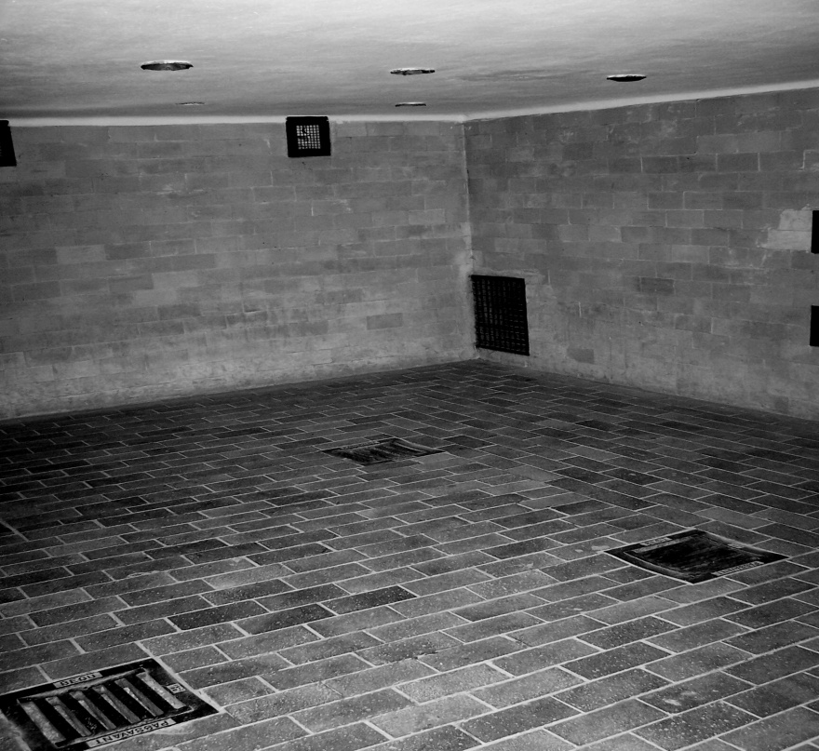
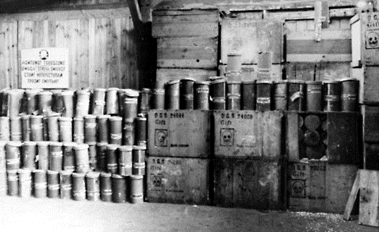
Finally…
You cannot live.
Prisoners were sent to gas chambers disguised as showers
Zyklon B gas used to gas people in 3 – 15 minutes
Up to 8000 people were gassed per day at Auschwitz-Birkenau, the largest death camp with 4 operating gas chambers

Slide 60
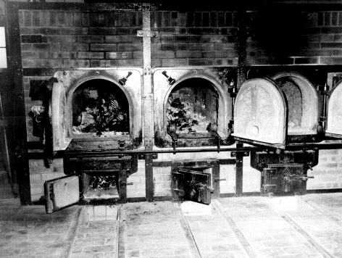
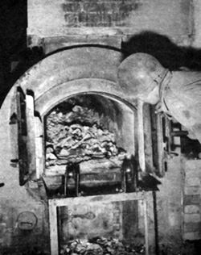
After…
You cannot live.
Prisoners moved dead bodies to massive crematoriums
Large industrial ovens were used to cremate the remains. Jewish inmates operated the ovens under SS supervision
Gold fillings from victims teeth were melted down to make gold bars

Slide 61
Major Death Factories
You cannot live.
Sobibor - 250 000
Chlemno - 255 000
Majdanek 360 000
Belzec 601 500
Treblinka 750 000 - 870 000
Auschwitz-Birkenau 1 100 000 – 1 600 000

Slide 62
You cannot live.
By 1945, the Nazis’ began to destroy crematoriums and camps as Allied troops closed in
Death Marches
Between 1944-1945, Nazis ordered marches over long distances. Approximately 250 000 – 375 000 prisoners perished in Death Marches

Slide 63
You cannot live.
1945 - Allied soldiers liberating the camps often had to dig mass graves.
On January 27, 1945, the Soviet army entered Auschwitz (largest camp) and liberated more than 7,000 remaining prisoners, who were mostly ill and dying.

Slide 64
You cannot live.
When the British liberated Bergen-Belsen April 15, 1945, they discovered tens of thousands of unburied bodies.
At 4:00 am on April 29, 1945, the last day of his life, Adolph Hitler made one last address to the German people: “Above all I charge the leaders of the nation and those under them to scrupulous observance of the laws of race and to merciless opposition to the universal poisoner of all peoples, international Jewry.”

Slide 65
You cannot live.
Even after liberation, Bergen-Belsen inmates continued to die. 14 000 prisoners died from April 15 to June 20, 1945.

Slide 66
You cannot live.
1945, Soviet troops liberated Auschwitz. Rudolf Hoess, Commander of Auschwitz, was asked if the Jews whom he had murdered had in any way deserved their fate. He answered, “Don’t you see, we SS men were not supposed to think about these things ... Besides, it was something already taken for granted that the Jews were to blame for everything.”

Slide 67
You cannot live.
Many SS guards claimed after the war that they had just “been following orders.”
Rudolf Hoess, Commander at Auschwitz said, “We were all so trained to obey orders without even thinking....”
Left: SS guards at Sobibor Death Camp, 1942

Slide 68
European Jewish Population in 1933 was 9,508,340
You cannot live.

Slide 69
Estimated Jewish Survivors of Holocaust: 3,546,211
You cannot live.

Slide 70
You cannot live.
“In spite of everything I still believe that people are really good at heart”
- Diary of Anne Frank
In March 1945, Fifteen-year-old Anne Frank died at Bergen-Belsen of typhus

Slide 71
There were some revolts.
In October 1942, the Sobibor armed revolt and escape attempt closed the camp
In October 1944, Auschwitz inmates revolted, but failed to achieve their goal: the destruction of the ovens & gas chambers

Slide 72
There were some heroes.
Oscar Schindler (1908-1974) A German businessman who first profited from the war but who later saved over 1,300 Jews from the gas chambers by declaring them essential workers – regardless of age or capacity to work.

Slide 73
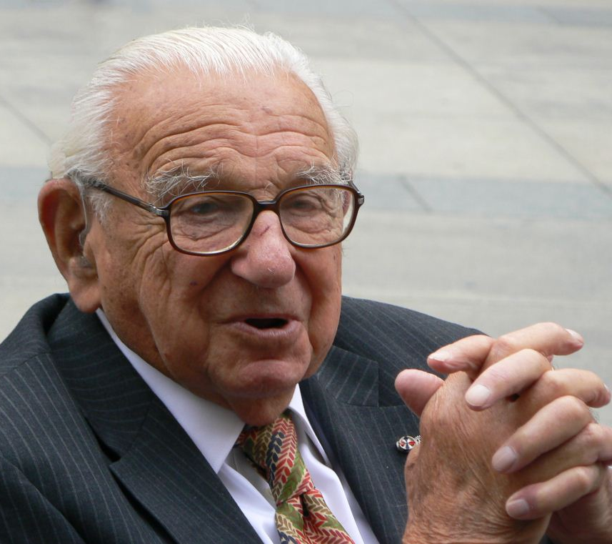
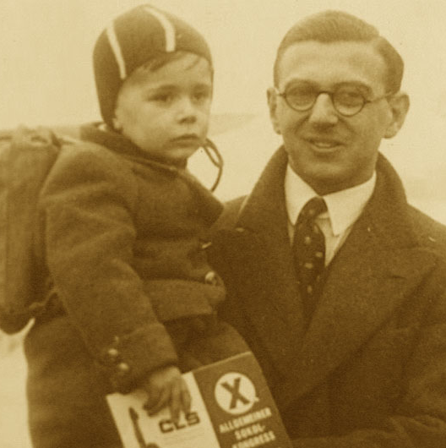
There were some heroes.
Sir Nicholas George Winton, is a British humanitarian who organized the rescue of 669 mostly Jewish children from German-occupied Czechoslovakia on the eve of the Second World War, in an operation later known as the Czech Kindertransport
Notes:
http://www.powerofgood.net/story.php

Slide 74
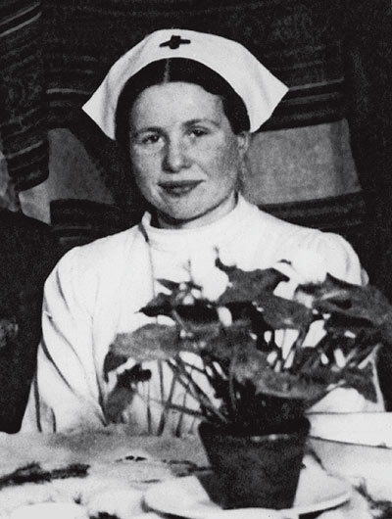
There were some heroes.

Slide 75
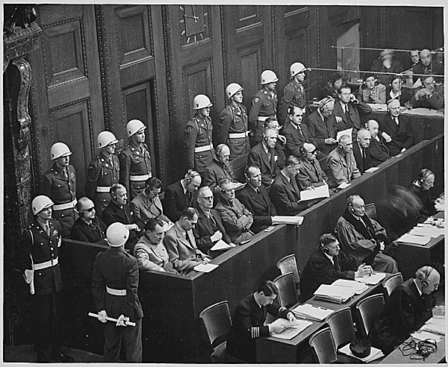
There was some justice.
On November 22, 1945, the Nuremberg War Crimes Tribunal began.

Slide 76
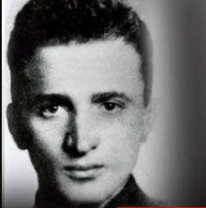
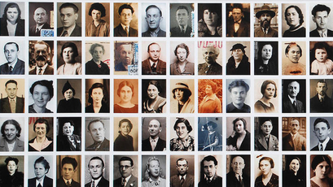
There were some survivors.
Stanislaw “Shlomo” Smajzner – survivor of Sobibor escape
Thomas Blatt – survivor of Sobibor escape

Slide 77
Did “your” person survive?

Slide 78
Works Cited
Chartock, Roselle and Jack Spencer. The Holocaust Years: Society on Trial. New York: Bantam Books, 1978.
Harran, Marilyn, et. al. The Holocaust Chronicle: A History in Words and Pictures. Lincolnwood: Publications International, Ltd., 2000.
Schumacher, Julie A. Voices of the Holocaust. Logan: Perfection Learning Corporation, 2000.

