Slide 1
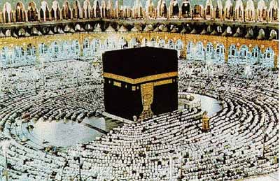
Islamic Civilization

Slide 2
Before Islam…

Slide 3
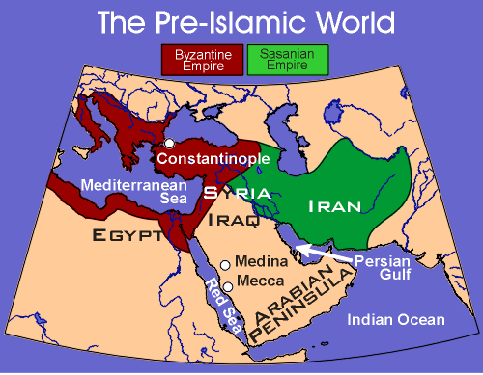
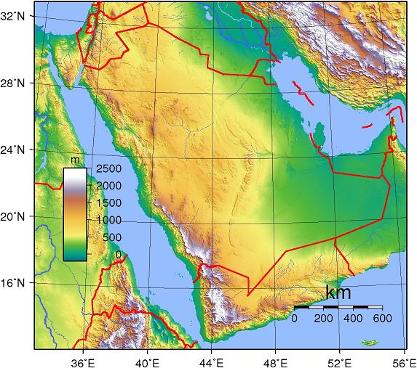
Before Islam…
The Arabian peninsula is the setting for the birth of Islam
This area is comprised mostly of deserts

Slide 4
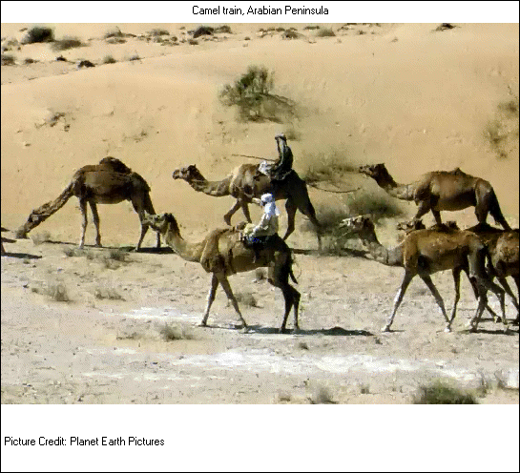
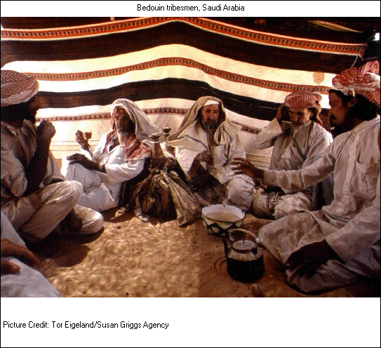
Before Islam…
Before the development of Islam most ancient Arabs were Bedouins, or nomadic tribes
Practiced polytheism & worshipped pagan idols

Slide 5
Before Islam…
The religious center for Arab polytheists was a small temple called Ka’aba in the city of Mecca
Arabs made an annual journey to worship at the Ka’aba

Slide 6
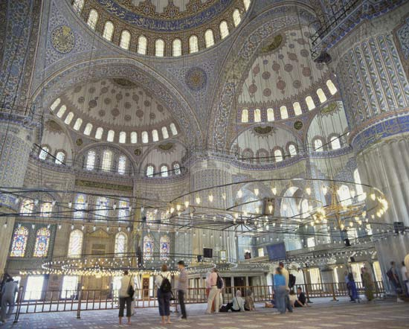
A New Faith

Slide 7
A New Faith
Prophet/Founder:
Muhammad, a 7th century Arab (born in Mecca)
Experienced a revelation from Allah (Arab word for God) while meditating

Slide 8
A New Faith
The Revelation:
Allah called for Muhammad to be the apostle of the one true God
Told him to “rise & warn” his people about divine judgment
Islam = “submission to the will of Allah”
Muslim = Follower (“one who has submitted”)

Slide 9
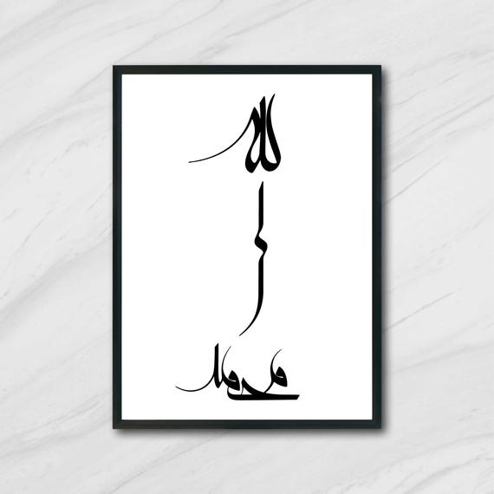
Opposition & Muhammad’s Return

Slide 10
Opposition to Islam
Wealthy merchants feared that monotheistic worship would end the annual pilgrimage to Mecca
Why?
Feared that they would lose profits

Slide 11
Opposition to Islam
Threatened, Muhammad fled to the city of Medina
His departure is known as the Hijrah (AD 622)
Marks the beginning of the Muslim calendar

Slide 12
Muhammad’s Return
In Medina Muhammad gained many followers
In 630 AD Muhammad returned to Mecca & reclaimed the city
Most Meccans converted to Islam at this time

Slide 13
Links to Judaism & Christianity

Slide 14
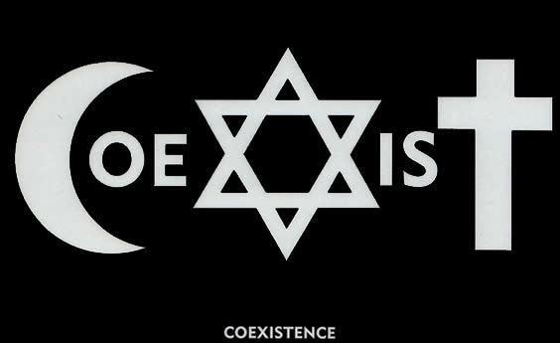
Links to Judaism & Christianity
Allah is believed to be the same God that is worshipped in Christianity & Judaism (monotheistic!)
Muslims view Jesus as a prophet, not the son of God
All 3 believed in heaven & a day of judgment & trace their origins to Abraham…

Slide 15
Abraham’s Genealogy
HAGAR
ABRAHAM
SARAH
Ishmael
Isaac
12 Arabian Tribes
Jacob
Esau
12 Tribes of Israel

Slide 16
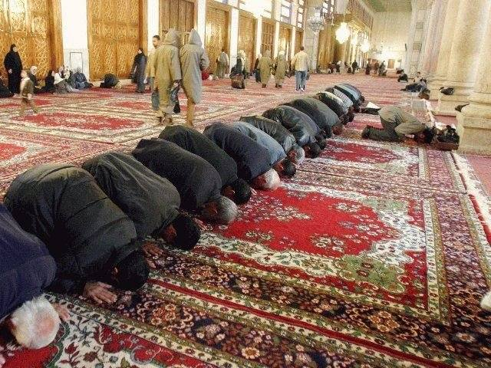
Beliefs, Practices and Values

Slide 17
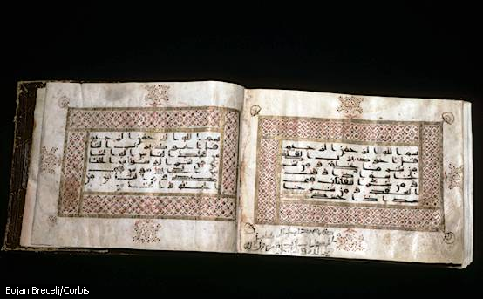
Beliefs & Practices
Holy Book: Quran (Koran): written in Arabic; believed to contain God’s message as revealed to Muhammad

Slide 18
Values: Submit to God (Allah)
Honor parents
Be kind to neighbors
Protect widows and orphans
Give to the poor
Condemns:
Murder
Stealing
Lying
Adultery
Forbids:
Gambling
Pork
Alcohol
The Quran
Endorses:
Polygamy
Slavery
Jihad
Regulates:
Marriage
Divorce
Inheritance
Business

Slide 19
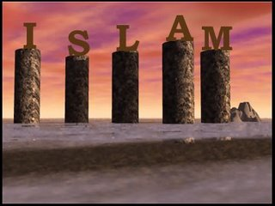
Beliefs & Practices
Shari’ah:
Islamic Law (regulates family life, moral conduct, business/community life)
5 Pillars of Islam:
The religious duties of every Muslim – demonstrate submission to the will of god

Slide 20
5 Pillars of Islam
Shahadah (expression of faith): “There is no God but Allah & Muhammad is the messenger of God”
Salah: the requirement to pray 5 times a day at fixed times, facing Mecca

Slide 21
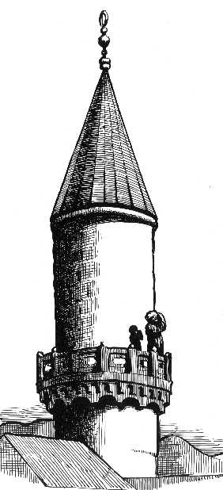

Slide 22
5 Pillars of Islam
Zakat: charity (i.e. giving to the poor)
Sawm: Fasting during daylight hours during the month of Ramadan (month Quran was revealed to Muhammad)
Hajj: Make a pilgrimage, or hajj to Mecca, at least once in a lifetime

Slide 23
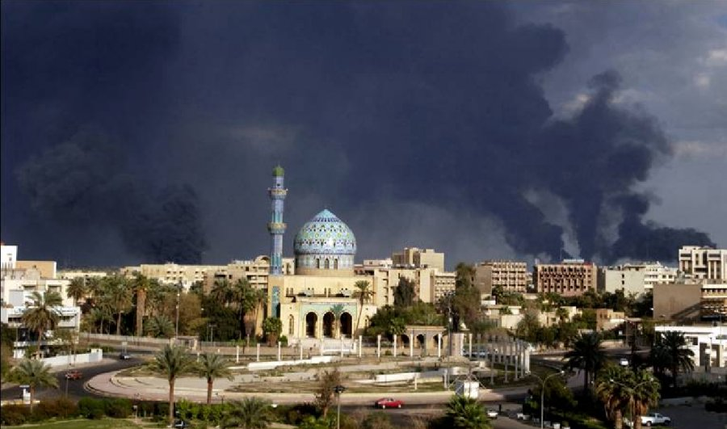

Slide 24
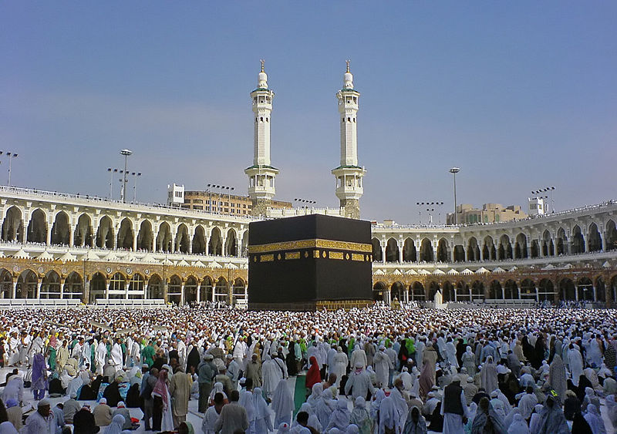

Slide 25
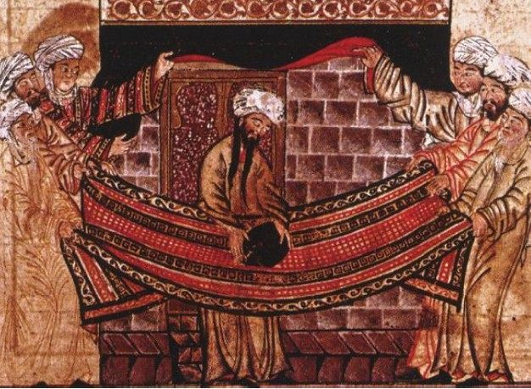

Slide 26
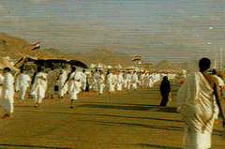
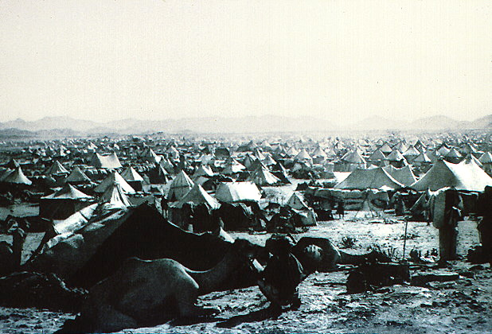
Pilgrims On
The Road to
And Camped
Outside of Mecca
Pil

Slide 27
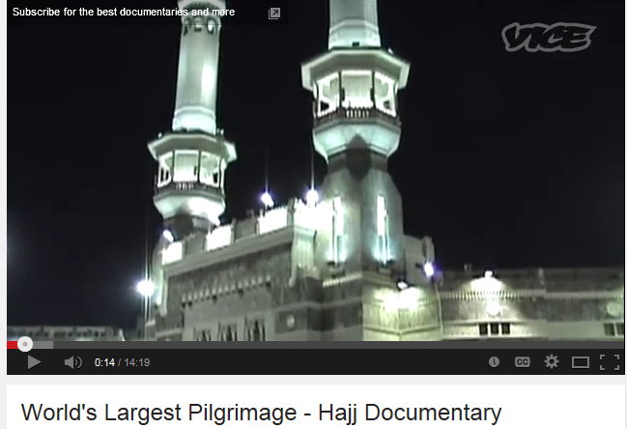

Slide 28
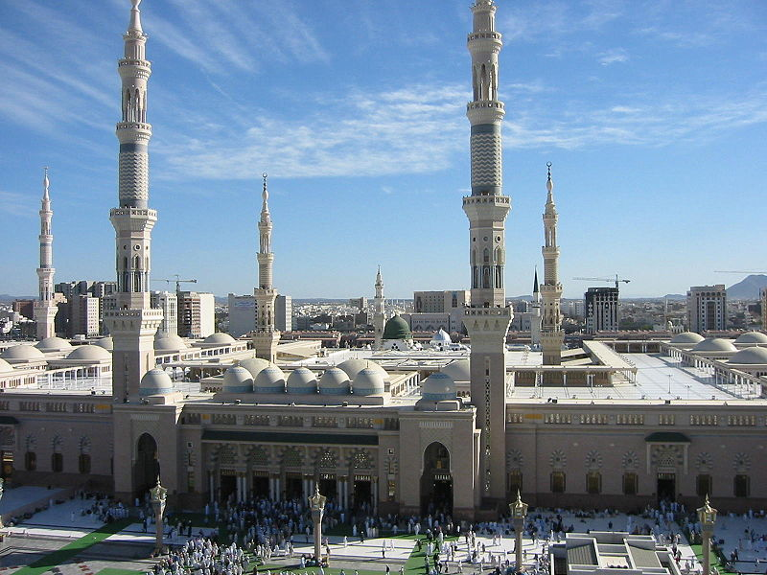
Spread of Islam

Slide 29
Spread of Islam
After Muhammad’s death, a prominent group of Muslims met & chose a new type of leader called a caliph, meaning “successor”

Slide 30
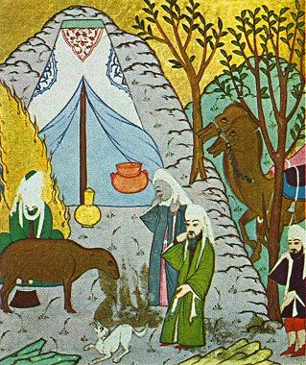
Spread of Islam
The First Caliph was Muhammad’s father-in-law & close friend, Abu Bakr
Worked to protect & spread Islam

Slide 31
Spread of Islam
Later, Arab armies swept into the Byzantine & Persian empires (Palestine, Syria, Iraq, Persia & Egypt)
Believed they had a religious duty to spread Islam; Jihad

Slide 32
Spread of Islam
Islam spread to borders of India & China in the east and North Africa and Spain in the west
Frankish leader Charles Martel stopped the Muslims at the Battle of Tours in France in 732AD
Halts the spread of Islam into Western Europe

Slide 33
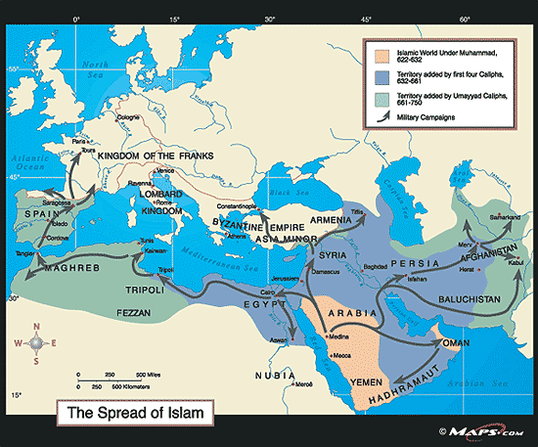
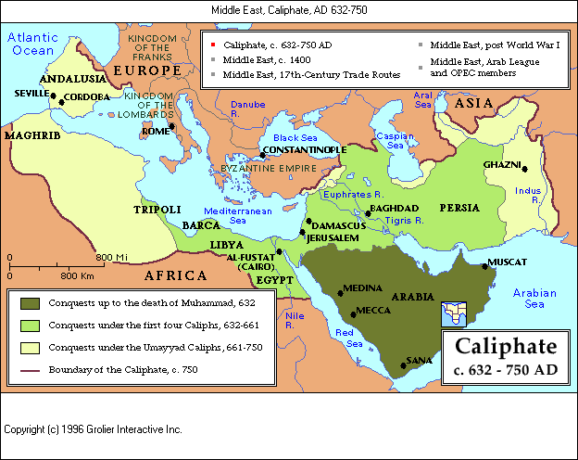

Slide 34
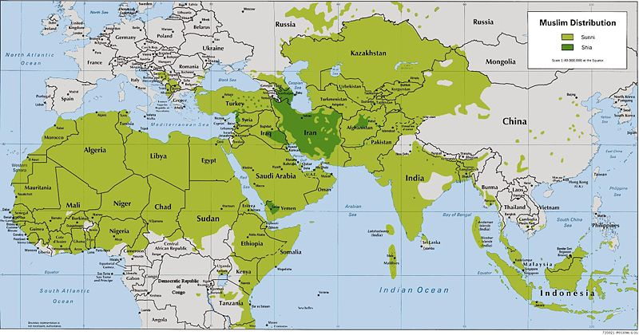
Sunnis v. Shiites
After a dispute over who the next caliphate should be, there was a split in Islam
Sunnis v. Shiites

Slide 35
Sunnis v. Shiites
Sunnis:
Majority of Muslims
Believe that the caliph is a leader, not a religious authority
Any devout leader could serve with the acceptance of the people

Slide 36
Sunnis v. Shiites
Shiites:
Believe that the caliph should be a descendant of Muhammad
Less than 10% of Muslims worldwide – Iran, Southern Iraq, Azerbaijan & Southern Lebanon
Notes:
Constitute less than 10% of Muslims worldwide
Concentrated in Iran, southern Iraq, Azerbaijan, and southern Lebanon

Slide 37
