Slide 1
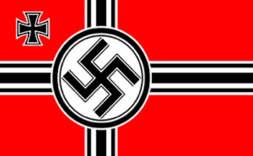
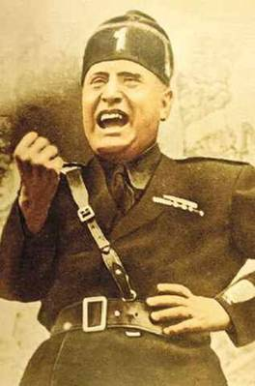
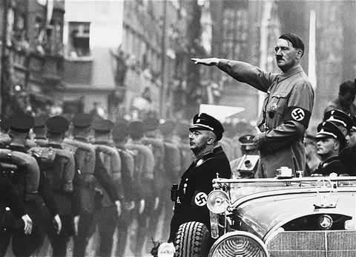
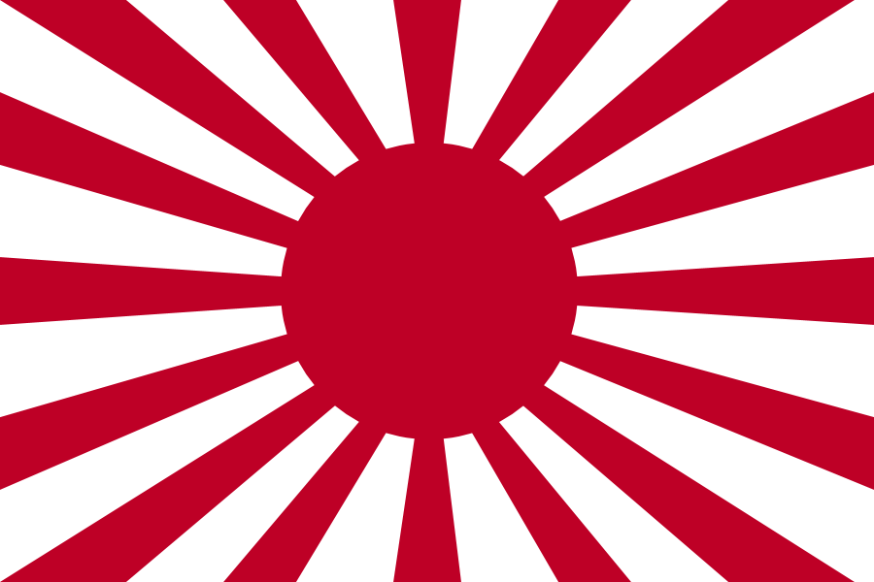
Path to WWII:
Aggression & Appeasement

Slide 2
Japanese Aggression

Slide 3
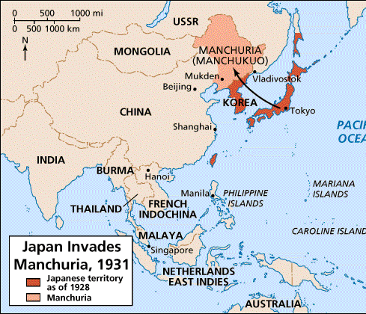
Japanese Aggression
Japan needs raw materials, especially iron & coal
1931: invade/conquer Manchuria, a province of China

Slide 4
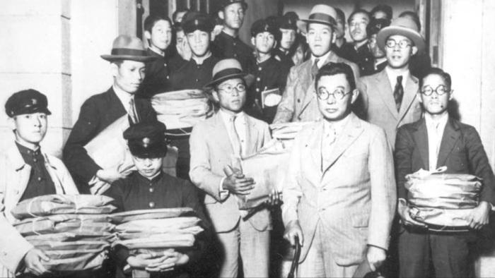
Japanese Aggression
China protests to the League of Nations
League orders Japan to return Manchuria
Japan withdraws from the League of Nations!

Slide 5
Japanese Aggression
1937: Japanese troops march into China’s capital city, Nanjing
Kill tens of thousands of captured soldiers and civilians and rape Chinese women in what is known as Rape of Nanjing

Slide 6
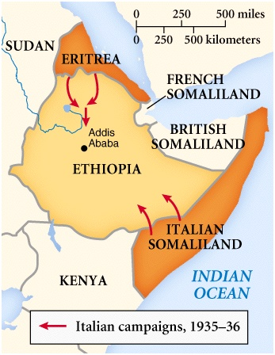
Italian Aggression

Slide 7
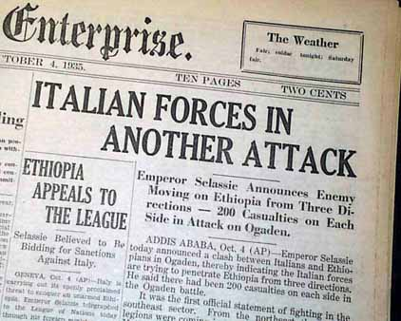
Italian Aggression
1935: Italy attacks Ethiopia (why??)
Ethiopian Emperor appeals to League of Nations for help

Slide 8
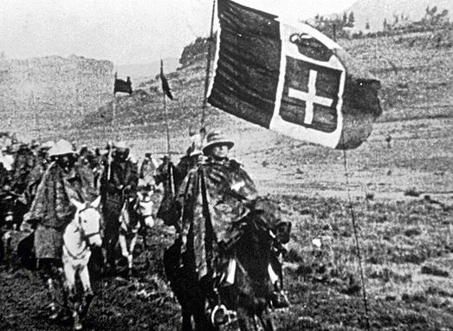
Italian Aggression
League condemns attack, but members do nothing
1936: Italy annexes Ethiopia

Slide 9
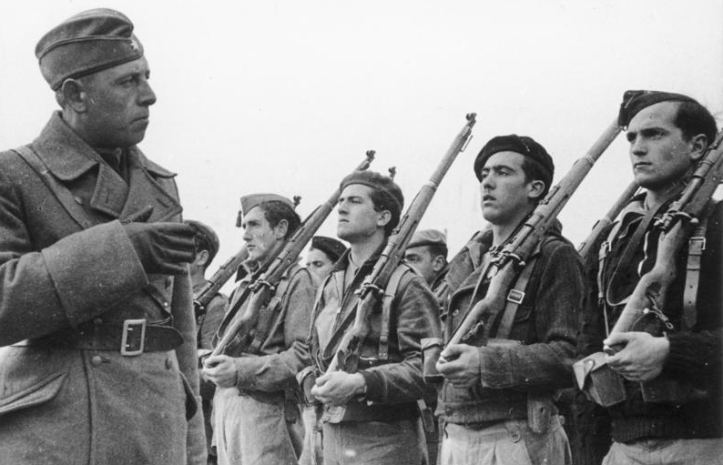
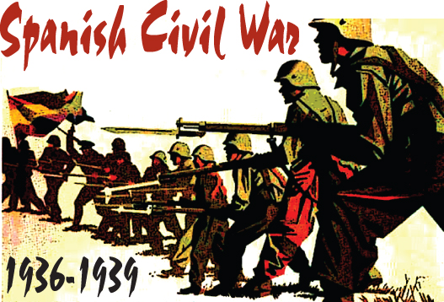
Spanish civil war

Slide 10
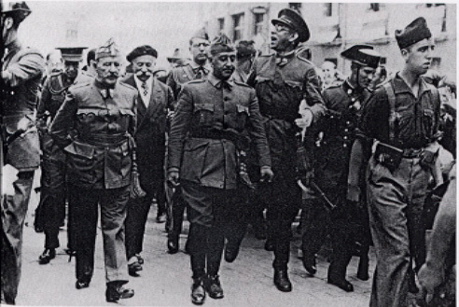
Spanish Civil War
1931: Spain becomes a republic
1936: General Francisco Franco leads rebellion

Slide 11
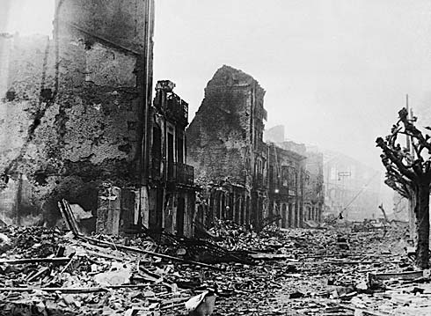
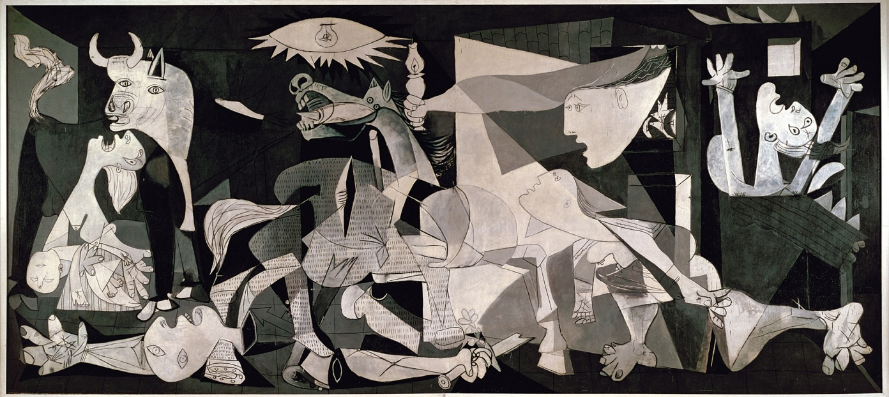
Spanish Civil War
Hitler & Mussolini help Franco & his fascists
No formal support from Allies for Republicans

Slide 12
Spanish Civil War
1939: Franco wins civil war
Franco becomes Spain’s fascist dictator
Hitler used Spanish Civil War as a “practice round”
What does this mean?

Slide 13
German Aggression

Slide 14
Hitler Makes a Move
Soon after becoming chancellor, Hitler begins rearming Germany, violating the Treaty of Versailles
League only issues a mild condemnation

Slide 15
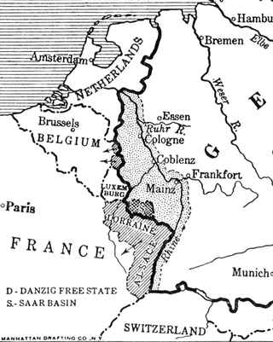
Hitler Makes a Move
1936: Hitler moves troops into the Rhineland (demilitarized zone formed as a buffer between FR/Germany)
Notes:
Rhineland → German region bordering France and Belgium; demilitarized zone according to the Treaty of Versailles

Slide 16
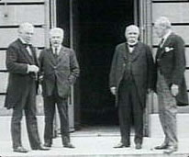
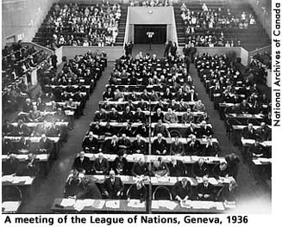
Hitler Makes a Move
League of Nations does NOTHING!
(why??)

Slide 17
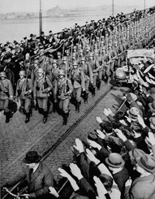
Hitler Makes a Move
Turning point towards war!
Strengthened Hitler’s power & prestige
France & Belgium now open to attack
Encouraged Hitler to speed up his expansion

Slide 18
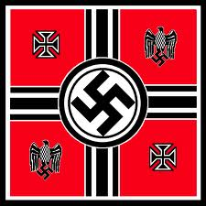
Third Reich
Wanted the land of neighboring nations as part of Third Reich (Empire)
Needed resources & “lebensraum” (living space)

Slide 19
Third Reich
1st target: Austria
Most Austrians supported unification with Germany
1938: Germany entered Austria; faced NO opposition
Official union (Anschluss)

Slide 20
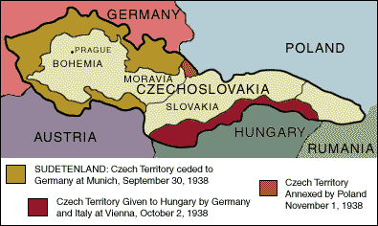
Third Reich
Next Czechoslovakia:
Demands Sudetenland (western border region of Czechoslovakia) be given to Germany
Notes:
3 million German-speaking people in region
Claimed that Sudeten Germans were being abused by the Czechs
Hitler’s justification for the annexation

Slide 22
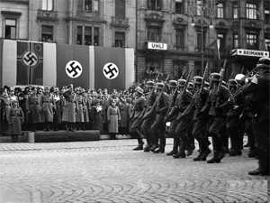
Appeasement
Czechs ask France & G.B. for help
1938: Munich Conference
Meeting of Germany, Fr, Britain & Italy (Czechs not invited!)

Slide 23
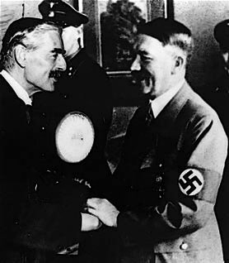
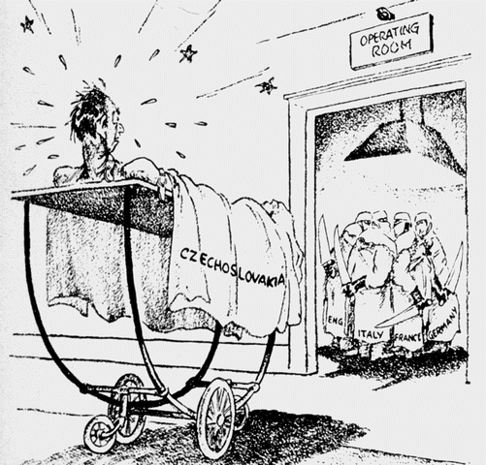
Appeasement
The Munich Agreement:
Allowed Hitler to have Czechoslovakia as his “last territorial demand”
Notes:
France & Great Britain had vowed to help Czechoslovakia in times of crisis
Munich agreement – desperate attempt at appeasement (shameful appeasement)

Slide 24
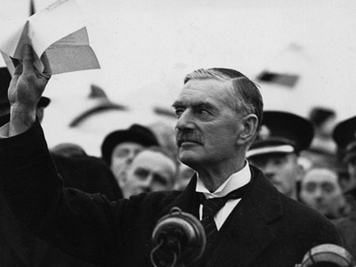
Appeasement
Policy of Appeasement: granting concessions to maintain peace
Chamberlin (Great Britain’s PM) believes peace has been made…BUT…

Slide 25
Hitler Wants Poland
6 months later takes the rest of Czechoslovakia!
Next…sets his sights on Poland
But first…
Notes:
Large German-speaking population
Hitler accuses the Polish of abusing Germans

Slide 26
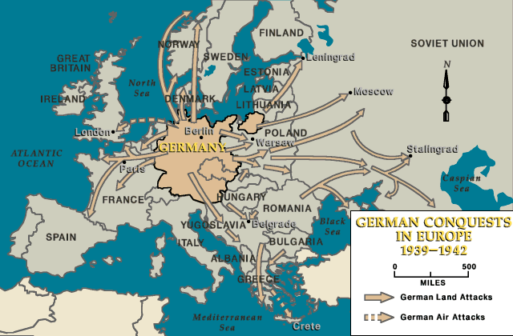
Hitler Wants Poland
What could happen if Hitler attacked Poland?
Hitler’s Predicament?
Solution?
Notes:
Attack on Poland had the potential to:
Spur conflict between Germany & Soviet Union
Provoke war with France & Great Britain who had promised to protect Poland

Slide 27
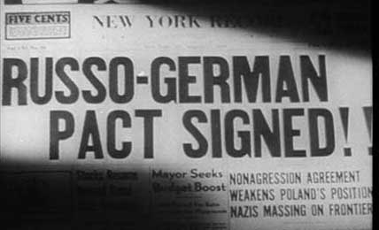
Hitler Wants Poland
Nonaggression Pact (1939)
Germany & Soviet Union:
Agree not to go to war against each other

Slide 28
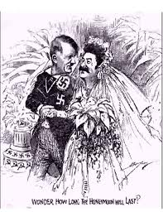
Hitler Wants Poland
Hitler & Stalin also promise to divide Poland between them

Slide 29
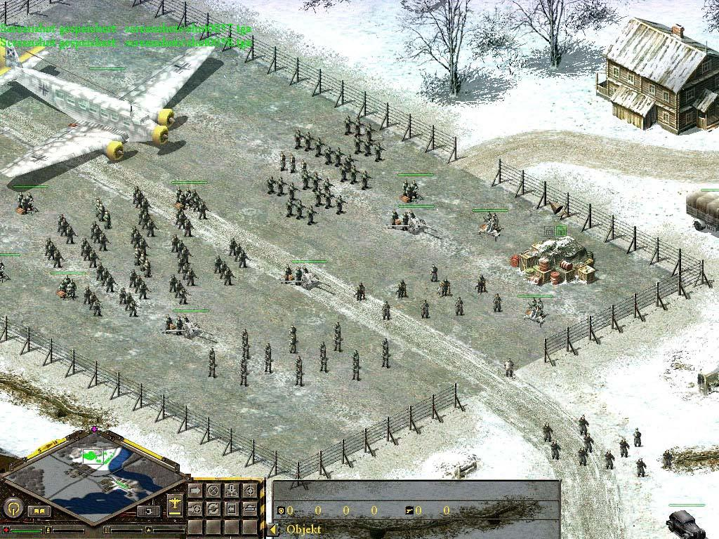
Hitler Wants Poland
Sept 1939 Hitler invades Poland & utilizes Blitzkrieg, or “lightning war”
Sudden & massive attack that combines air and ground forces

Slide 30
World War II Begins
France & Great Britain declare war on Germany
Hitler takes most of Western Poland; Stalin invades from the east & takes over
World War II has begun!!…

