Slide 1
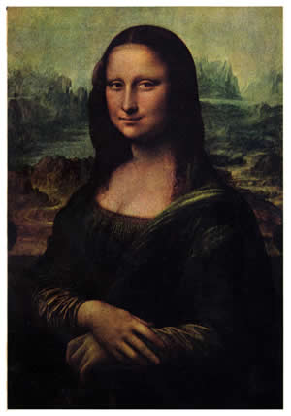
The Renaissance
An Intellectual Revolution

Slide 2
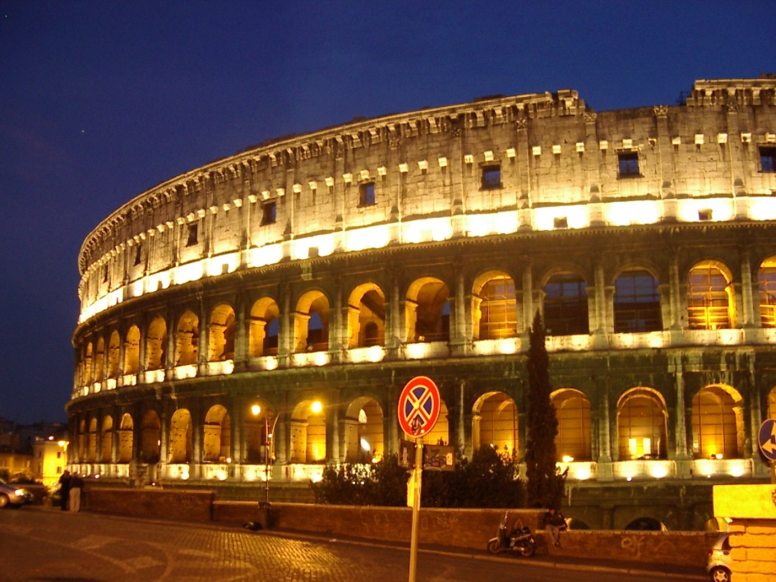
The Renaissance Defined
Renaissance = REBIRTH
What was reborn?
An interest in the CLASSICAL WORLD
Ancient Greece and Ancient Rome

Slide 3
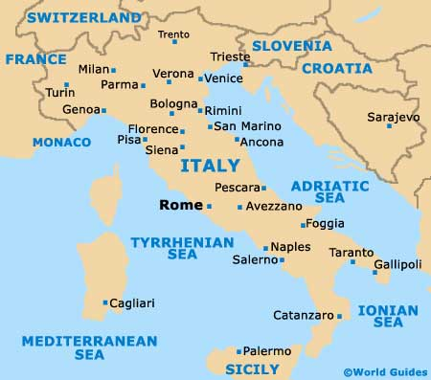
The Renaissance
Where did the Renaissance begin?
Italy (circa 1350)
(flourished in Florence, Italy in 1400s)

Slide 4
Renaissance Italy

Slide 5
The Renaissance
Why did the Renaissance begin in Italy?
Ruins of the ancient world were still starkly visible in Italy
“New” ideas reached Italy before reaching other areas

Slide 6
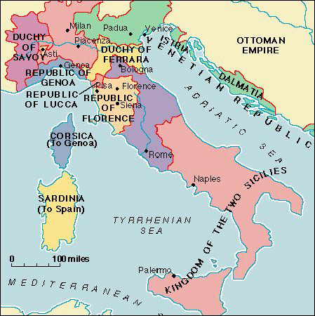
The Renaissance
Small city states competed with one another for trade & prestige
EX: Florence, Genoa, Venice, Milan, Rome

Slide 7
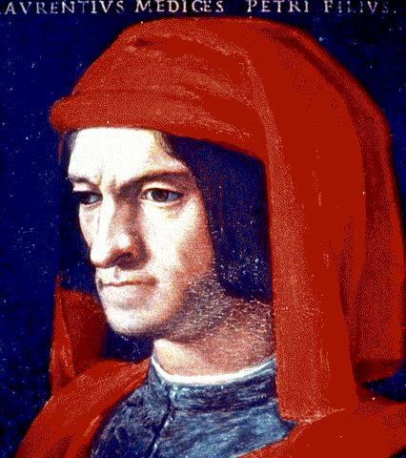
Money, Money, Money?

Slide 8
Renaissance Support
Who supported the Renaissance?
Wealthy bankers, Italian nobles & the Papacy; known as…
PATRONS of the Arts – one who provided financial support for the arts

Slide 9
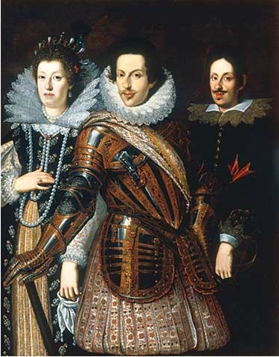
Renaissance Support
Florence comes under the rule of a powerful banking family
The Medici Family

Slide 10
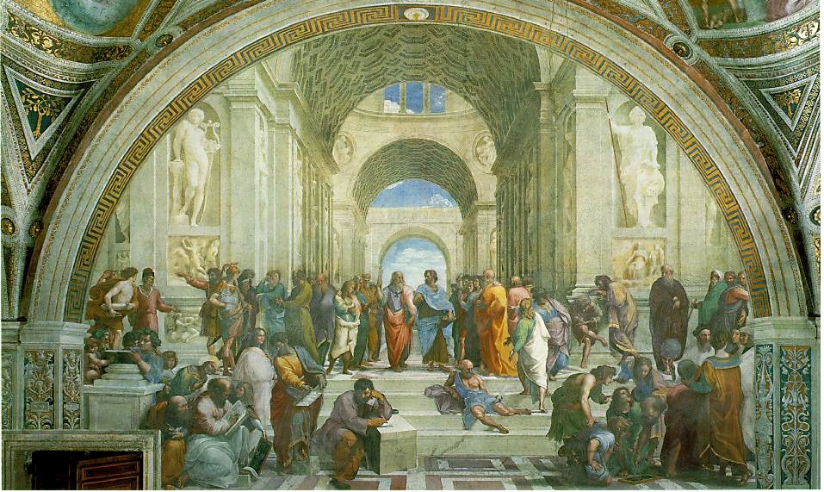
The Renaissance
Humanism:
A movement that focused on individuality, human potential & achievement
Classical values
Secular: Worldly rather than spiritual; concerned with the here & now

Slide 11
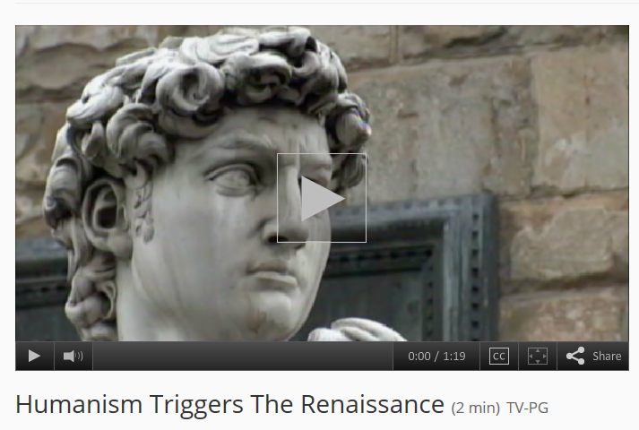
The Renaissance

Slide 12
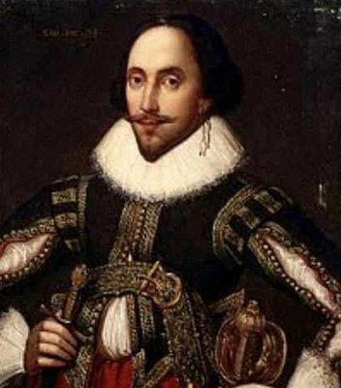
Renaissance Writers Change Literature

Slide 13
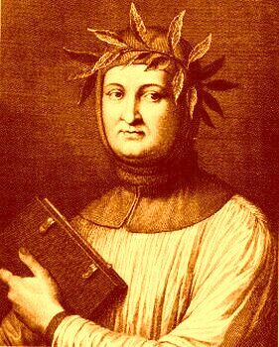
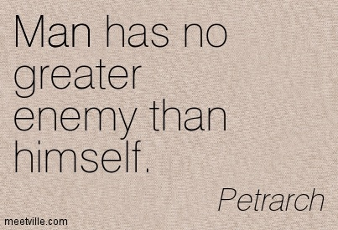
Italian Renaissance Writers
Wrote in the vernacular - native language – instead of Latin
Influential writers in Italy included Dante & Petrarch
Petrarch: Father of Humanism
Notes:
Petrarch: Father of Humanism
Collector & translator of ancient manuscripts
Promoted the study of classical Latin & Greek

Slide 14
Italian Renaissance Writers
Writers like Petrarch & Dante wrote to express their own thoughts or feelings
Petrarch wrote a collection of poems/sonnets about a woman named Laura
He was so passionate about writing that he died with the pen in his hand
Notes:
Petrarch: Father of Humanism
Collector & translator of ancient manuscripts
Promoted the study of classical Latin & Greek

Slide 15
Italian Renaissance Writers
Dear Rulers., just follow my advice…
Niccolo Machiavelli:
Wrote “The Prince”: examines how a ruler can gain & keep power

Slide 16
Italian Renaissance Writers
According to The Prince:
Primary goal – to keep power
The ends justify the means
Use any means necessary to achieve your goal

Slide 17
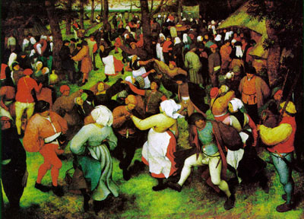
The Renaissance Spreads

Slide 18
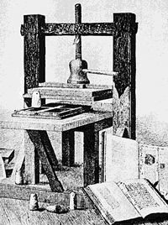
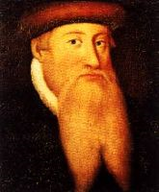
Printing Press Spreads Ideas
Johann Gutenberg develops a printing press with new technologies
Printing press makes it possible to produce books quickly & cheaply
I have two beards in one!

Slide 19
The Renaissance Moves North
Northern writers try to reform society
Desiderius Erasmus & Thomas More = Christian humanists
(combined humanism + faith, urged reforms in Church & society)

Slide 20
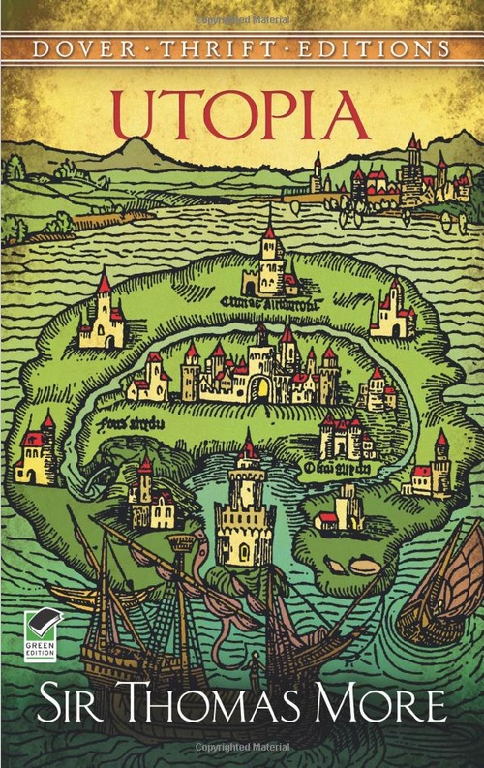
The Renaissance Moves North
Thomas More writes “Utopia”: tries to show a better model of society
(ideal place where greed, war, & conflict did not exist)

Slide 21
Northern Renaissance Writers
William Shakespeare:
English Playwright
Tragedies, comedies & histories
(His plays showed a deep understanding of human character & how people interact with each other)

Slide 22
The Legacy of the

Slide 23
Changes in the Arts…
Art drew on techniques & styles of classical Greece & Rome
Paintings & sculptures portrayed individuals & nature in more lifelike ways

Slide 24
Changes in the Arts…
Artists created works that were secular as well as works that were religious
Writers began to use vernacular languages to express their ideas
The arts praised individual achievement

Slide 25
Changes in Society…
Printing made information available & inexpensive for society at large
Availability of books prompted increased desire for learning & a rise in literacy throughout Europe

Slide 26
Changes in Society…
Published accounts of maps, discoveries, & charts led to further discoveries
Published legal proceedings made laws clear so people could understand their rights

Slide 27
Changes in Society…
Christian humanists’ attempts to reform society changed views about how life should be lived
People began to question political structures & religious practices

Slide 28
A little Review…

Slide 29
The Renaissance was a…
R.E.B.I.R.T.H.

Slide 30
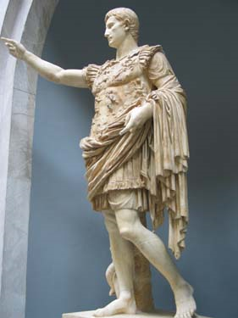
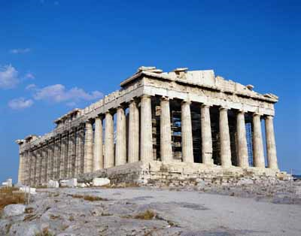
Rebirth of Greek & Roman classic culture
R
Classics = ideas of ancient Greece & Rome

Slide 31
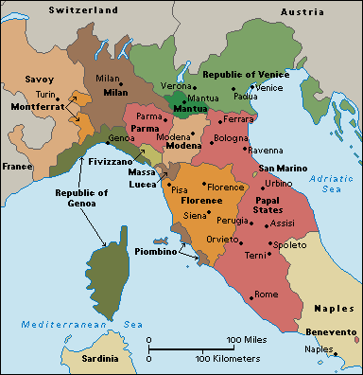
Established in Italian city-states
E
City-States were wealthy from trade

Slide 32
Birth of the ‘modern’ world (c.1350 – 1600)
B
Less superstition
Education, literature encouraged
Sports, art, music important
Study of history & science

Slide 33
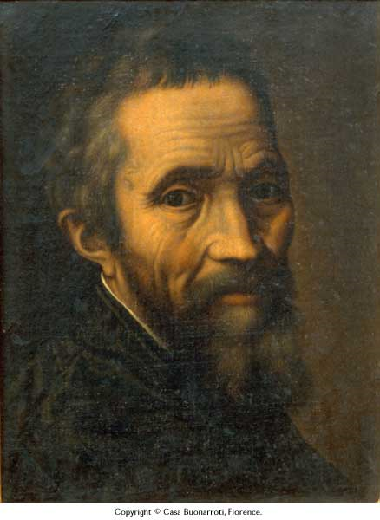
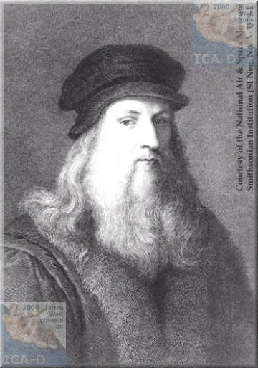
Italian Artists
I
Michelangelo & da Vinci

Slide 34
Renaissance spreads from Italy to Northern Europe
R
Helped by printing press (Gutenberg)

Slide 35
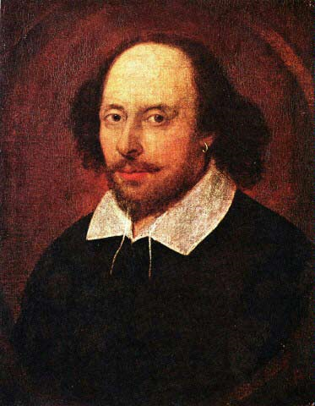
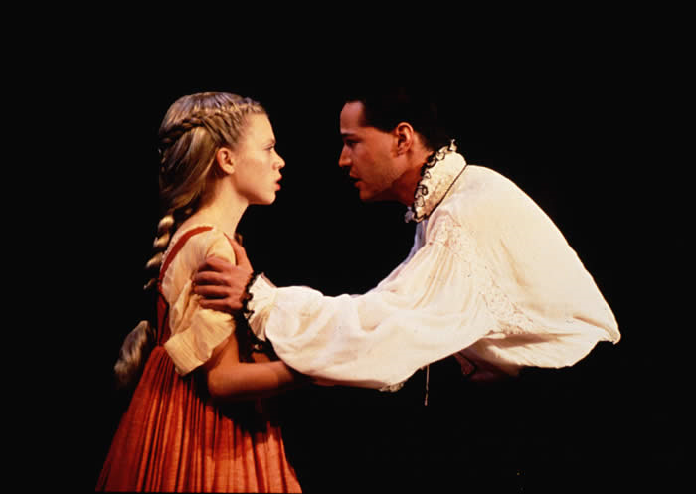
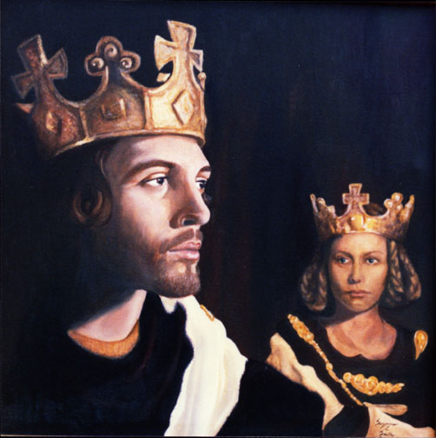
Theatre: Shakespeare & others
T

Slide 36
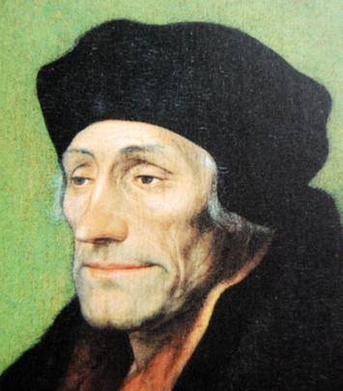
Humanism
H
Want people to be the best they can be

