Slide 1
Between the Wars
1918-1939

Slide 2
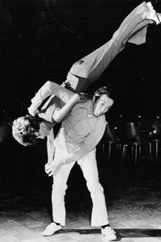
In the 1920s…
America Swings

Slide 3
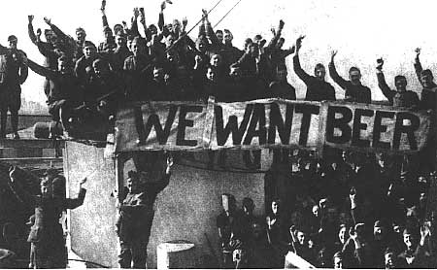
America Swings?
U.S. economy BOOMING
Made $$$ after WWI
Dominated Trade
Increase in American business

Slide 4
Leads to Social & Cultural Changes…

Slide 5
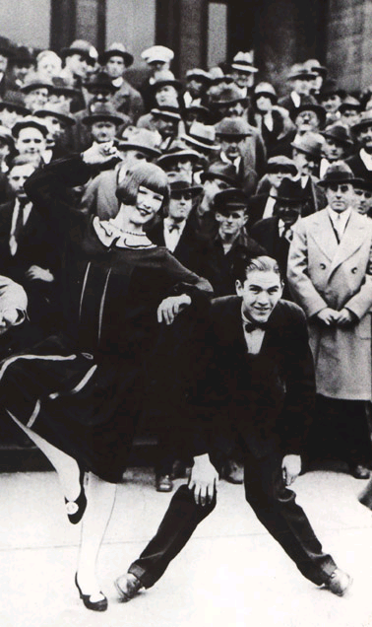
Glamour
The Charleston
Notes:
http://www.youtube.com/watch?v=ZJC21zzkwoE

Slide 6
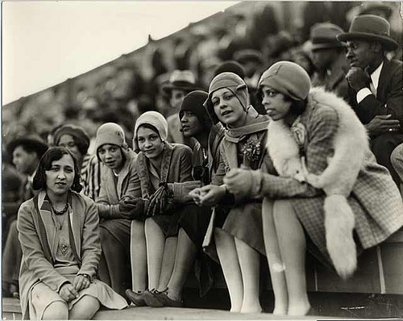
New Role of Women
Had worked outside of the home during WWI
New equality (i.e. voting rights!)
The Flapper – boy haircuts, pants, etc.

Slide 7
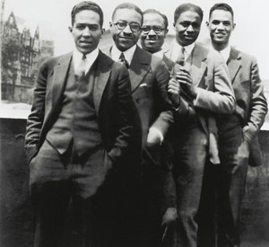
Harlem Renaissance
Explosion of art, music, & literature in African American communities
1920’s – Golden Age of Jazz

Slide 8
Louis Armstrong
Notes:
The Harlem Renaissance
Interestingly, many black performers became famous in Europe first

Slide 9
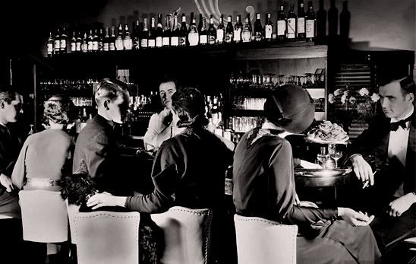
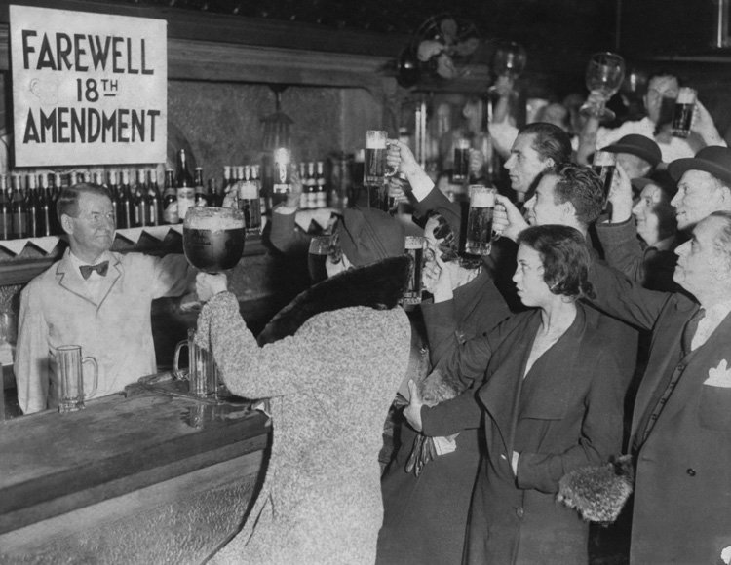
Prohibition
Organized crime, speakeasies & prohibition

Slide 10
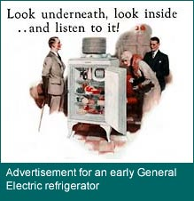
New Technology
Notes:
During the 1920s, vacuum cleaners, refrigerators, and washing machines seemed to promise consumers more time for leisure activities. Advertising came of age during this era to sell the goods that bustling factories were producing. The traditional "wash day" in many homes was Monday, and the arrival of the washing machine did, indeed, free up part of that day for other activities.
By 1924, two thirds of all American homes had electricity. It became practical to create and advertise home electrical appliances. General Electric, founded in 1878 as the Edison Electric Company, introduced the first electric refrigerator— the popular Monitor Top, which sold for around $350. Earlier refrigerators had a compartment that held a block of ice. Iceboxes were used until the 1950s in some homes. But as early as 1929, ice boxes were well on their way to extinction; half of the refrigerators sold were electric.

Slide 11
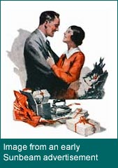
New Technology
Several changes made the use of electrical household appliances more widespread
Notes:
While General Electric tried to appeal to the quality-conscious consumer, early Sunbeam advertisements targeted the husband seeking to ease the burden of a wife's housework. The Sunbeam electric iron sold for $7.50. It promised "52 hours less work a year."

Slide 12
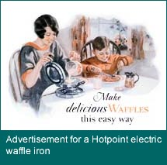
New Technology
By 1930, 70% of homes had electricity
Merchants offered installment plans
Use of advertising grew
Notes:
The benefit of new kitchen appliances was the key to attracting consumers in the 1920s. Electric toasters became commonplace. The Hotpoint company, which sold many electric appliances, ran advertisements that claimed its $15 waffle iron would bring "joy and health to the home."

Slide 13
New Communication
Notes:
All about imagination in the United States
Stories
News
Drama
Comedies

Slide 14
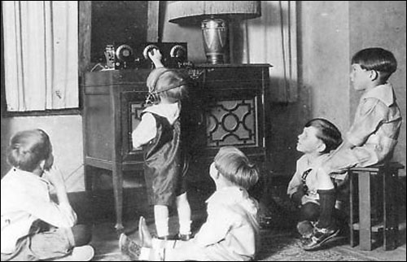
New Communication
1920, world’s 1st commercial radio station began broadcasting
Stories, News, Sports, Drama, Comedy & advertising
Worldwide events → seen and heard…
Notes:
What did they listen to? Check out this website… http://www.scratchygrooves.com/

Slide 15
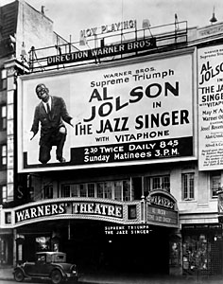
New Communication
Motion pictures became a major industry in 1920’s
90% of movies made in Hollywood
Silent at first, but 1927 first “talkie”

Slide 16
But Europe Struggles…
Notes:
ECONOMIC HARDSHIPS → in times of economic struggle people/nations move toward political extremes

Slide 17
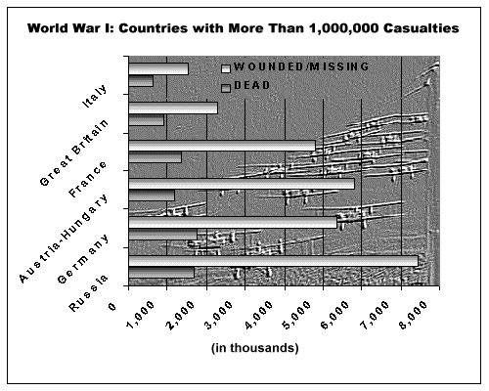
1) Death

Slide 21
1) Death
Russia & France lost the most lives during World War I
After World War I both countries were motivated by their desire to avoid another war

Slide 22
2) Destruction
Notes:
War torn Europe

Slide 23
2) Destruction
Western Europe (especially France) was largely destroyed by German advances during World War I
Needed to REBUILD!

Slide 24
3) Unemployment
Notes:
Post war unemployment – soldiers returning home to nothing

Slide 25
3) Unemployment
Due to poor economic conditions after World War I, Europe experienced high rates of unemployment
Soldiers returned home to NO JOB!!

Slide 26
4) Famine

Slide 27
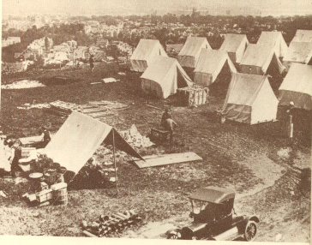
5) Disease

Slide 28
5) Disease
1918 influenza pandemic → more people died than in all of World War I
(and more than 4 years of the Black Death!)

Slide 29
European Countries try to Gain Stability…

Slide 30
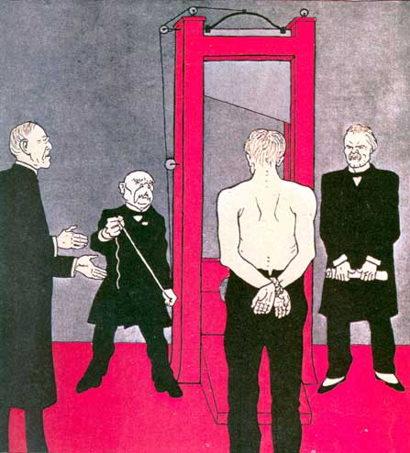
Germany & the Weimar Republic
Weimar Republic (1919-1933) – Germany attempted to establish a liberal republic
But BIG problems!

Slide 31
Inflation: German money so worthless they burn it to keep warm!

Slide 32
Germany & the Weimar Republic
Dawes Plan (1924): provided for a $200 million loan from American banks to stabilize German economy
Also set a more realistic schedule for Germany’s reparation payments
Notes:
Plan works – slowed inflation & German economy was able to recover. By 1929, German factories were producing as much as they had before the war…

Slide 33
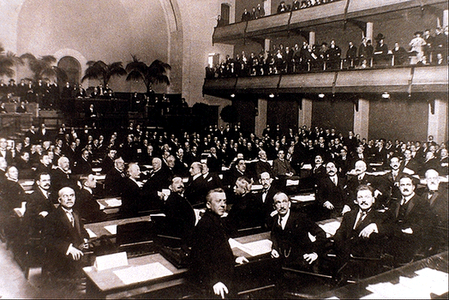
Efforts at Lasting Peace

Slide 34
Lasting Peace?
Locarno Treaty (1925):
France & Germany would not go to war against each other again
After signing treaty, Germany was admitted to League of Nations

Slide 35
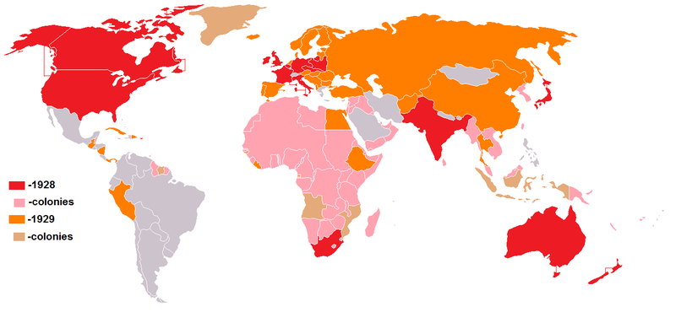
Lasting Peace?
Kellogg-Briand Pact (1928):
Almost every country agreed to “renounce war as an instrument of national policy”

Slide 36
Lasting Peace?
BUT…League of Nations had:
No armed forces
No way to enforce agreements

Slide 37
THEN… In 1929 the American Stock Market Crashes leading to a WORLDWIDE economic depression

Slide 38
1930’s World-Wide Depression

Slide 39
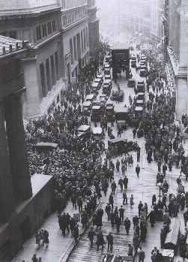
Unemployment & Food Lines

Slide 40
Worldwide Depression
People started to turn towards government to deal with economic crisis
Governments step in to direct economies & recovery effort (socialism!)

Slide 41
Worldwide Depression
Franklin D. Roosevelt (FDR) deals with the Depression in the United States
New Deal – program of government reform
Notes:
Elected to the presidency in 1932

Slide 42
Worldwide Depression
Nations like G.B., France, & U.S. are able to remain democratic, BUT…
Depression causes people to lose faith in democracy
Opens the door for the rise of Totalitarian Regimes…

