Slide 1
The Counter Reformation
The Catholic Church Reforms
S.I.C.

Slide 2
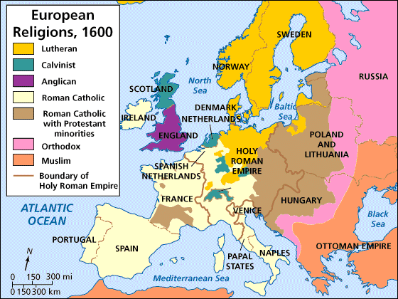
The Counter (Catholic) Reformation
Catholic Church realizes it needs to make changes in order to keep loyal followers

Slide 3
Goals of the Counter-Reformation
Create a more spiritual outlook in the Catholic Church
Define Catholic doctrines more clearly
Win converts back to the Catholic Church and stop the spread of Protestantism

Slide 4
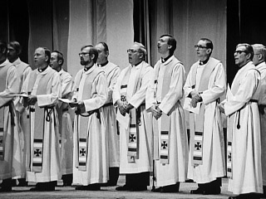
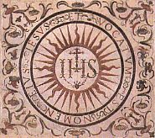
Society of Jesus (Jesuits)
S

Slide 5
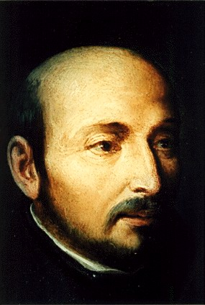
Society of Jesus (Jesuits)
Ignatius of Loyola forms the Jesuits
Spanish nobleman wounded in battle
Did daily spiritual devotions during his healing period
Gathered followers; Pope creates a religious order for them

Slide 6
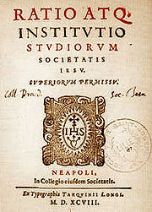
Society of Jesus (Jesuits)
Jesuits had 3 main focuses:
Found theological schools
Convert non-Christians to Catholicism
Stop the spread of Protestantism

Slide 7
DID YOU KNOW?
The work of the Jesuits had a lasting impact around the world
By 1556, about a thousand Jesuits had brought his ministry to Europe, Africa, Asia, and the Americas
The Jesuits today run about 45 high schools and 28 colleges/universities in the U.S., including Georgetown Univ, Boston College, Marquette Univ, & Univ of Chicago

Slide 8
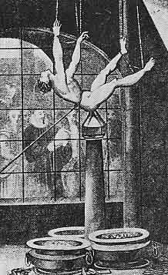
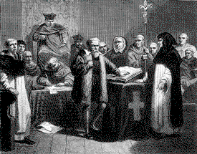
Inquisition
I

Slide 9
Inquisition
The Inquisition was revived
Established local Inquisition courts
Tried to stop Protestantism by declaring Protestants as heretics, and bringing them to trial

Slide 10
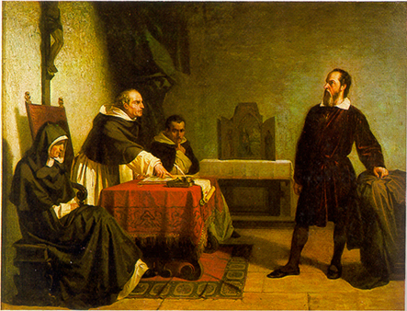

Slide 11
Council of Trent
C
The Council of Trent (1545-1563): Catholic bishops & cardinals met & agreed on several doctrines…

Slide 12
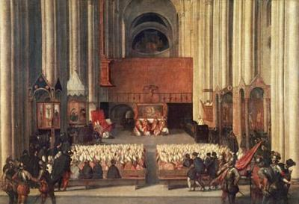
Council of Trent
Church’s interpretation of the Bible was final
Christians need faith & good works for salvation

Slide 13
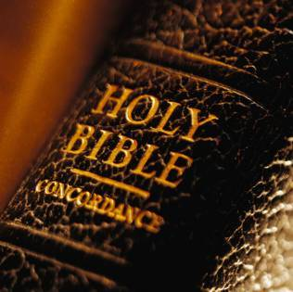
Council of Trent
The Bible & Church tradition were equally powerful authorities for guiding Christian life

Slide 14
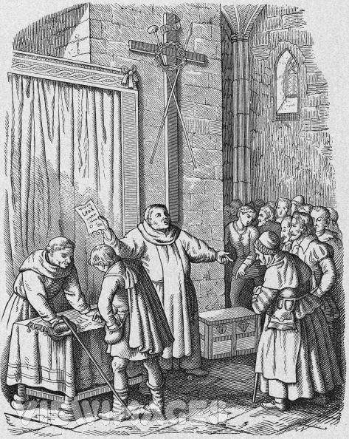
Council of Trent
Indulgences are allowed; however, the false sale of indulgences is banned

Slide 15
Council of Trent
ALSO CONFIRMED…
Clergy DID have special powers
Only clergy could explain the bible
Bible should only be in Latin
Mass should only be said in Latin

Slide 16
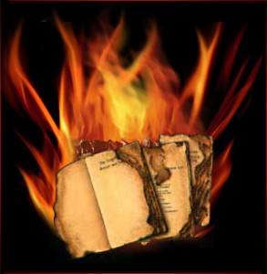
Council of Trent
Index of Forbidden Books:
A list of books considered dangerous to the Catholic faith
Massive book burnings were held throughout Europe (Venice alone burned 10,000 books in 1 day!)

Slide 17
Council of Trent
REFORMS…
Only worthy people would be allowed to enter clergy
Established seminaries for educating priests
Tightened discipline in monasteries & convents

Slide 18
Legacy of the Reformation
Religious conflict/war between Protestants & Catholics
Catholic Church became more unified as a result of the Council of Trent
But Catholic Church’s political authority declined & monarchs and states gained power
Rulers of nation-states would seek more power for their countries through warfare, exploration & expansion

