Slide 1
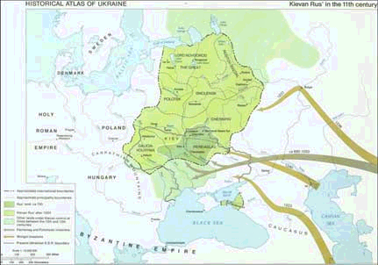
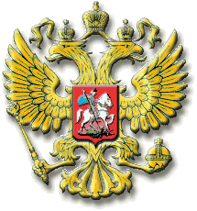
Early Russia:
Kiev to Moscow

Slide 2
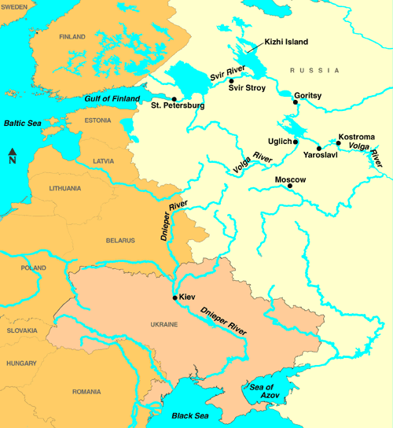
Kievan Rus’
Kiev developed along the Dnieper River
Important trade route between Baltic & Black Sea
Influenced by the Byzantines & Scandinavians (Vikings)

Slide 3
Kievan Rus’
Important Features:
Slavic nationality
PRINCIPALITIES: area ruled by a prince
BOYARS: Russian nobles
Farming & hunting

Slide 4
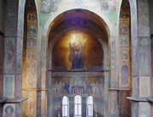
The golden age of kiev

Slide 5
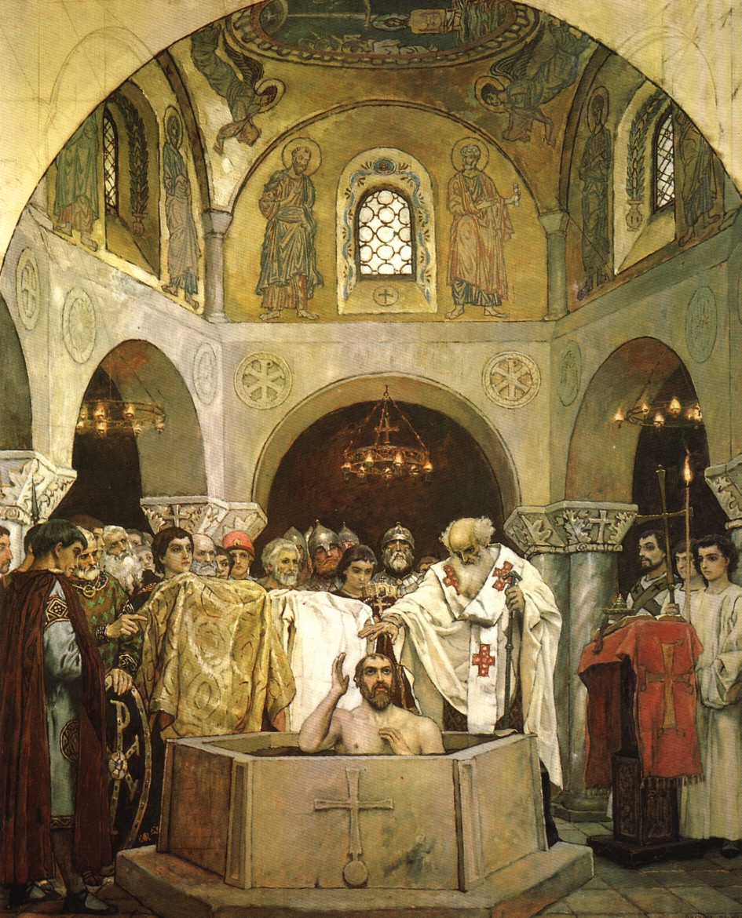
Vladimir I
Investigated various religions including Roman Catholicism, Judaism and Islam

Slide 6
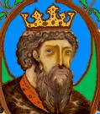
Vladimir I
After visiting the Byzantine Empire Vladimir adopted Eastern Orthodox Christianity
Provided mass baptism for all of his subjects

Slide 7
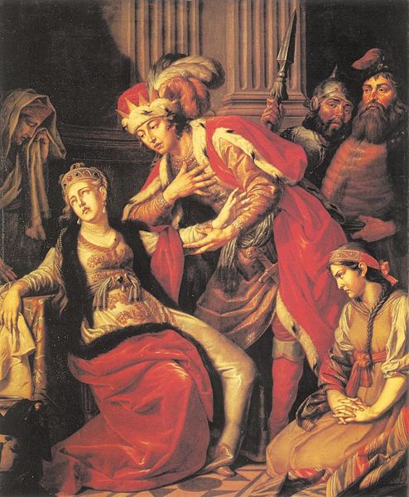
Vladimir I
Married a Byzantine princess
Through this marriage he brought Byzantine culture to Kiev

Slide 8
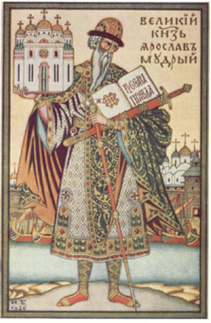
Yaroslav “The Wise”
Established:
Schools, libraries, law code (Russkaia Pravda)
Kiev declined after his death – became part of the Mongol Empire…

Slide 9
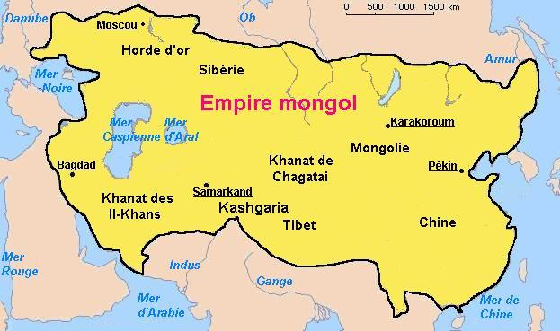
The Mongols

Slide 10
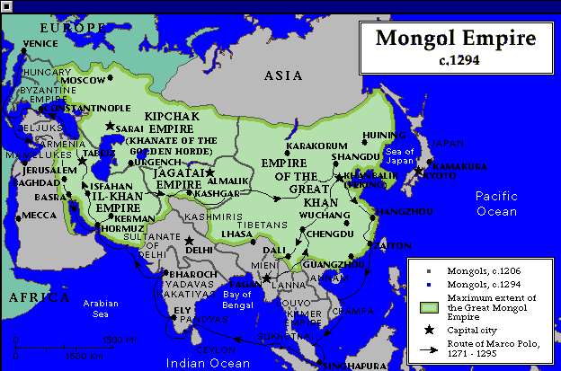
The Mongols
From central Asia
Created the largest land empire in history

Slide 11
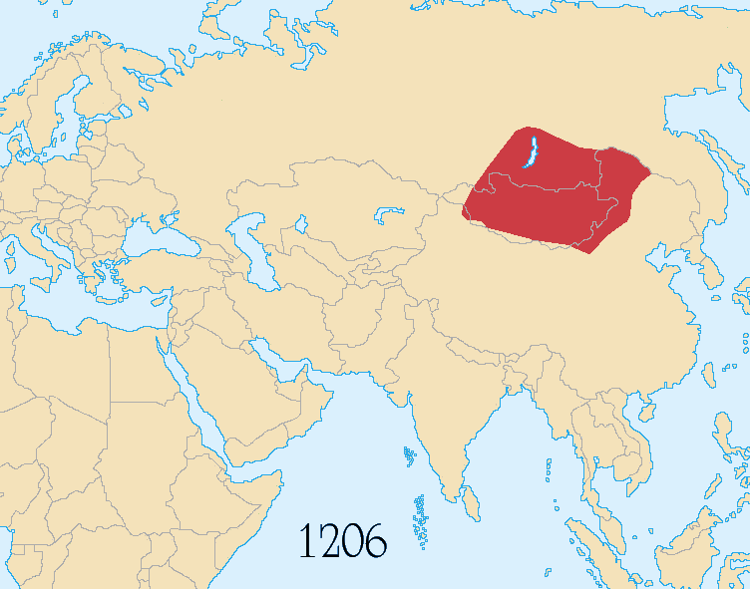

Slide 12
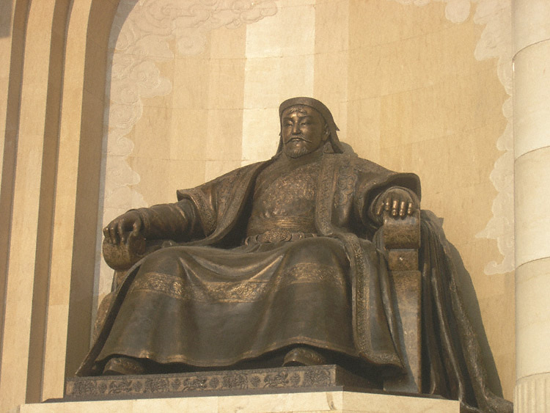
The Mongols
Genghis Khan:
Mongol that united clans of expert fighters on horseback
Organized them into disciplined cavalry units

Slide 13
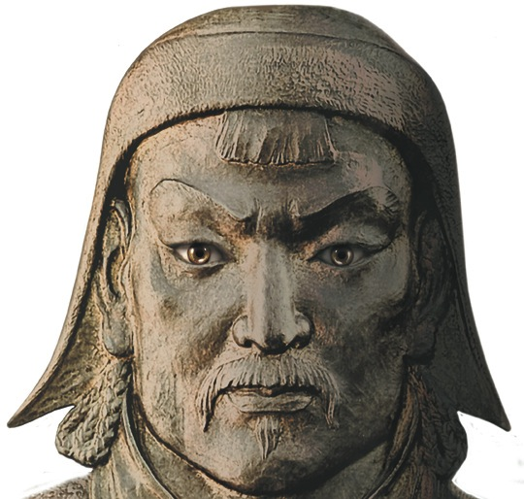
“The greatest happiness is to vanquish your enemies, to chase them before you, to rob them of their wealth, to see those dear to them bathed in tears, to clasp to your bosom their wives and daughters…”

Slide 14
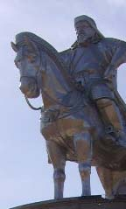
The Mongols
Used these units to gain control of Russia
Mongols ruled the Russians, but DID NOT try to impose upon their culture

Slide 15
The Mongols
The Mongols ruled the Russians for almost 250 years
Demanded 2 things:
Absolute obedience
Massive tribute, or taxes

Slide 16
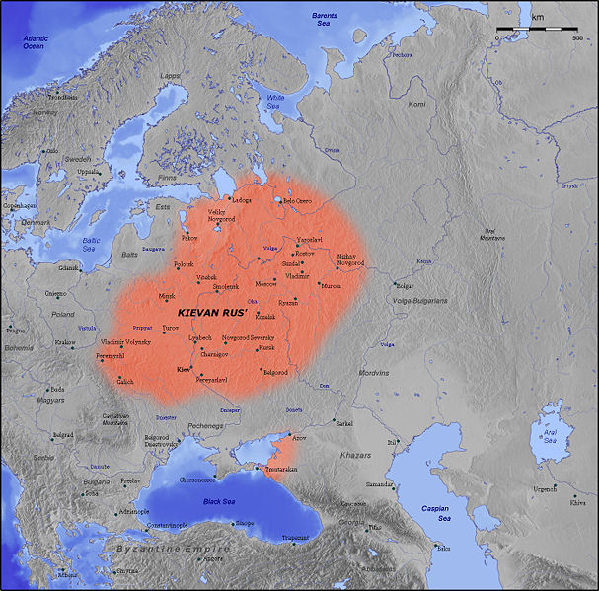
The Mongols
Impact of the Mongols:
Russia influenced by Asia
Russia is isolated from the West, or the rest of Europe
As a result, Russia developed a unique culture

Slide 17
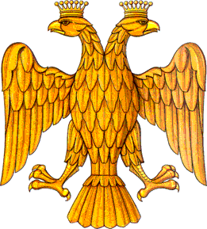
The rise of Moscow

Slide 18
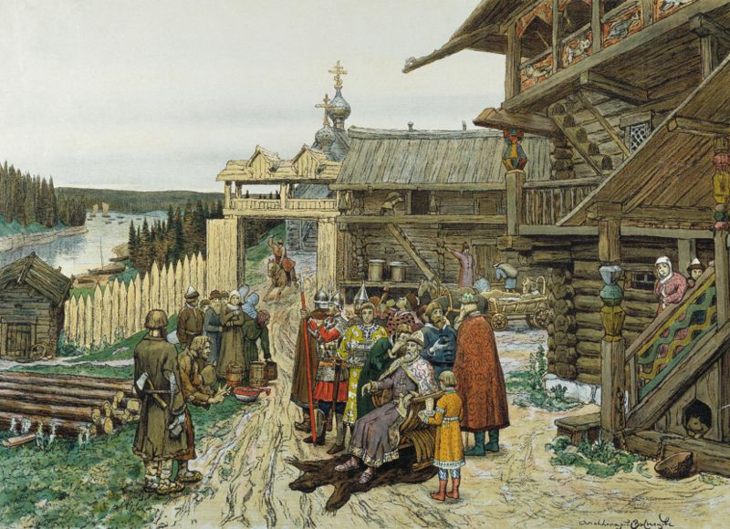
Moscow
Moscow developed near the Volga & Dnieper Rivers
The princes of Moscow collected taxes for Mongols
Moscow gradually became more independent

Slide 19
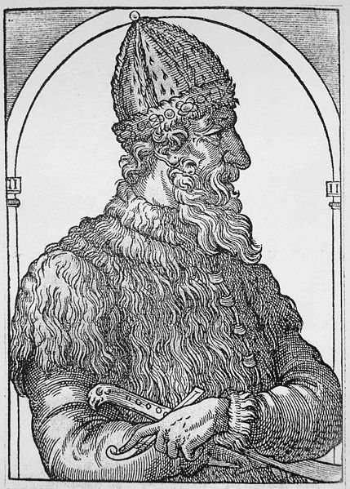
Ivan III
Moscow became independent in 1480
Unified Russian principalities
Became the first czar (emperor) of Russia

Slide 20
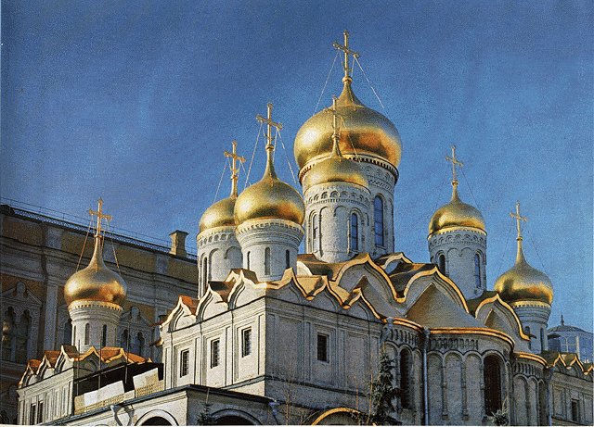
Ivan III
Moscow became the “Third Rome” after the fall of Constantinople

Slide 21
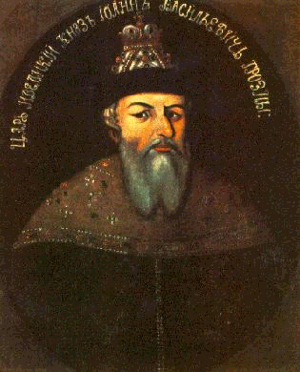
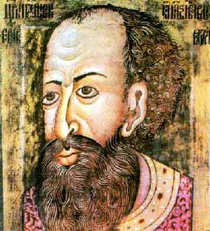
Ivan IV
“the Terrible”
Ruthless & violent
Reduced the power of the boyars
Oprichniki: secret police
Expanded Russia

Slide 22
REVIEW
Russian Noble
boyar
Russian religion
Eastern (Russian) Orthodox
Russkaia Pravda
Medieval Russian law code

Slide 23
MORE REVIEW
Ruler who adopted Eastern Orthodox Christianity
Vladimir I
Ruler who developed the law code
Yaroslav I
Ruler who gained Moscow independence
Ivan III
Term for Russian Emperor
czar

Slide 24
Byzantine Influence
Religion (Eastern Orthodox)
art (icons) and architecture
trade
alphabet adapted from Greek (Cyrillic)
law

Slide 25
MONGOL Influence
Isolation from West
Develops unique culture (not European, not Asian)

