Slide 1
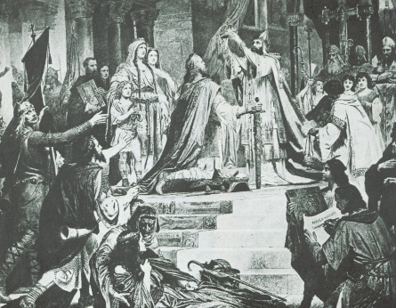
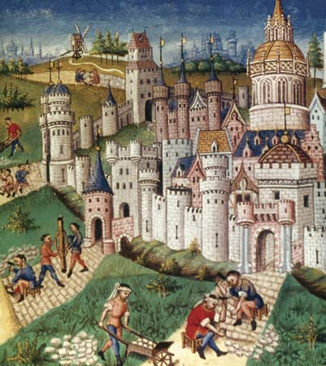
The European Middle Ages

Slide 2
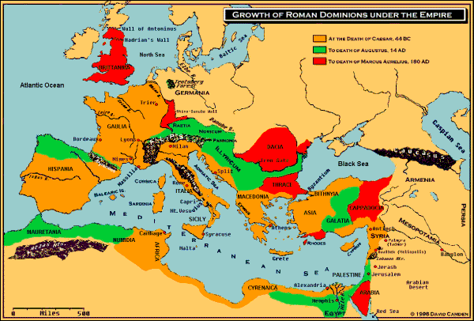
What Happened to Rome??
By the end of the 5th century, Germanic invaders had destroyed the Roman Empire…

Slide 3
What Happened to Rome??
The Impact of Invasion:
Disruption of Trade
Downfall of Cities
Population Shifts
Decline of Learning
Loss of Common Language

Slide 4
What Happened to Rome??
BUT, there was one institution that survived the fall of Rome…

Slide 5
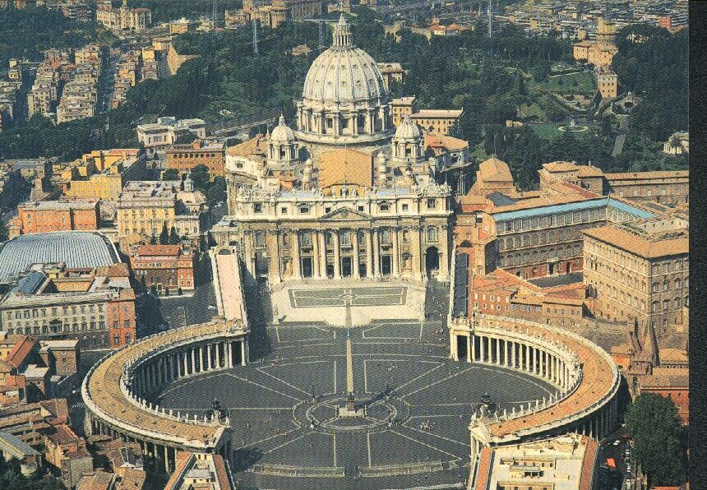
The (Roman Catholic) CHURCH!! (but more on that later…)

Slide 6
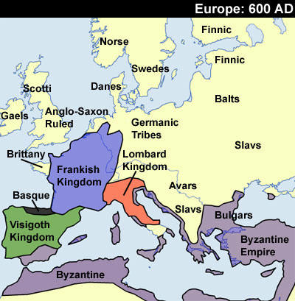
Germanic Kingdoms Emerge

Slide 7
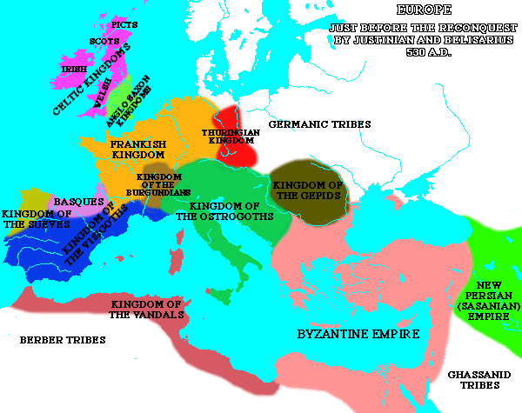
Germanic Kingdoms Emerge
Between AD 400 & 600 small Germanic Kingdoms replaced large Roman provinces

Slide 8
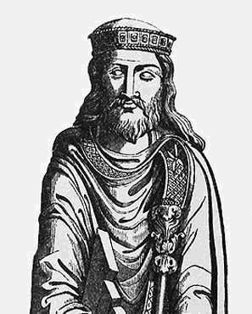
Germanic Kingdoms Emerge
In GAUL, a Germanic people called the FRANKS held power
Influential Frankish Rulers:
Clovis…

Slide 9
Frankish Rulers: Clovis
Converted to Christianity
Gained support of the Church in Rome
United the Franks into one kingdom

Slide 10
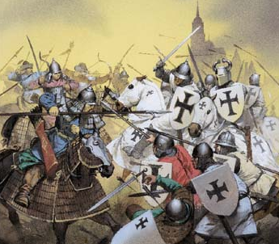
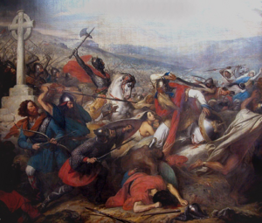
Frankish Rulers: Charles Martel
Charles Martel:
Defeated the Muslims at the Battle of Tours (732AD)
(Remember: Islam develops in 622; spreads rapidly, huge Islamic empires emerge; overrun Christian lands)

Slide 11
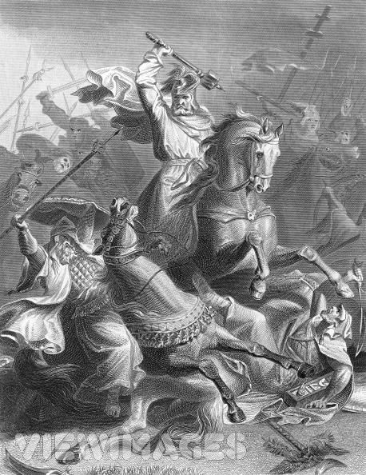
Frankish Rulers: Charles Martel
He became a Christian hero
His grandson is Charlemagne (Charles the Great)…

Slide 12
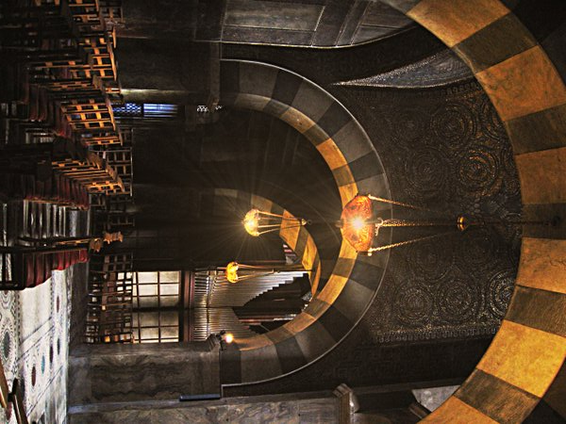
Charlemagne

Slide 13
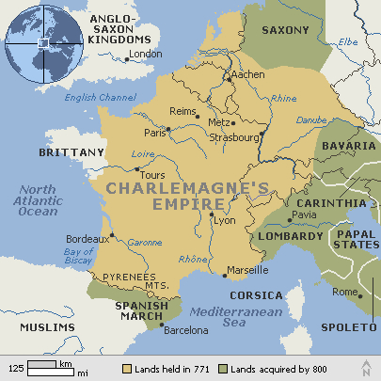
Charlemagne’s Empire
Germanic Kingdoms unite under Charlemagne
Empire included:
2/3 of Italy
All of present day France
Small part of Spain
All of German Saxony

Slide 14
Charlemagne, the Hero?
Spread Christianity through his conquest of other lands
AD 800 – Pope Leo III asks for Charlemagne’s help to crush an angry mob – SUCCESS!!

Slide 15
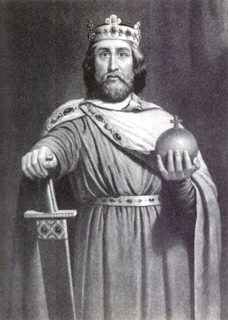
Charlemagne, the Hero?
In gratitude, the Pope crowned Charlemagne & called him the “Roman Emperor”

Slide 16
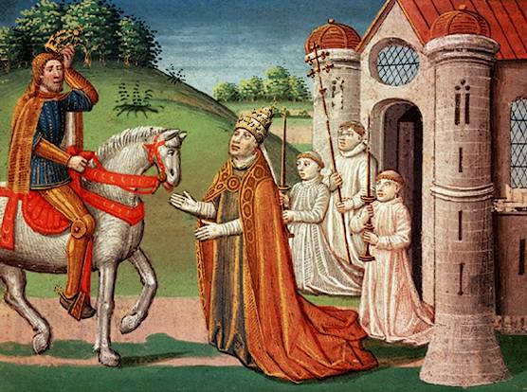

Slide 17
Charlemagne, the Hero?
Why does this matter?
A Christian Pope crowned a German king as the successor to the Roman Emperors
Gave him control over the former Roman Empire

Slide 18
Charlemagne, the Hero?
Revived the idea of a UNITED CHRISTIAN COMMUNITY
Would eventually lead to future power struggles between popes and emperors

Slide 19
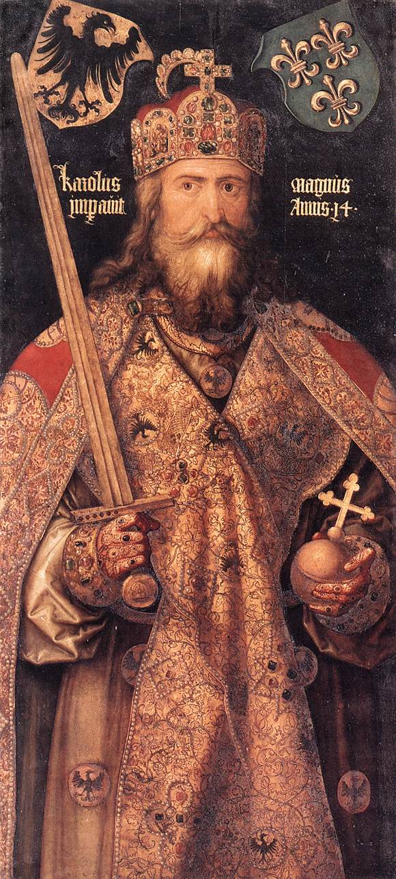
Charlemagne In Power
Government:
Appointed nobles to rule over local regions
STRONG, EFFICIENT & ORDERLY!

Slide 20
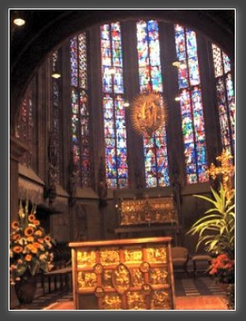
Charlemagne in Power
Revived Latin learning: grammar, rhetoric, logic, arithmetic, geometry, music, astronomy
Became the educational model for Medieval Europe

Slide 21
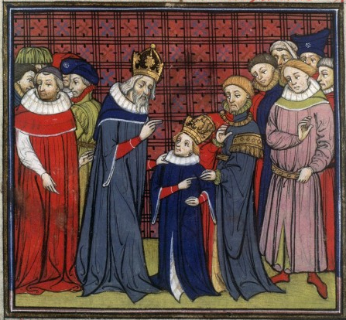
The End of Charlemagne
Charlemagne’s son (Louis the Pious) is heir to the throne
Weak ruler

Slide 22
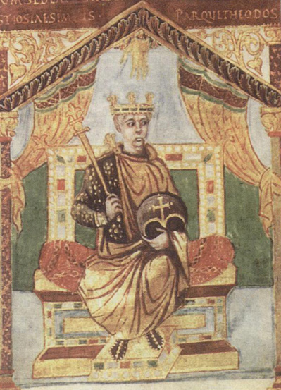
Charlemagne’s Heirs
Louis’s sons fight for control of the empire
Civil war!
Ends in 843; empire is divided into 3 kingdoms

Slide 23
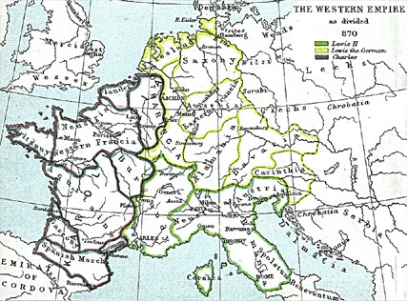

Slide 24
Charlemagne’s Legacy
Despite the breakdown of the empire, Charlemagne left a lasting legacy…
Extended Christian civilization into N. Europe
Further blended Greek, Roman & Christian traditions

Slide 25
Charlemagne’s Legacy
3. Educational model
4. Government style is copied by future leaders
And one more contribution… ☺

Slide 26
