Slide 1
Mongols 101
A Basic Introduction to Genghis Kahn and the Mongol Empire

Slide 2
Background - Temujin
Ghengis Kahn was born Temujin around 1162CE.
At the time the Mongols were greatly divided and constantly warring.
Stealing, kidnapping and murder were commonplace among tribes.
Ex: Temujin’s own father was poisoned to death by a rival clan
Ex 2: Temujin murdered his own ½ brother to take control of his household as a young teenager.
Temujin’s wife was kidnapped by a rival clan
In a daring rescue Temujin reclaimed his wife while making alliances along the way…thus began his ascent to power

Slide 3
The Rise of Genghis Khan
Temujin promoted his military leaders based on ability NOT family name
He killed all leaders of rival tribes and absorbed the remaining men into his own army
By 1205CE he had no rivals left and united all of the Mongol tribes taking the title “Chinggis Khan” or “Universal Ruler”…known to the West as “Genghis Kahn”

Slide 4
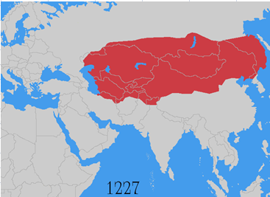
The Expansion of the Mongols
Using unprecedented speed and brutal tactics the Mongols under the leadership of Genghis Khan built the largest contiguous land empire in world history (seen below at the time of his death)

Slide 5
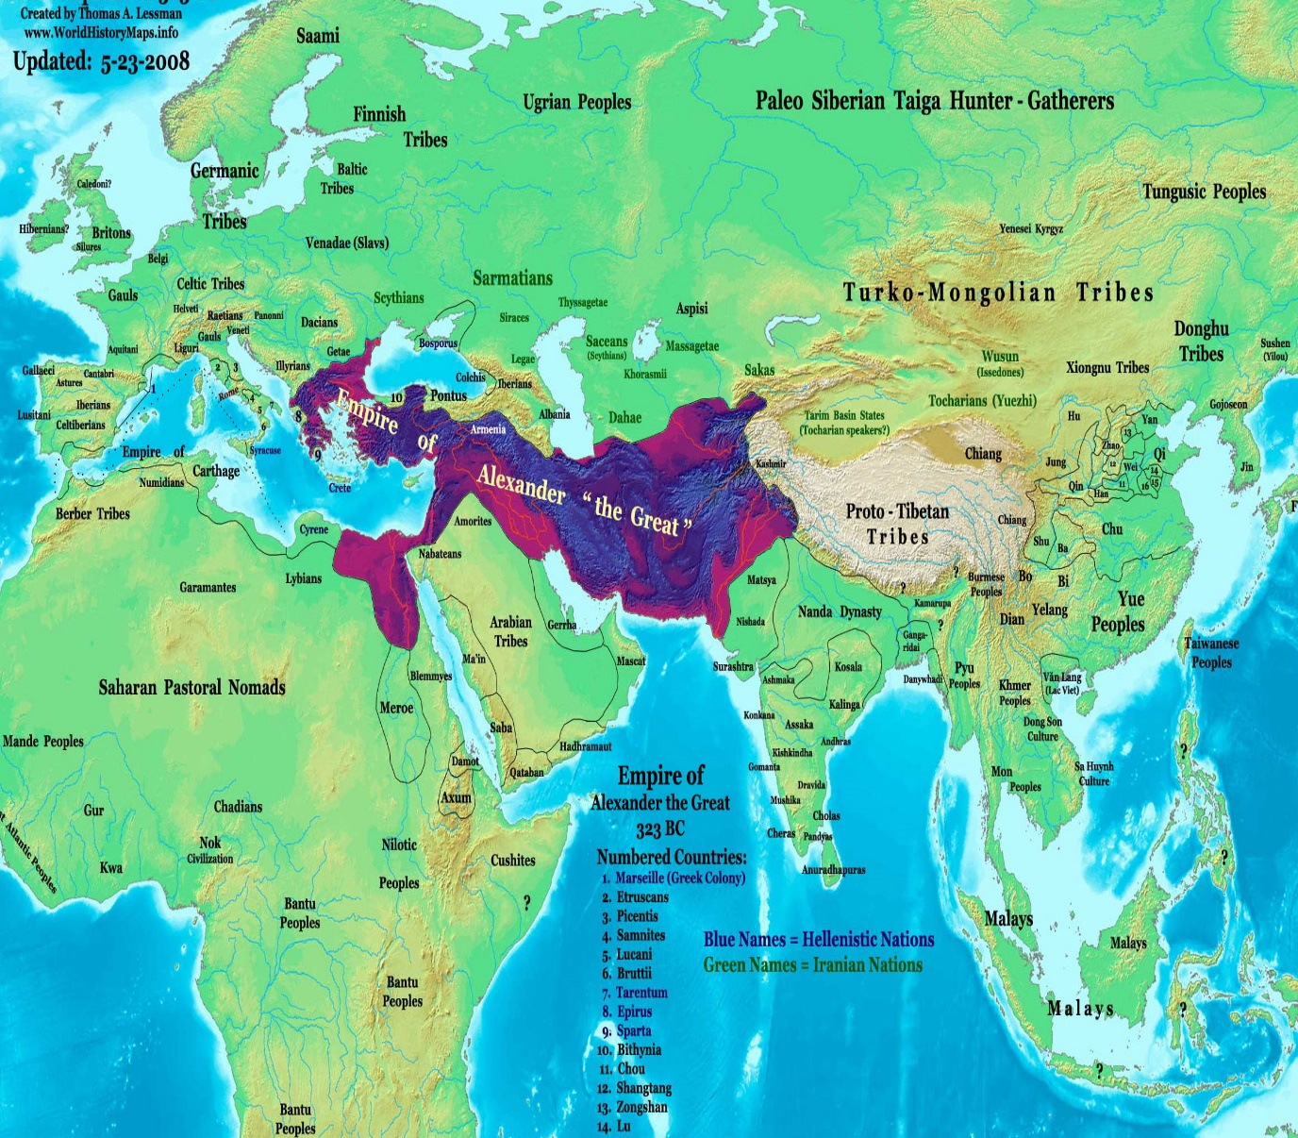
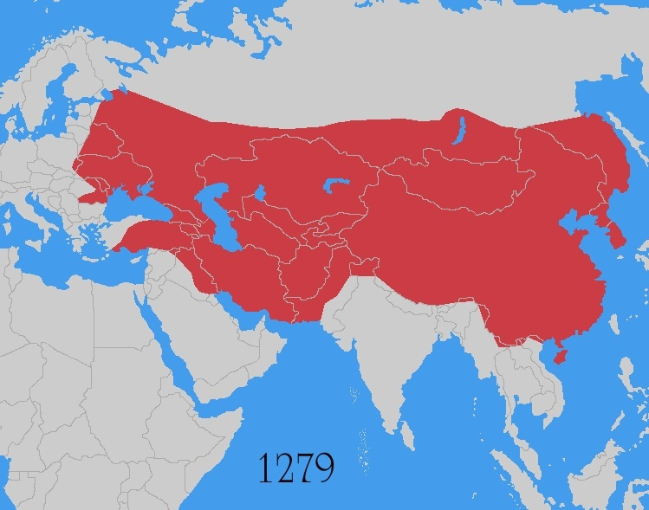
How does it compare…vs. Alexander The Great?
Alexander the Great
Genghis Khan

Slide 6
How does it compare…vs. All Time

Slide 7
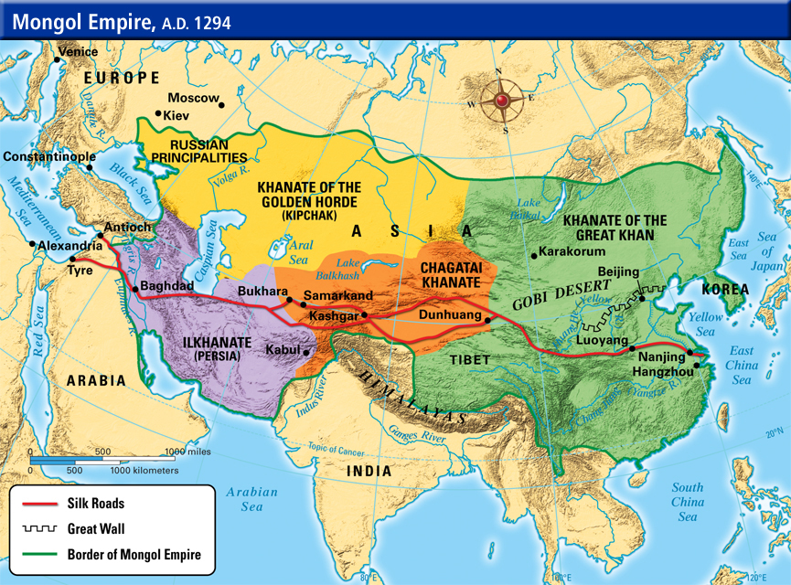
Expansion Continued…
Even after Genghis Khan’s death in 1227 the empire continued to grow
Eventually it developed into four kingdoms or ‘Khanates’ (seen below)

Slide 8
The Mongol Legacy
Did the Mongols ultimately have a more positive or negative impact on the world?
Historians disagree on this point and sound arguments can be made for both sides
**READ background essay: “The Mongols: How ‘barbaric’ were the barbarians?”

Slide 9
Debate Activity
PRO
CON
You are researching and looking for evidence that the Mongols ultimately had a POSITIVE impact on the world.
You are researching and looking for evidence that the Mongols ultimately had a NEGATIVE impact on the world.

