Slide 1
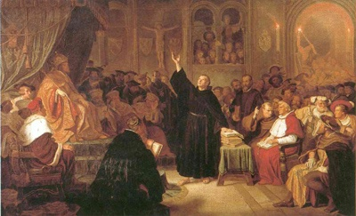
The Protestant Reformation

Slide 2
Origins of the Reformation
Began in Germany due to the lack of a strong central government
“Germany” included 365 independent states (kingdoms)
A weak emperor COULD NOT control independent ideas about religion within the German states

Slide 3
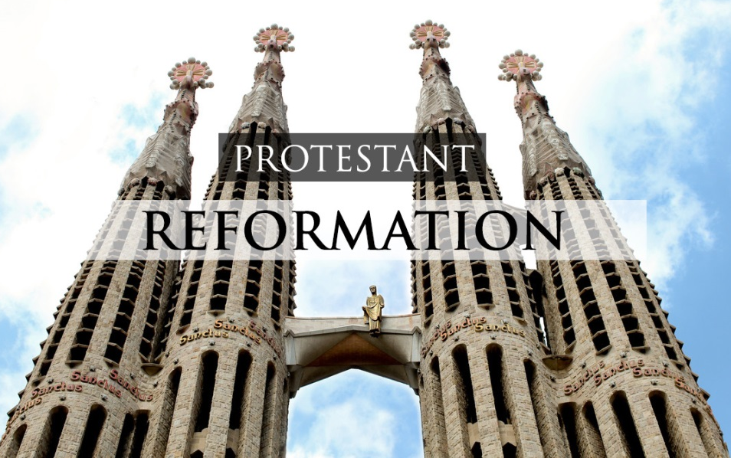
Causes of the Reformation
Ideas & individuals question the Church’s power & authority

Slide 4
Causes of the Reformation
Critics claim that the Church is corrupt; popes seemed too busy pursuing worldly affairs to have time for spiritual duties
Lower clergy members were poorly educated, broke their vows, drank & gambled

Slide 5
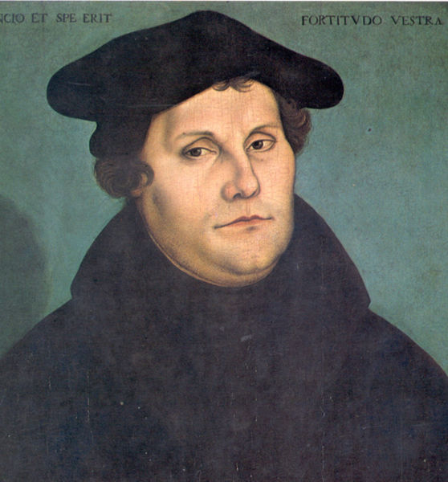
Martin Luther
German monk who started the Reformation
Believed:
People could get salvation only by faith; “good works” were not necessary
(idea called Justification by Faith Alone)

Slide 6
Martin Luther
Church teachings should be based solely on the Bible; the pope, etc…were false authorities
All people with faith are equal; people didn’t need priests to interpret the Bible for them

Slide 7
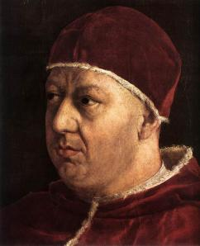
The Sale of Indulgences
Luther is against the practice of selling indulgences
Indulgences: Certificates issued by the Church

Slide 8
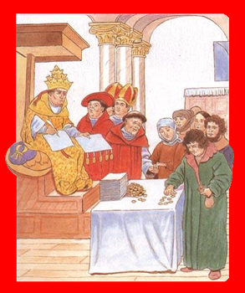
The Sale of Indulgences
Were said to reduce or even cancel punishment for a person’s sins
Applied to dead relatives as well…

Slide 9
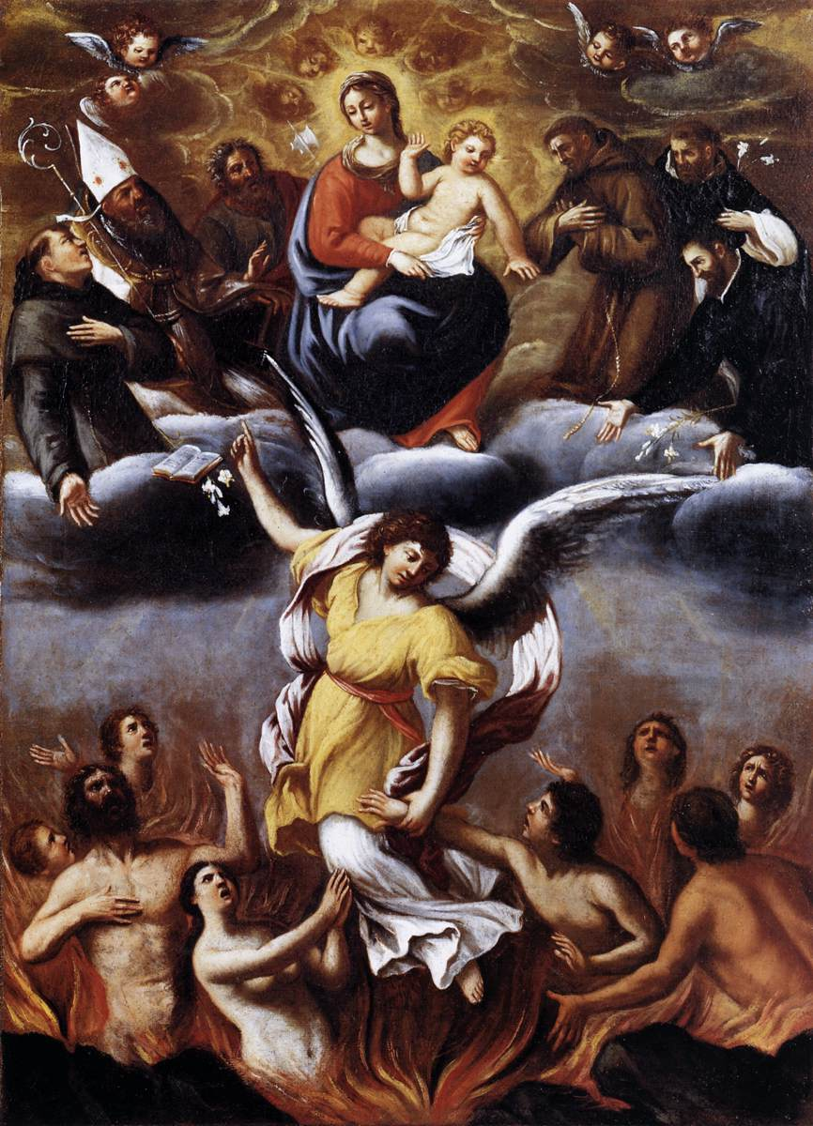
The Sale of Indulgences
“Once you hear the money’s ring, the soul from purgatory is free to spring…”
(Purgatory: Location in the afterlife where people are made fit for heaven)

Slide 10
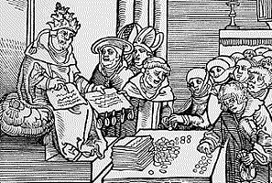
The Sale of Indulgences
Many people thought they were buying their way to heaven
John Tetzel was a German church agent that sold indulgences
Promised peasants that indulgences would relieve them of guilt for future sins!

Slide 11
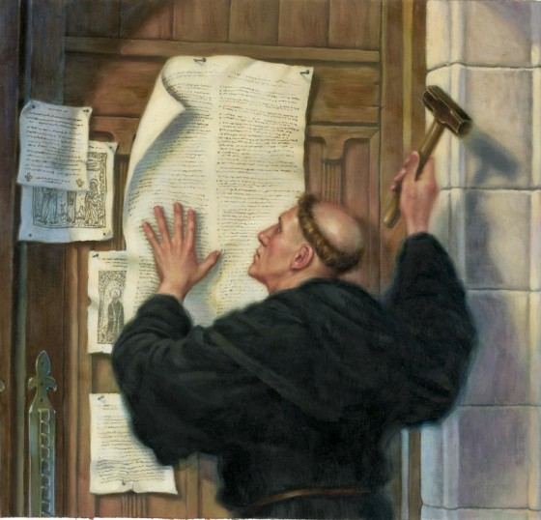
Luther’s Protest
Luther wrote & posted his 95 Theses
(debating points) in 1517
Criticized the sale of indulgences
His actions began the Reformation: a movement for
religious reform

Slide 12
Some of the 95 Theses…
#2: Only God can give salvation – not a priest
#6: Only God can forgive – the pope can only reassure people that God will do this
#21: An indulgence will not save a man
#37: Any Christian – dead or alive – can gain the benefit & love of Christ without an indulgence
#52: It is vain to rely on an indulgence to forgive your sins
#93: Those in the church who claim there is no problem must go

Slide 13
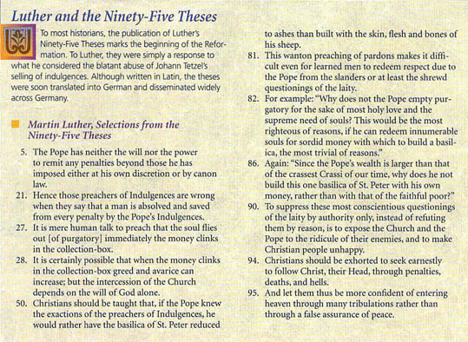

Slide 14
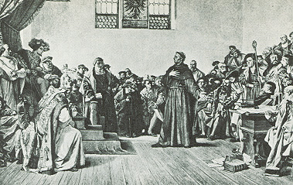
The Backlash
In 1521 the Pope Leo X EXCOMMUNICATED Luther for his statements
Diet of Worms:
Tried to get Luther to retract his criticisms of the Church

Slide 15
The Backlash
“I am bound by the Scriptures I have quoted and my conscience is captive to the Word of God. I cannot and I will not retract anything, since it is neither safe nor right to go against conscious. I cannot do otherwise, here I stand, may God help me. Amen” - - - Martin Luther

Slide 16
The Backlash
Luther refused!
Condemned as a heretic
Went into hiding; translated the Bible into German

Slide 17
The Backlash
Luther & his followers formed a separate religious group: the Lutherans
Eventually, the term Protestant was applied to Christians who belonged to non-Catholic Churches

Slide 18
The Backlash
The Reformation causes war in the Holy Roman Empire (Germany)
The Peace of Augsburg allows the German princes to decide the religion of his region/state

Slide 19
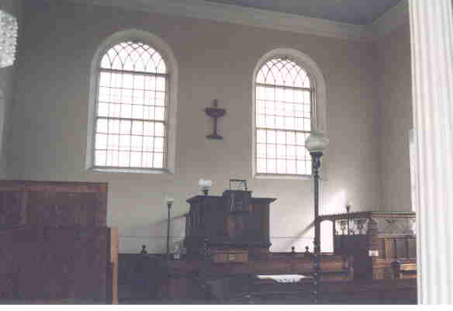
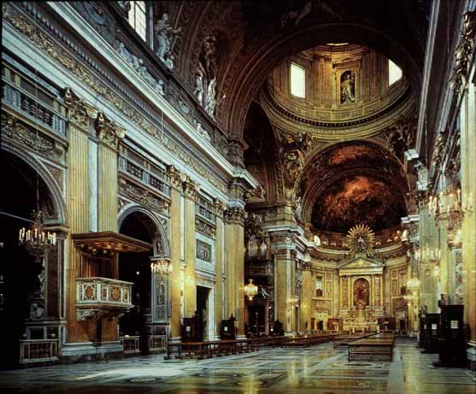
What’s the Difference?

Slide 20
The Difference - Leadership
Catholicism
Lutheranism
Pope is the head of the Church
Church is a hierarchy
Clergy cannot marry
Ministers lead congregations
Church is community of believers - equal status
Clergy can marry

Slide 21
The Difference - Worship
Catholicism
Lutheranism
Elaborate ceremonies & churches
Rituals
Believe in saints
Simple churches
Very few rituals
No saints

Slide 22
The Difference - Salvation
Catholicism
Lutheranism
Faith and good works needed for salvation
Only faith needed for salvation

Slide 23
The Difference - Bible
Catholicism
Lutheranism
Bible read in Latin
Available only to clergy who interpret it for the masses
Bible should be printed in the vernacular so everyone can read it and interpret it for themselves

Slide 24
The Difference – Religious Truth
Catholicism
Lutheranism
The Bible and the Church are equally powerful sources of religious truth
The Bible is the sole source of religious truth

Slide 25
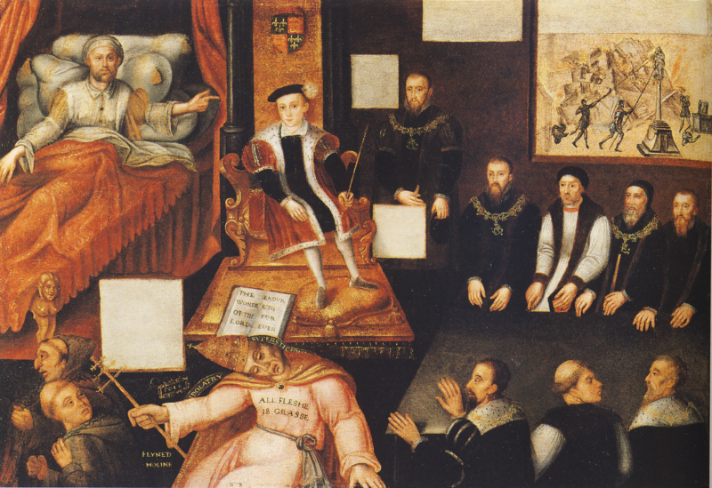
The Spread of Protestantism

Slide 26
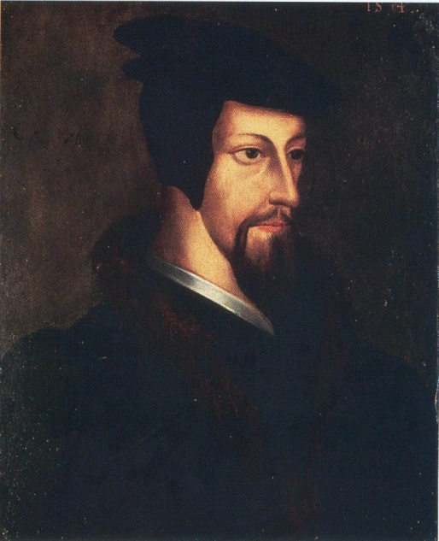
John Calvin
CALVINISM:
John Calvin promotes the
idea of predestination: God already knows who will be saved
Those predestined were called “the elect”
Calvin believes an ideal government is a theocracy (Geneva, Switzerland)

Slide 27
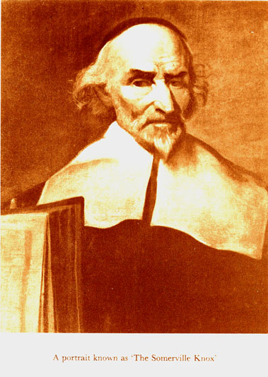
John Knox
PRESBYTERIANISM:
Leader of Reformation in SCOTLAND
Based on Calvin’s teachings
Presbytery: a group of decision makers within the church
“Priesthood of all believers”

Slide 28
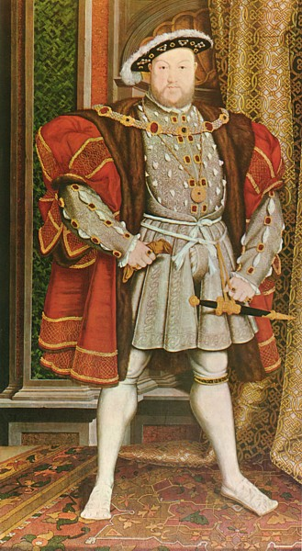
Henry VIII
Henry VIII (Tudor) is a devout Catholic king of England in 1509

Slide 29
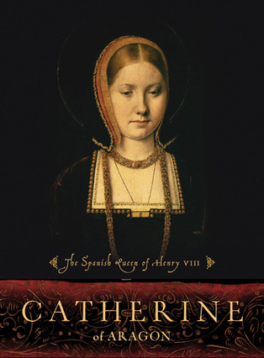
Henry VIII
Henry wants a male heir & is convinced that his first wife, Catherine of Aragon, would have no more children

Slide 30
Henry VIII
Henry wants to divorce her and take a younger queen
Problem?
Catholic law did not allow divorce
Asks pope to annul (set aside) the marriage
Pope says no

Slide 31
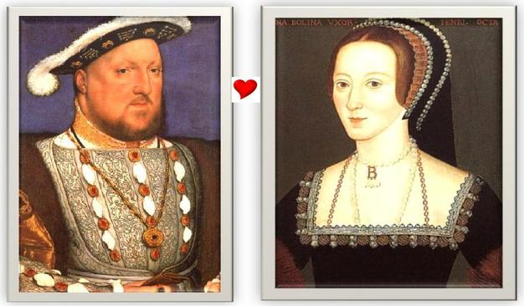
Henry VIII
Henry asks Parliament to create a set of laws that ended the pope’s power in England
They legalize Henry’s divorce
He marries Anne Boleyn

Slide 32
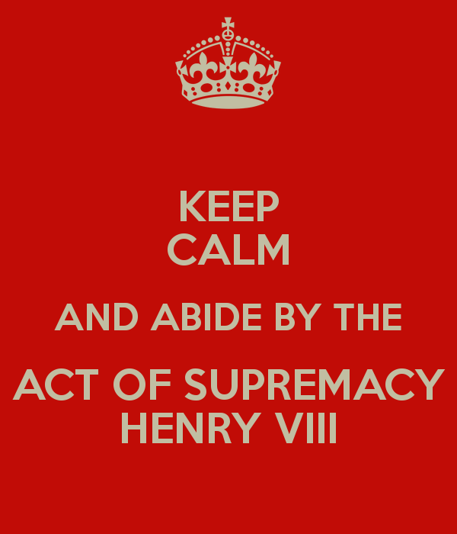
Henry VIII
The Act of Supremacy makes Henry the head of the Church of England
Recognizes the break from the pope

Slide 33
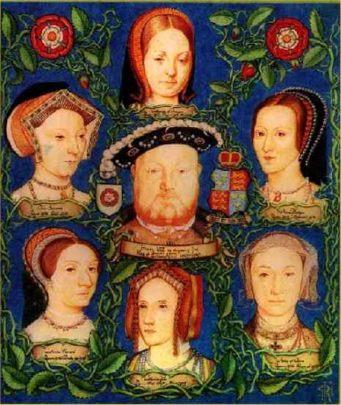
Henry VIII
Henry goes on to have 4 more wives for a total of 6
His 3 living children are Mary, Elizabeth, & Edward
When Elizabeth inherits the throne, she sets up the Church of England (Anglican Church)

Slide 34
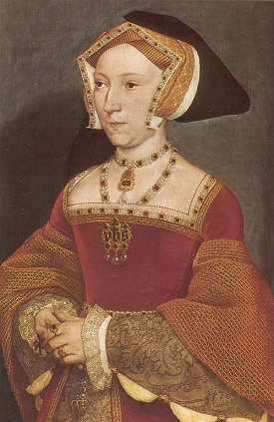
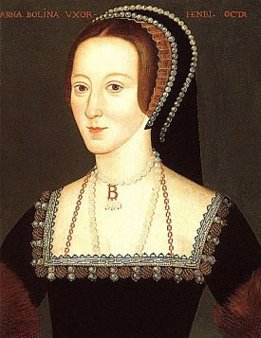
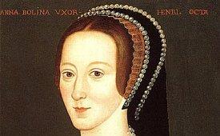
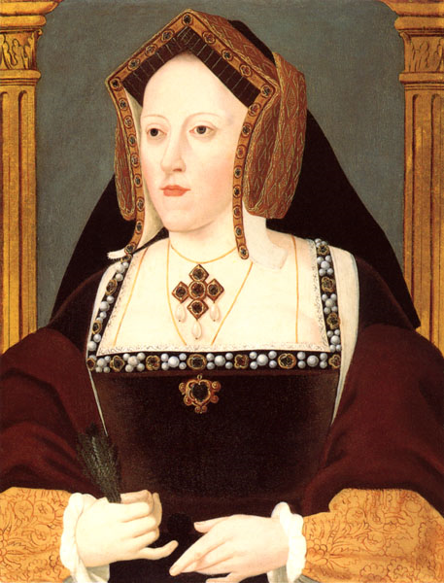
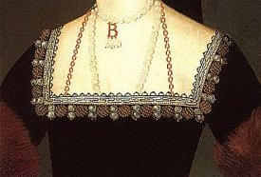

The Wives of Henry VIII
Catherine of Aragon
Anne Boleyn
Jane Seymour
DIVORCED!!!
DIED!!!
BEHEADED!!!

Slide 35
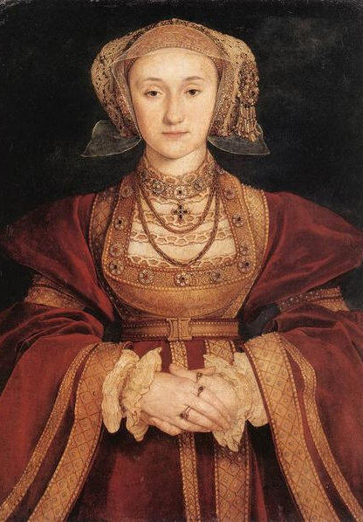
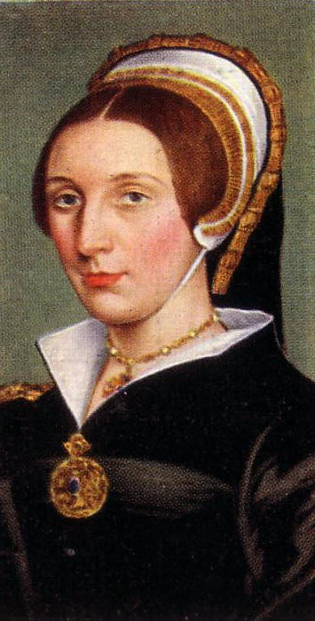
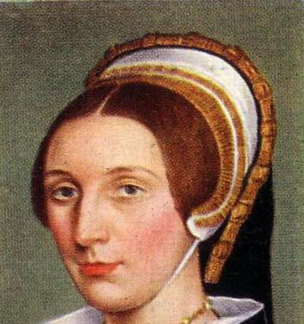
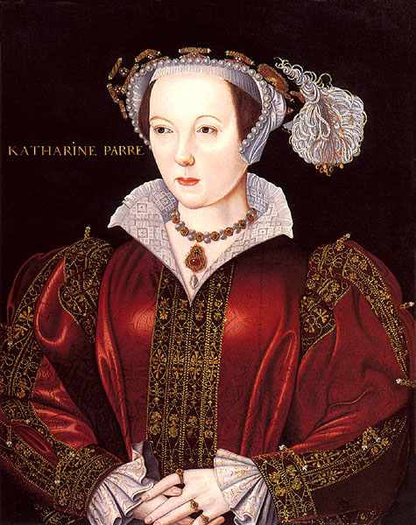
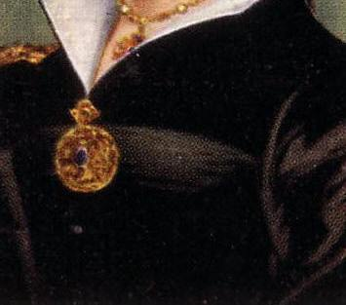
The Wives of Henry VIII
4. Anne of Cleves
5. Catherine Howard
6. Catherine Parr
SURVIVED!!!
DIVORCED!!!
BEHEADED!!!

