Slide 1
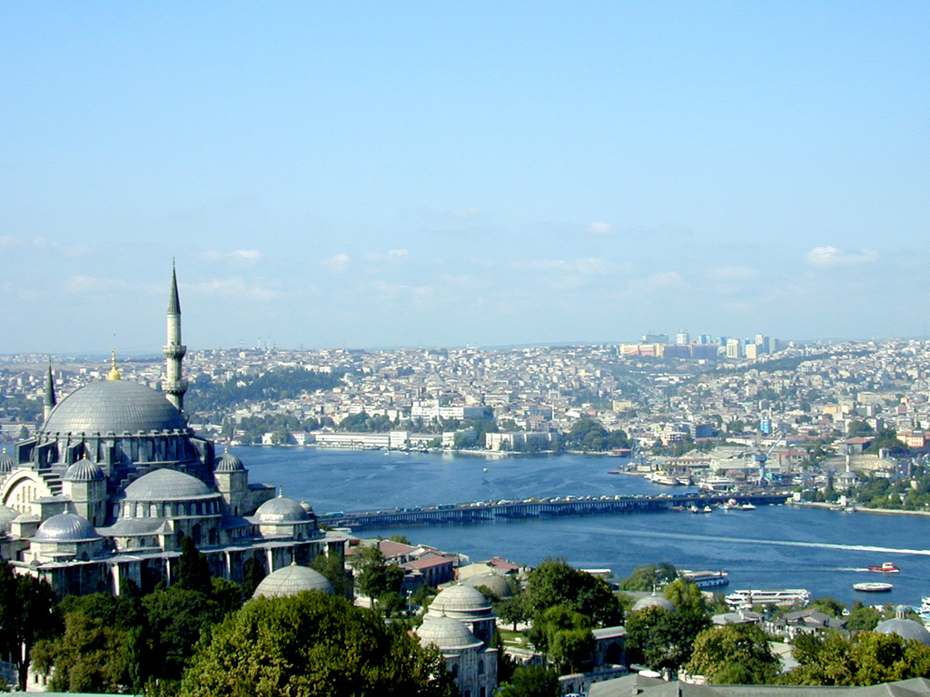
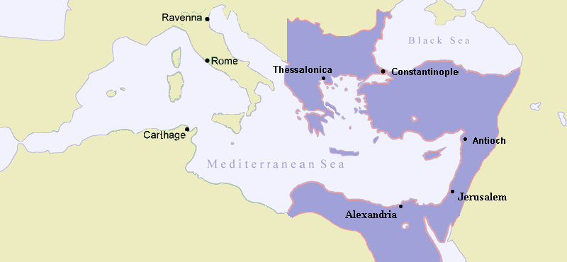
The Byzantine Empire The “New Rome”

Slide 2
Practice saying ‘Byzantine!’ (Biz – un – teen)

Slide 3
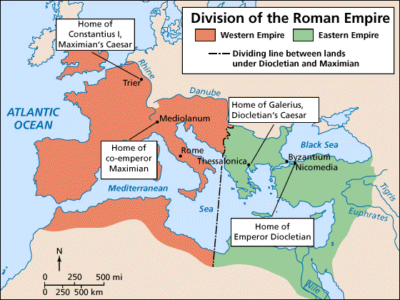

Slide 4
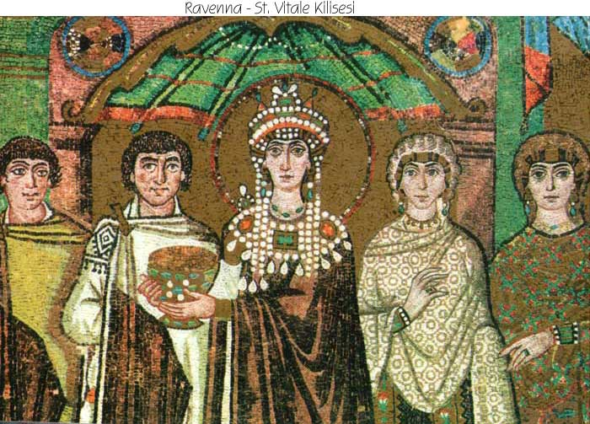
Byzantine Empire
Constantine moved capital to Byzantium & renamed it Constantinople
AD 476: Western Rome fell due to barbarian invasions
Eastern Rome, ruled from Constantinople, survived for another 1000 years
Preserved Greek & Roman culture

Slide 5
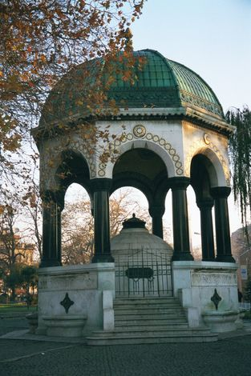
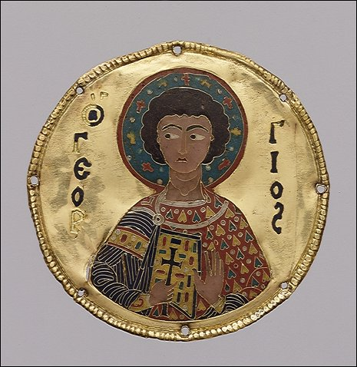
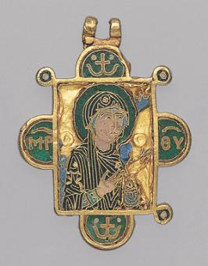
Constantine lavished on his new capital a university, 2 theaters, 8 public and 53 private baths, 52 covered walkways, 4 law courts, 14 churches, and 14 palaces. He imported staggering quantities of the best Greco-Roman art from throughout the empire.

Slide 6
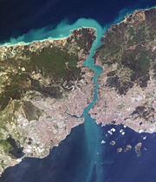
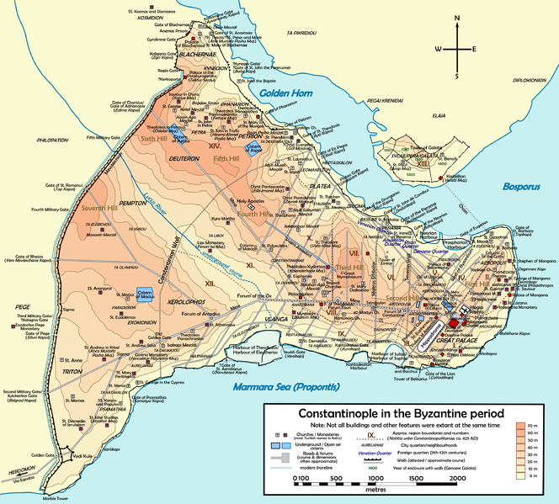
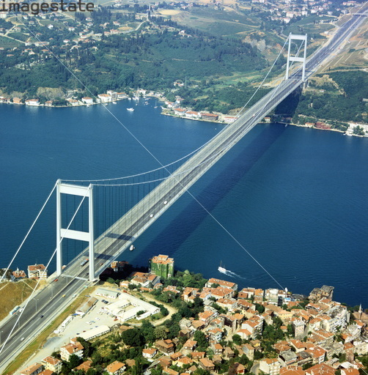
Constantinople: Strategic Location
Notes:
http://www.youtube.com/watch?v=iglYVm01RHU&feature=fvwrel

Slide 7
Constantinople
Overlooked the Bosporus Strait
Richest & largest European city
Dominated economic life in the Mediterranean
Major center of trade between the east & west; where Europe & Asia meet

Slide 8
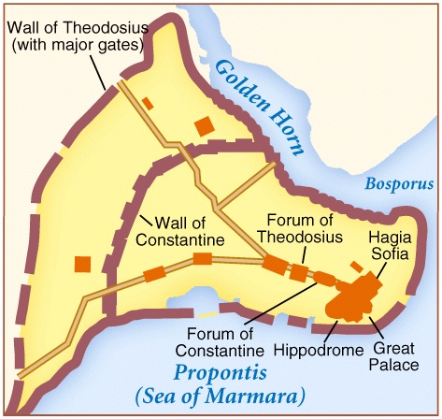
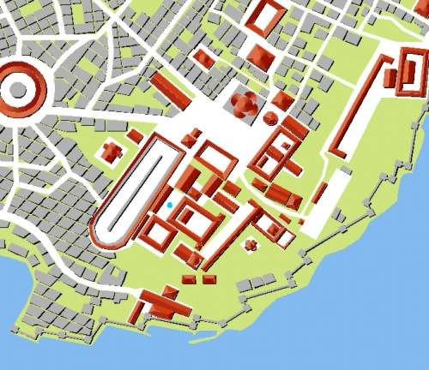
Constantinople
(Modern Day Istanbul)
Easily fortified location; armies could respond quickly to threat from invaders
Notes:
Fortified!

Slide 9
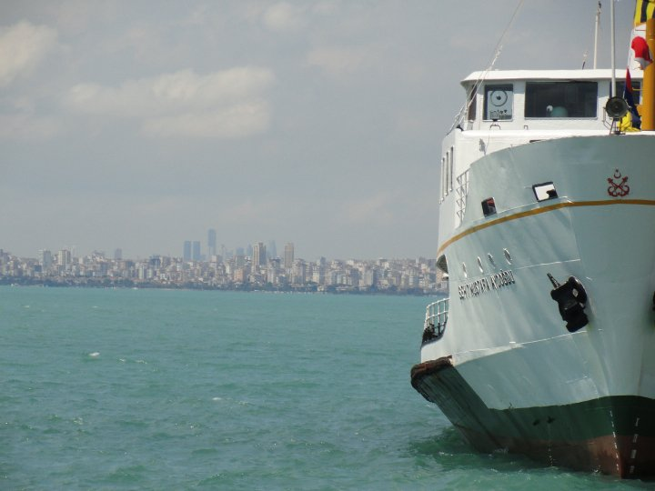

Slide 10
Byzantine Empire: “New Rome”
Mainly Greeks occupied Byzantium
Greek replaced Latin as the official language
Christian Church became the Eastern Orthodox Church
Byzantine emperor controlled both the church and the government
Emperor appointed the head of the church

Slide 11
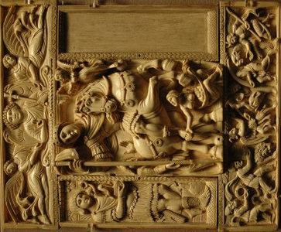
Influential Leaders

Slide 12
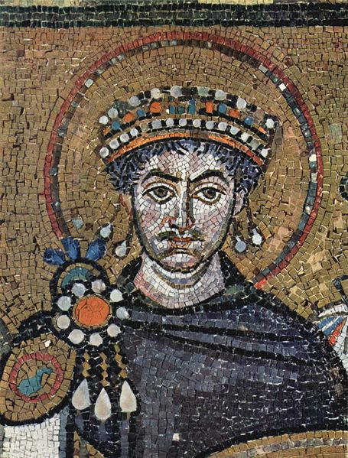
Justinian
Justinian - 6th century emperor (Eastern empire)
Took power in 527AD
One of Byzantine’s greatest rulers

Slide 13
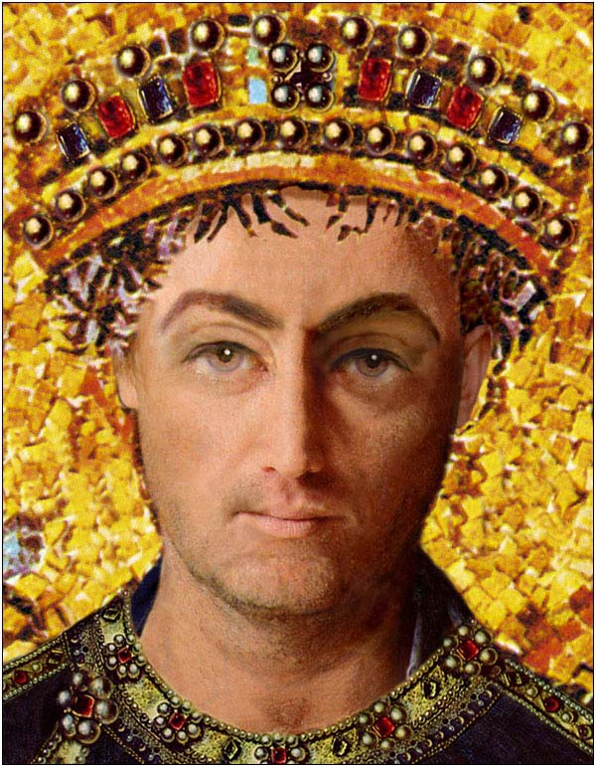
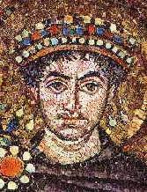

Slide 14
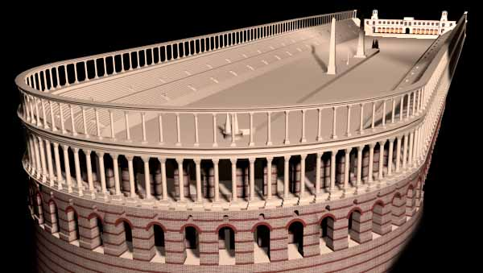
Justinian
Justinian had ambitious public building program
City becomes unparalleled with churches, baths, aqueducts, law courts, schools, hospitals
Free entertainment at the Hippodrome (“horse track”); held 60,000 people

Slide 15
Justinian
Justinian's Code:
Justinian had Roman laws codified & classified
Decided legal questions regulating marriage, slavery, property, inheritance, crime, women’s rights, etc.
Preserved Rome’s legal heritage & later became the basis for most European legal systems

Slide 16
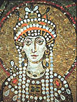
Theodora
Justinian’s wife Theodora was VERY influential during his reign
Wanted to improve the social standing of women; urged Justinian to give women more rights

Slide 17
Theodora
Nika Rebellion – violent riot that started in the Hippodrome
Justinian wanted to flee
Theodora advised against this course of action
Justinian stayed and had his army crush the rebels; thousands killed

Slide 18
Military Expansion
Belisarius:
Peasant with little military experience
Friend of Theodora’s
Eventually appointed general of the Byzantine army

Slide 19
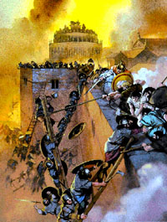
Military Expansion
In addition, Belisarius fought a series of wars against the Vandals, Ostrogoths & Visigoths
The Byzantines conquered these Germanic groups and extended their rule in the west

Slide 20
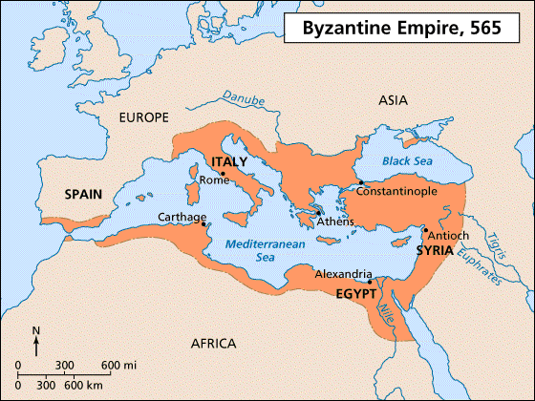
Justinian’s Empire at its Peak

Slide 21
Conflict in the Church

Slide 22
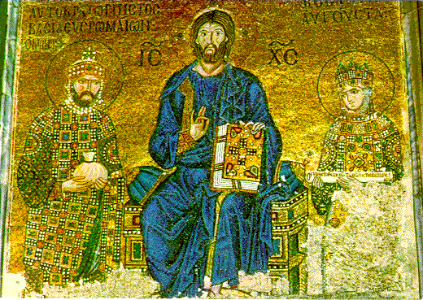
Conflict in the Church
During the 8th century a church controversy arose over the use of icons (religious images) in worship
Eastern church (Constantinople) vs. Western church (Rome)

Slide 23
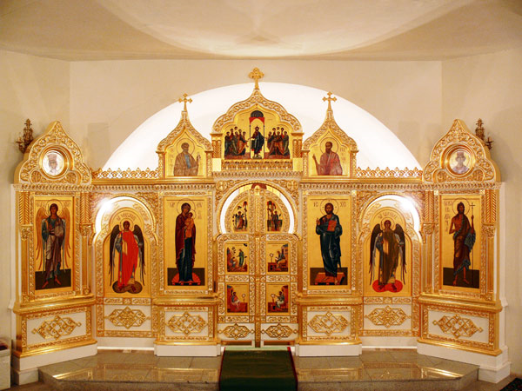

Slide 24
Conflict in the Church
In AD 726 Emperor Leo III ordered the removal of all icons
Believed that they encouraged superstition & the worship of idols
Led to iconoclasts (“image breakers”) who broke into churches to destroy images

Slide 25
Conflict in the Church
Resulted in an argument over the true source of religious authority
Eastern church or western church?
The Pope, in Rome, claimed that he was the supreme leader of church
The Patriarch, in Constantinople, claimed that he was the supreme leader of the church

Slide 26
The Church Splits!
This controversy eventually resulted in a schism (separation) in 1054
The church became permanently divided
Roman Catholic Church in the West & Eastern Orthodox Church in the East

Slide 27
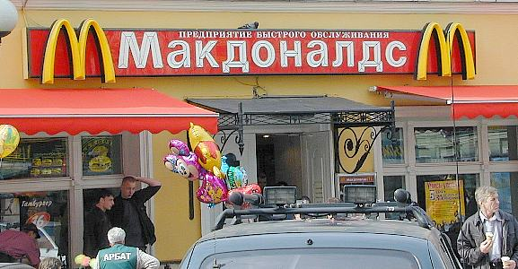
The Church Splits!
Both churches competed with each other for converts
Eastern Orthodox missionaries tried to convert the Slavs
Invented an alphabet for Slavic languages so they could read the bible
This is the creation of the Cyrillic Alphabet

Slide 28
Roman Catholic | Eastern Orthodox
Services are conducted in Latin | Services conducted in Greek or local language
Pope has authority over all other bishops | Patriarch & other bishops head the church as a group
Pope claims authority over all kings/emperors | Emperor claims authority over patriarch & other bishops
Priests may not marry | Priests may marry
Divorce is not permitted | Divorce is allowed under certain conditions

Slide 29
Byzantine Culture

Slide 30
Byzantine Art
Byzantine art glorified religion
Icons in homes, churches & shrines
Mosaics:
Tiny pieces of colored glass or flat stone set in plaster

Slide 31
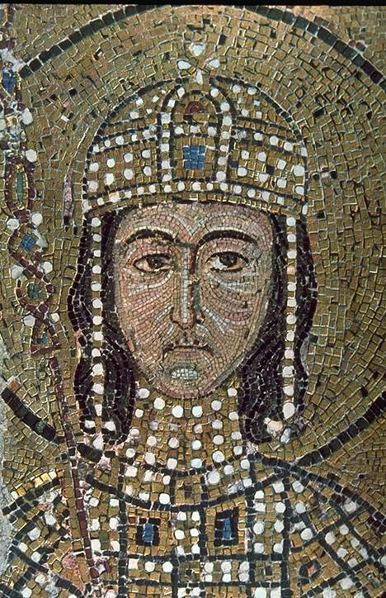
Saint Sophie, Constantinople
Mosaic – Bits of colored tile/glass

Slide 32
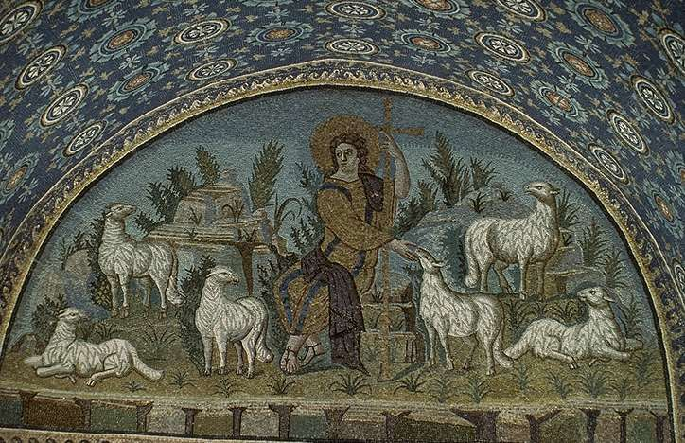
Shepherd and the Flock, Constantinople
Mosaic

Slide 33
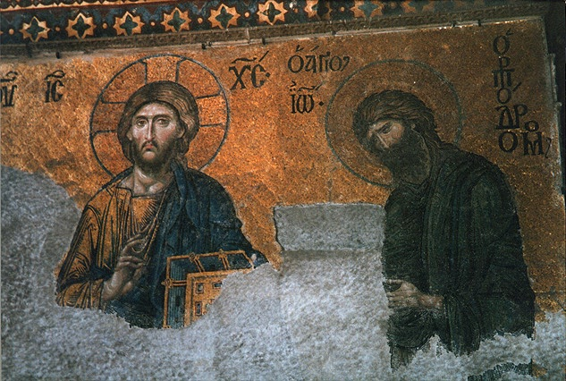
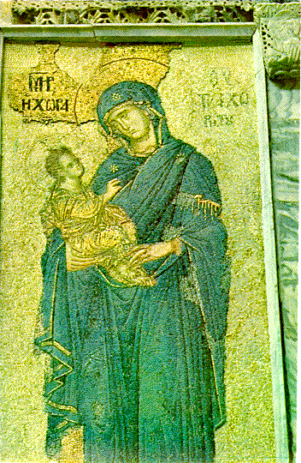
Byzantine Art
Subjects of Byzantine art appeared stiff & artificial with calm, meditative faces to inspire reverence

Slide 34
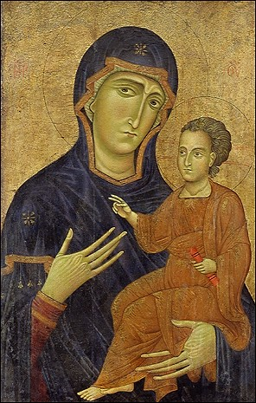
Madonna and Child, circa 1230

Slide 35
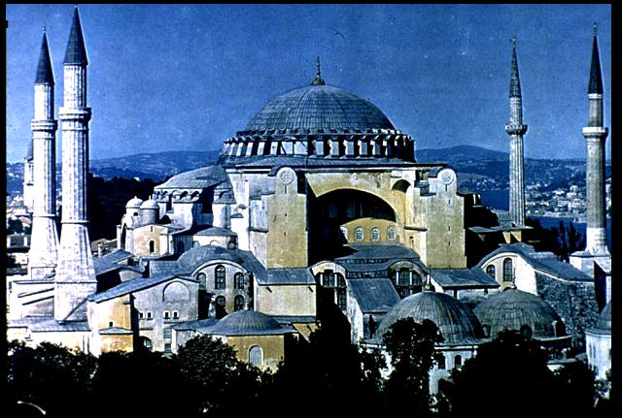
Byzantine Architecture
Greatest form of Byzantine art
Greatest masterpiece:
The Hagia Sophia (church), meaning “holy wisdom” (built by Justinian)

Slide 36
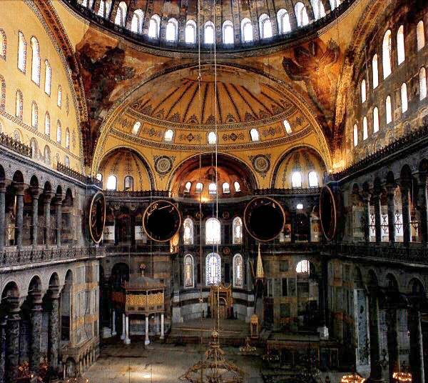
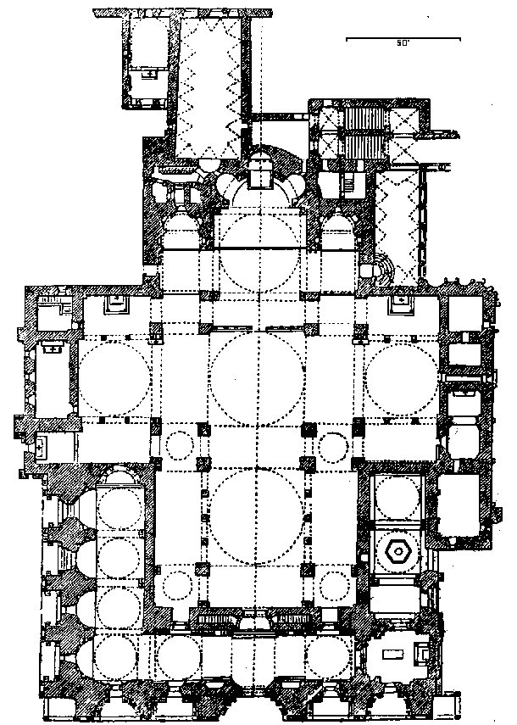
Byzantine Architecture
Built in the shape of a Greek cross
Includes murals, mosaics & insets of ivory, silver & jewels

Slide 37
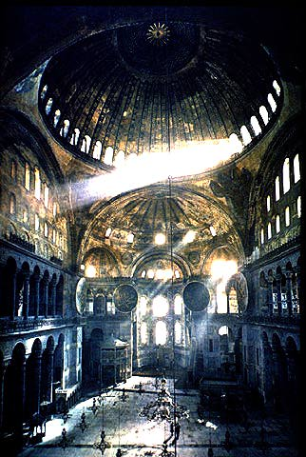
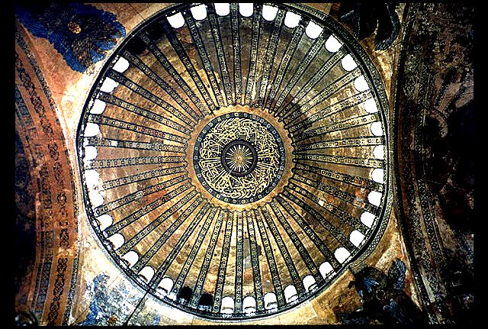
Byzantine Architecture
Byzantine Architecture
Capped by a huge dome that rests on massive columns

Slide 38
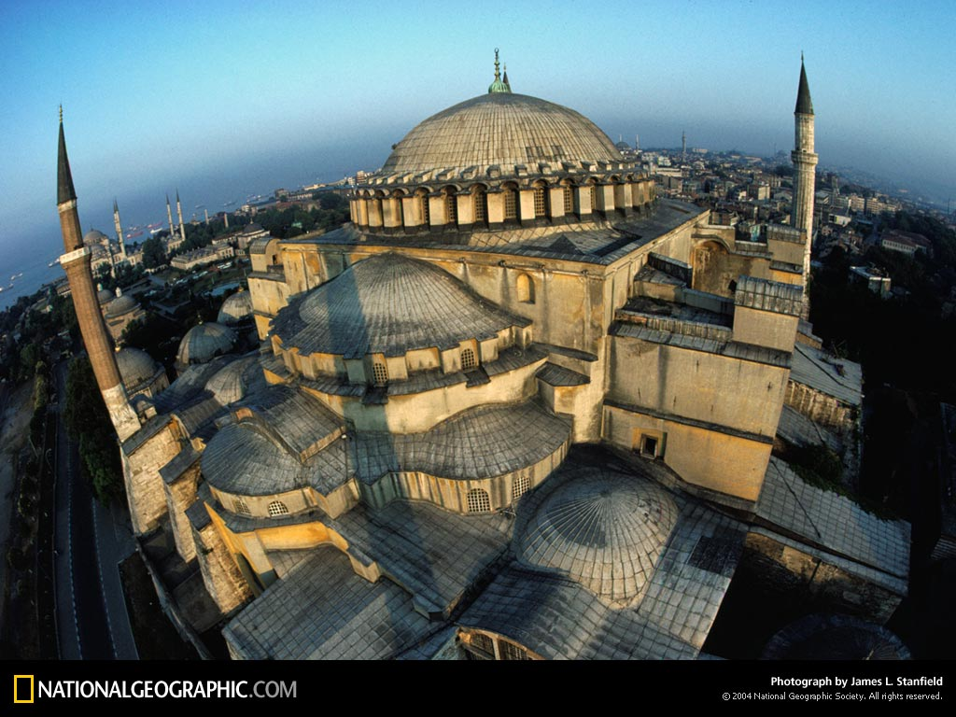

Slide 39
Decline of the Empire

Slide 40
Decline of Empire
The Plague of Justinian:
In the worst year of the plague, 10,000 people died every day
Destroyed a huge % of the empire’s population

Slide 41
Decline of Empire
Foreign Invasions:
Attacks from the Avars, Slavs, Bulgars and Persians
GREATLY weakened the empire

Slide 42
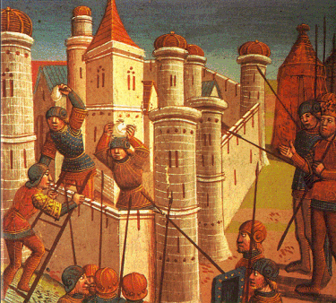
Fall of Constantinople
Ottoman Turks from central Asia attacked the Eastern provinces
AD 1453 - Ottomans laid siege to Constantinople
Constantinople fell…

Slide 43
Review…

Slide 44
What were Justinian’s Accomplishments?
Expanded the Empire
Justinian’s Code
The Hagia Sophia
Helped spread Christianity
Increased women's’ rights

