Slide 1
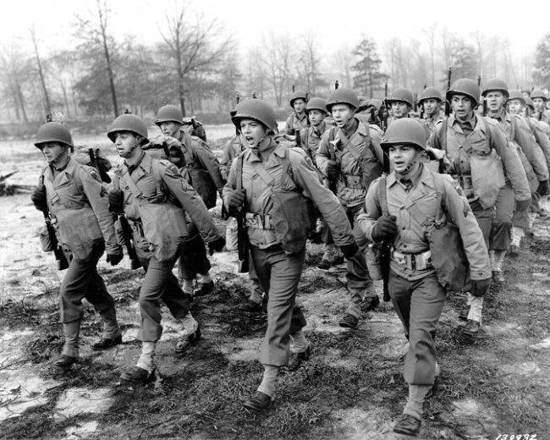
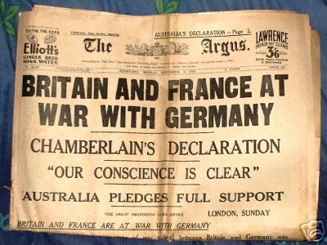
World war i: The Beginnings

Slide 2
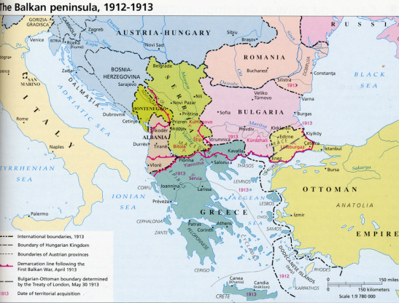
Trouble in the Balkans
Many groups in the Balkans win independence from Ottoman Empire in the early 1900s
New nation of Serbia is made up largely of Slavs
The Balkan Powder Keg

Slide 3
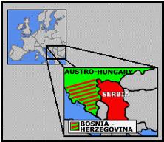
Trouble in the Balkans
Austria-Hungary annexes the Slavic region of Bosnia & Herzegovina (1908)

Slide 4
Trouble in the Balkans
Serbia is outraged!; sees itself as the rightful ruler of these Slavic lands
Serbia vowed to take B-H away from Austria; Austria-Hungary vowed to crush them if they did…

Slide 5
The Spark!
“If there is ever another war in Europe, it will come out of some silly thing in the Balkans” --Otto Von Bismarck (1898)
The Balkan Powder Keg

Slide 6
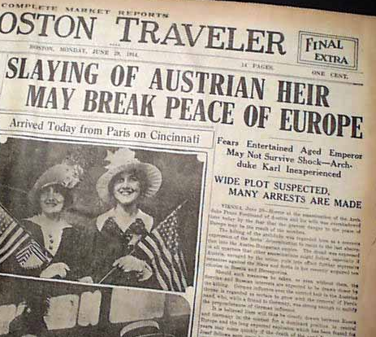
The Spark!
Archduke Franz Ferdinand of Austria-Hungary was assassinated by Gavrilo Princip
Princip was a member of the Serbian nationalist group Black Hand

Slide 7
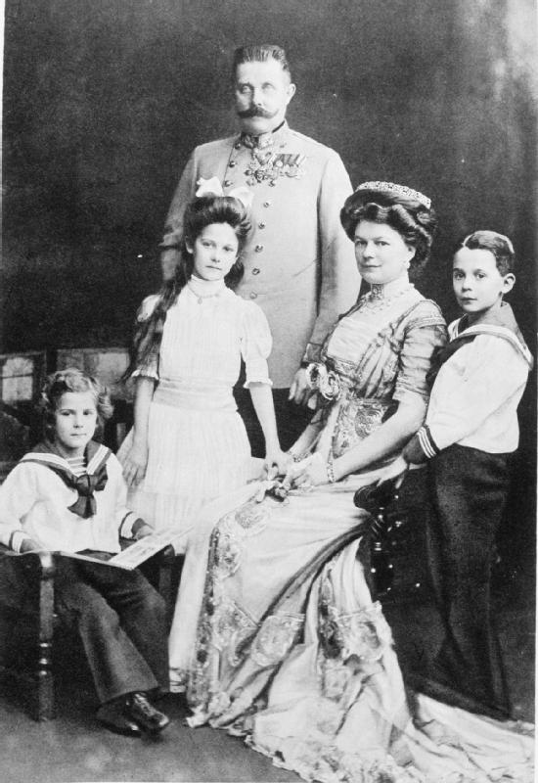
The Spark!
Ferdinand planned to give the Slavs of Bosnia-Herzegovina an equal voice in the Austro-Hungarian government
This threatened the movement for a separate Slavic state

Slide 8
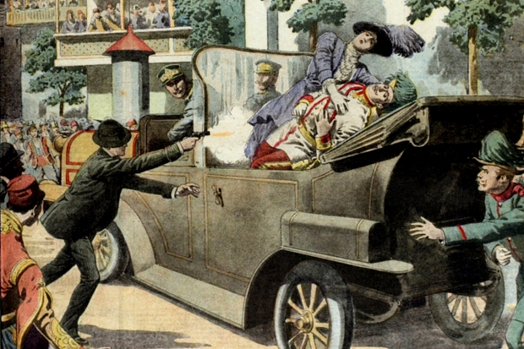
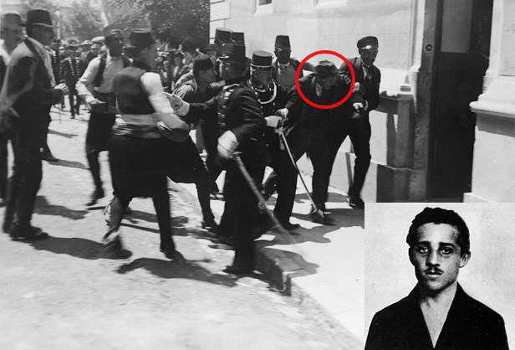
The assassination
The assassin:
Gavrilo Princip, Serbian Nationalist
Sarajevo,
June 28, 1914

Slide 9
Tensions build
Austria-Hungary held the Serbian government responsible for the assassination of Ferdinand
Austria-Hungary sought backup from Germany in the event of war

Slide 10
Tensions build
Germany issued a “Blank Check” to Austria-Hungary
Blank Check:
William II agreed to support any actions that Austria-Hungary might take against Serbia

Slide 11
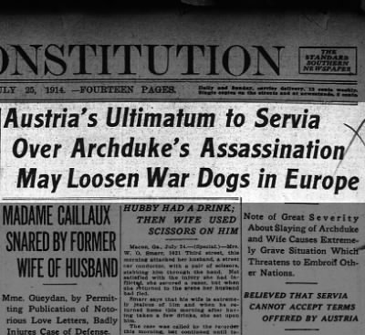
Tensions build
The Ultimatum: (set of final conditions that must be accepted to avoid severe consequence)
Main condition: Austria-Hungary demanded entrance into Serbia to conduct an investigation

Slide 12
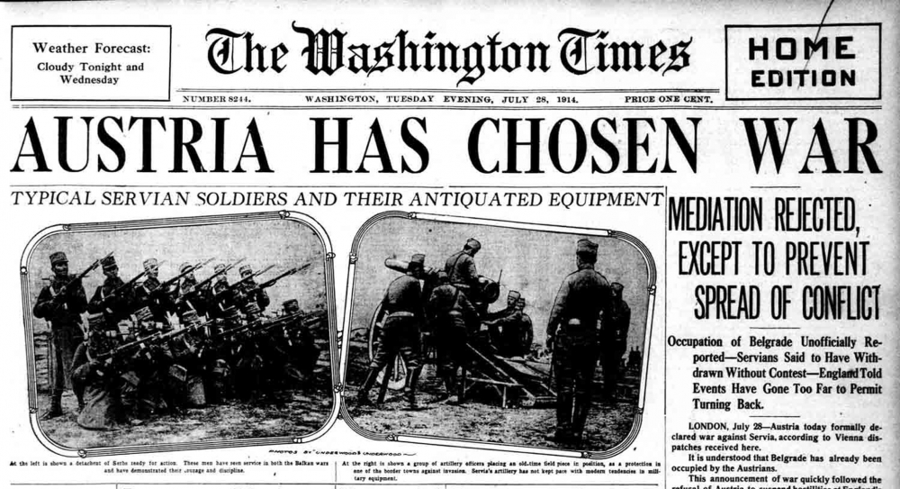
Declarations of war
Austria-Hungary gave Serbia 48 hours to agree to the ultimatum
Serbia REFUSED to agree to all parts
July 28, 1914:
A-H declared war on Serbia!

Slide 13
Declarations of war
Russia, an ally of Serbia, mobilized troops along the borders of Germany & Austria-Hungary
Germany warned Russia to stop
Russia refused!

Slide 14
Declarations of War
Germany issued an ultimatum to France
Gave France 18 hours to decide whether or not it would support Russia
France gave an inconclusive answer!

Slide 15
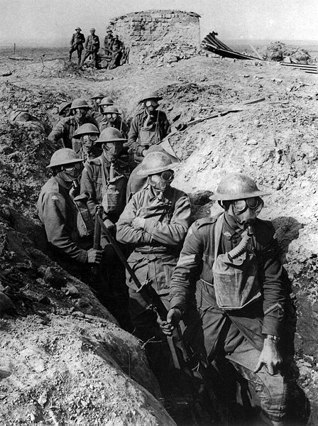
Declarations of War
08/01/1914:
Germany declared war on Russia
08/03/1914:
Germany declared war on France

Slide 16
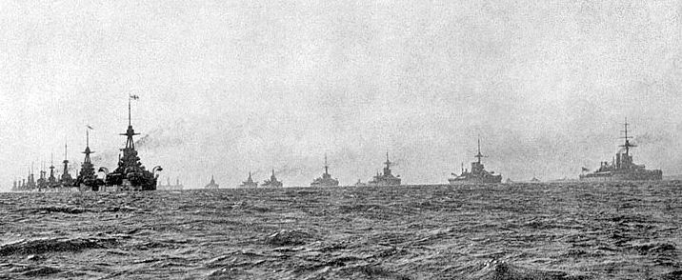
Declarations of War
Great Britain hoped to remain neutral (or as Keishon says, they wanted to stay “coolin’ in the cut”)
DID NOT want to become involved in a war
HOWEVER…

Slide 17
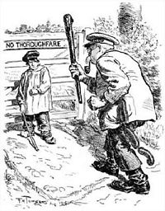
The Belgium Issue
Germany demanded passage across Belgium in order to fight France
Part of Germany’s Schlieffen Plan

Slide 18
The Belgium Issue
Back in 1839 Britain, Russia, France & Germany had signed a treaty that guaranteed Belgium’s neutrality
Great Britain protested Germany’s demand

Slide 19
The Belgium Issue
Despite Belgium’s neutrality, Germany invaded it
Great Britain demanded that Germany immediately withdraw from Belgium

Slide 20
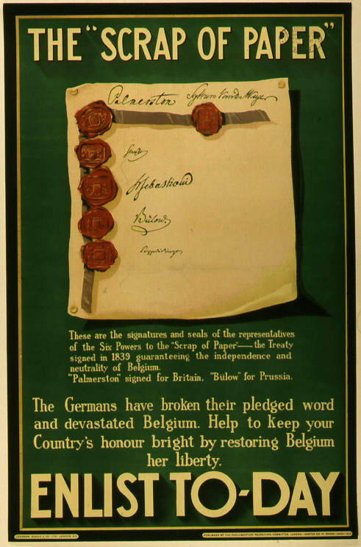
The Belgium Issue
Germany responded by referring to the treaty as nothing more than a “scrap of paper”
Great Britain declared war on Germany on Aug 4, 1914

Slide 21
The Schlieffen Plan
The Schlieffen Plan
Germany’s plan to deal with a TWO-FRONT war
The German army DID NOT want to fight the war on BOTH fronts at the SAME time

Slide 22
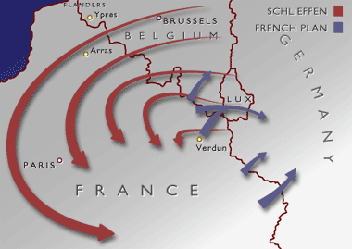
The Schlieffen Plan
Germany believed that the Russian army would be slow to mobilize
Believed they could defeat France on the Western Front in 5 to 6 weeks

Slide 23
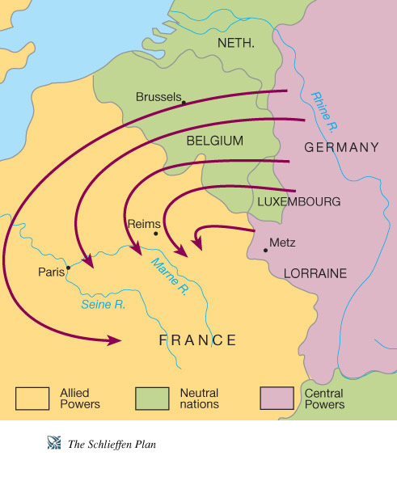
The Schlieffen Plan
Planned to invade Belgium & encircle Paris
They would then be able to fight Russia on the Eastern Front

Slide 24
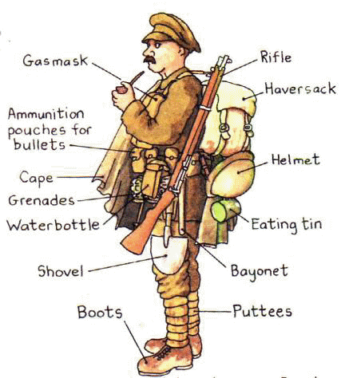
EXPECTATIONS
Both sides thought that the war would be a quick ordeal…
Notes:
Kaiser told his soldiers, “you’ll be home before the leaves have fallen from the trees.”
French troops marched off shouting, “We’ll be home by Christmas.”
They underestimated the role industrialization would play in this war

Slide 25
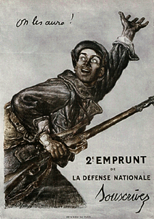
EXPECTATIONS
French troops marched off shouting, “We’ll be home by Christmas.”
Notes:
Kaiser told his soldiers, “you’ll be home before the leaves have fallen from the trees.”
French troops marched off shouting, “We’ll be home by Christmas.”
They underestimated the role industrialization would play in this war

Slide 26
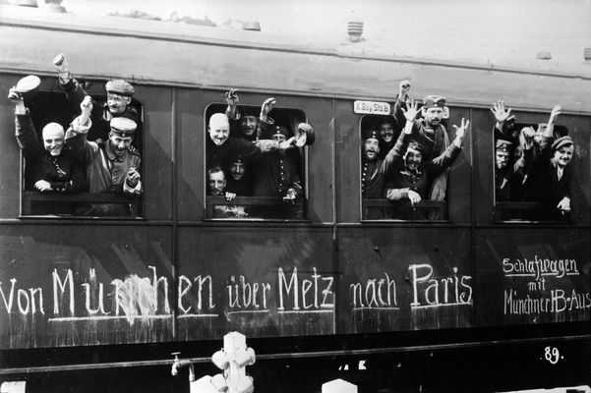
EXPECTATIONS
Kaiser told his soldiers, “You’ll be home before the leaves have fallen from the trees.”
Notes:
Kaiser told his soldiers, “you’ll be home before the leaves have fallen from the trees.”
French troops marched off shouting, “We’ll be home by Christmas.”
They underestimated the role industrialization would play in this war

Slide 27
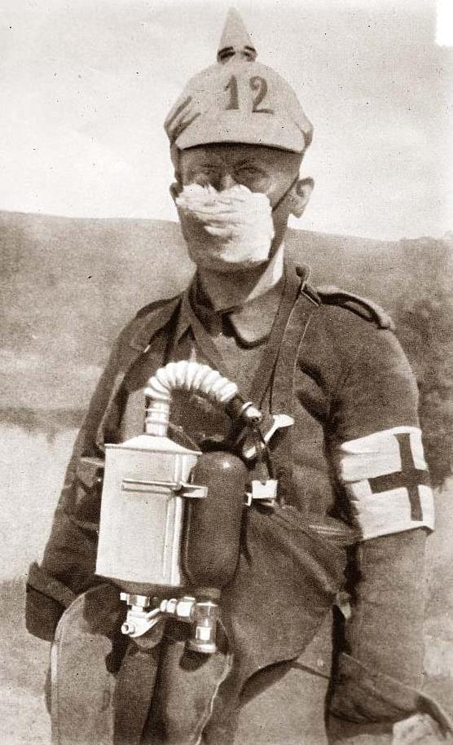
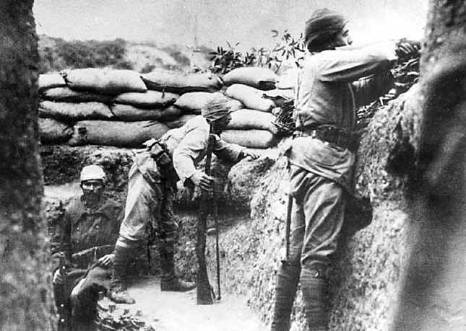
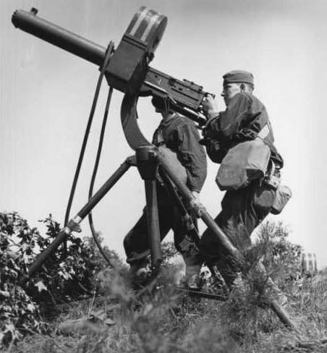
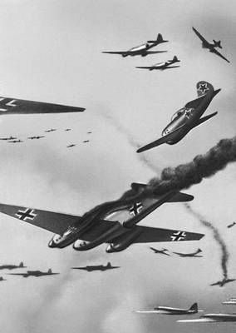
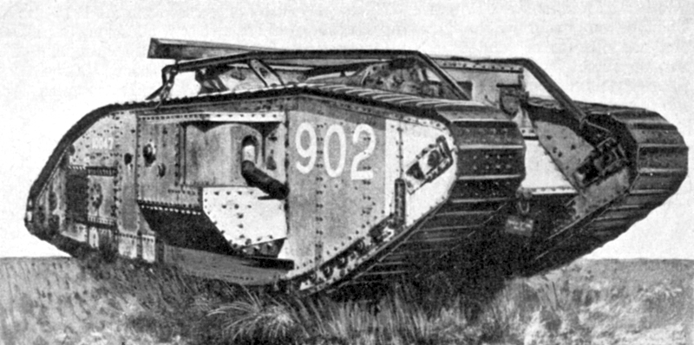
EXPECTATIONS
They underestimated the role industrialization would play in this war…
Notes:
Kaiser told his soldiers, “you’ll be home before the leaves have fallen from the trees.”
French troops marched off shouting, “We’ll be home by Christmas.”
They underestimated the role industrialization would play in this war

Slide 28
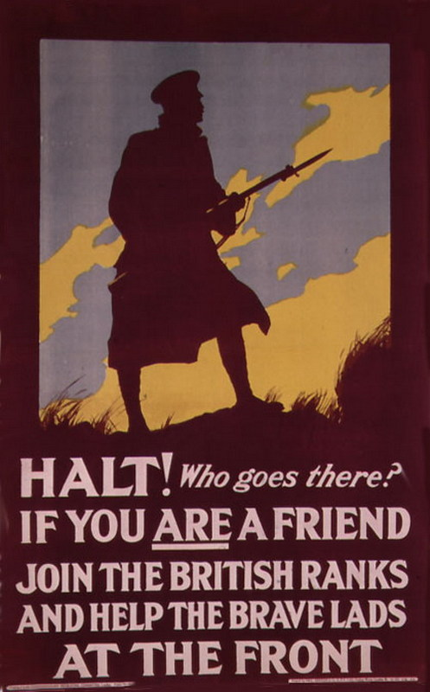
WWI recruitment posters

Slide 29
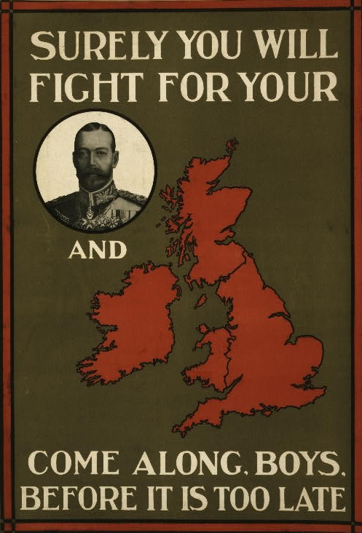
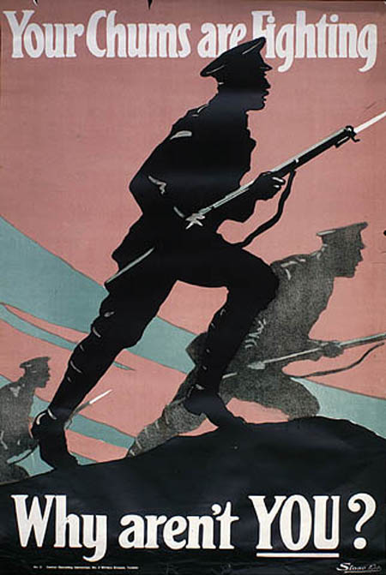
WWI recruitment posters

Slide 30
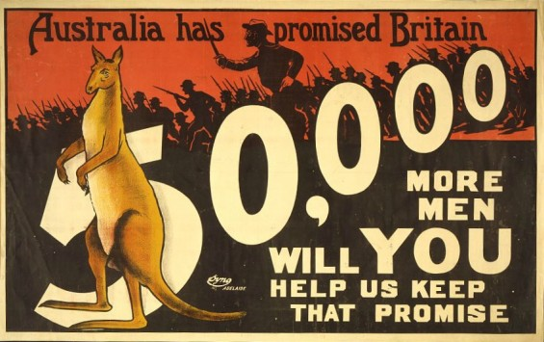
WWI recruitment posters

Slide 31
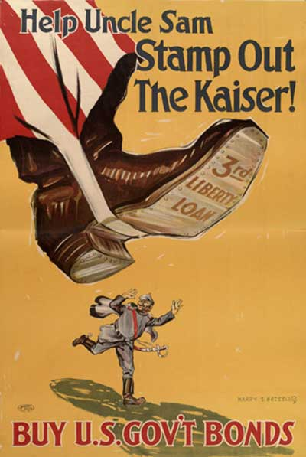
WWI recruitment posters

Slide 32
WWI recruitment posters

