Slide 1
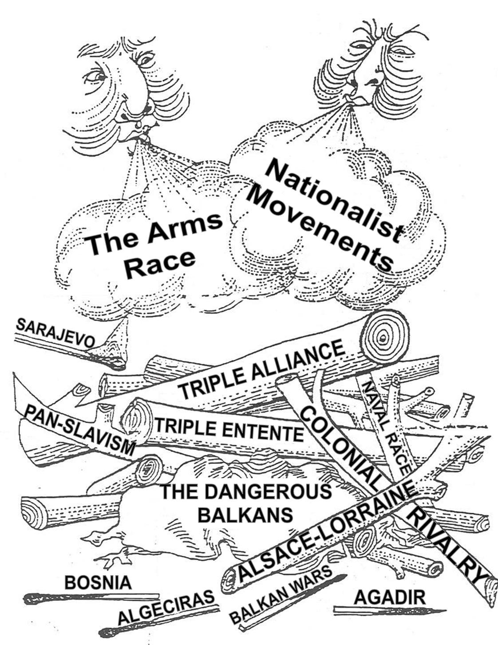
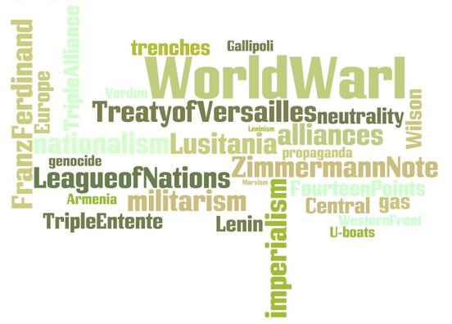
World War I: Underlying causes
A Local Conflict Goes Global

Slide 2
The Cousins War Wilhelm II George V Nicholas II
Germany
Great Britain
Russia

Slide 3
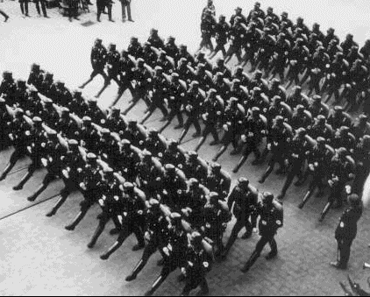
Underlying Causes M.A.N.I.A.
Militarism
Alliances
Nationalism
Imperialism
Anarchy

Slide 4
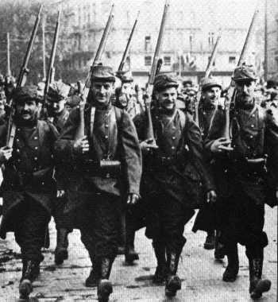
Militarism

Slide 5
Militarism
Militarism:
The policy of glorifying military power and keeping an army prepared for war
Includes the development of new weapons and large reserve armies

Slide 6
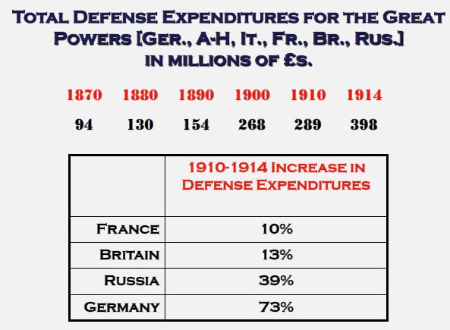
Militarism
Results in the rise of a dangerous European arms race

Slide 7
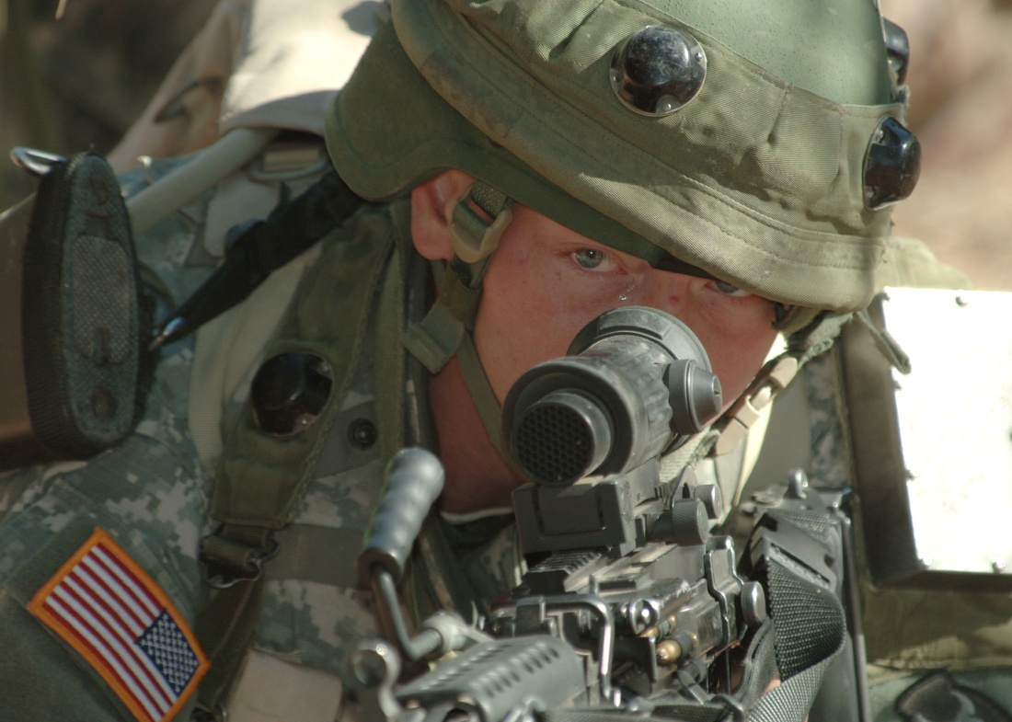
Militarism
Mobilization:
The organization of resources for combat
Generally triggers other nations to do the same

Slide 8
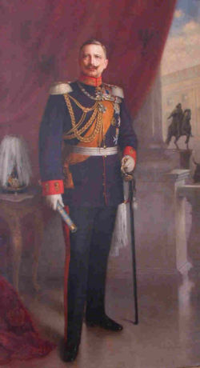
Militarism
Example:
During the early 1900s Kaiser Wilhelm II expanded the German Navy
Wanted Germany to be equal to Great Britain in terms of naval strength

Slide 9
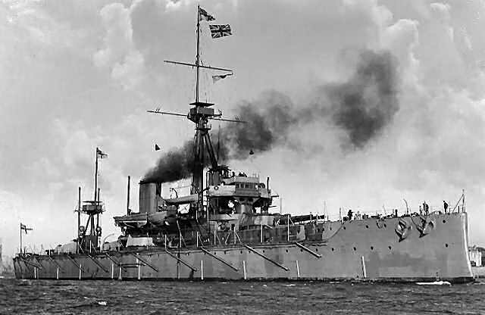
Militarism
Great Britain felt threatened as a result of Germany’s naval buildup
Solution?
Expanded the British Navy
Developed a new battleship; The Dreadnought

Slide 10
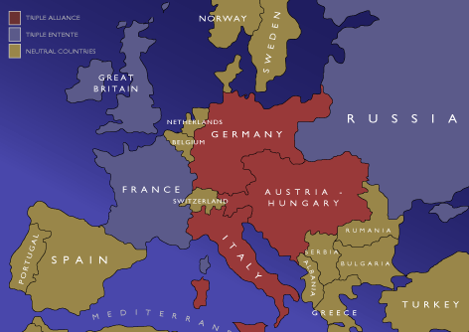
Alliances

Slide 11
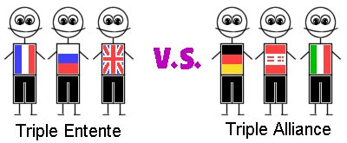
Alliances Defense Agreement Among Nations

Slide 12
Alliances
Triple Alliance (1882):
Germany, Austria-Hungary, Italy* (Central Powers)
Allied in an attempt to isolate France
Triple Entente (1907)
France, Great Britain, Russia (Allied Powers)
*after the war starts, Italy switches sides & joins the Allied Powers

Slide 14
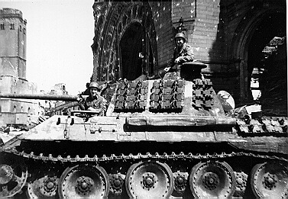
Nationalism

Slide 15
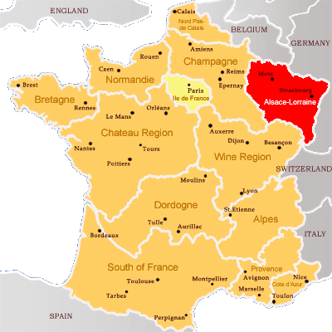
Nationalism
French Nationalism:
French nationalists sought revenge against Germany after their loss of Alsace-Lorraine in the Franco-Prussian War (1870)
Notes:
Alsace-Lorraine – French territory lost after the Franco-Prussian War of 1870

Slide 16
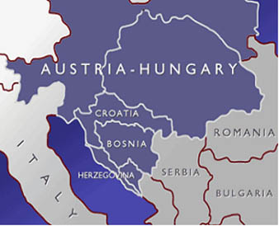
Nationalism
Slavic Nationalism:
A large-scale movement to unify all Slavic people under one empire
The Serbs wanted to lead Slavic unification; supported by Russia

Slide 17
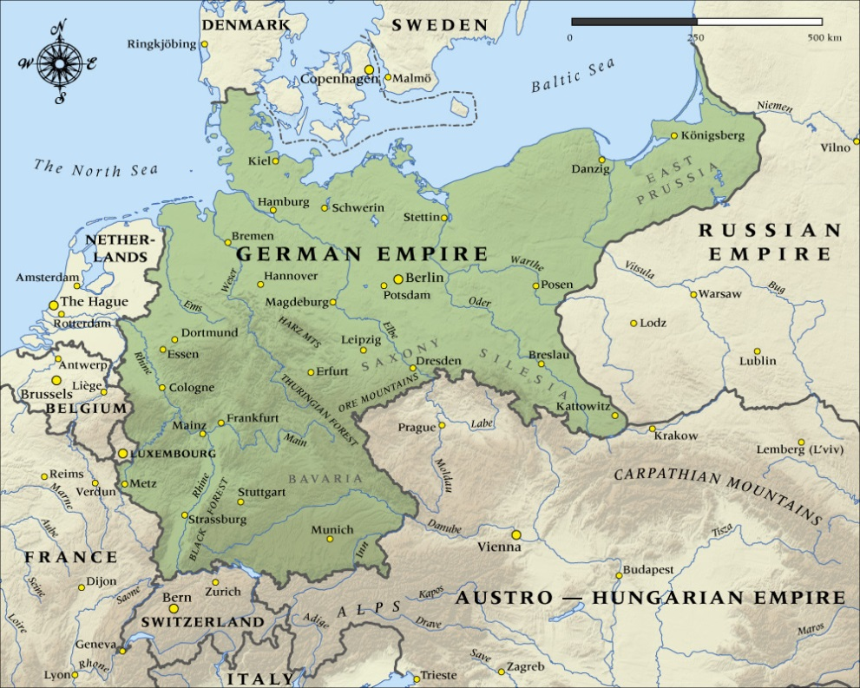
Nationalism
German Nationalism:
Germany wanted to prove its strength in comparison to the other great powers of Europe

Slide 18
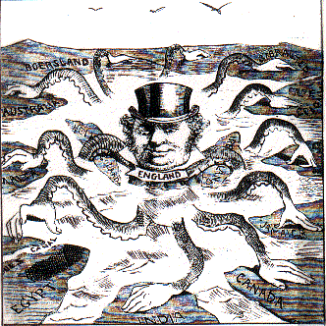
Imperialism

Slide 19
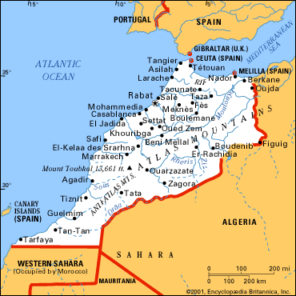
Imperialism
As European countries continued to compete for overseas empires, their sense of rivalry & mistrust of one another deepened
Germany & France came close to fighting a war over the control of Morocco

Slide 20
Imperialism
Germany wanted to create a Berlin to Baghdad Railway
Caused resentment in Britain
Feared interference with India & reduced traffic thru the Suez Canal

Slide 21
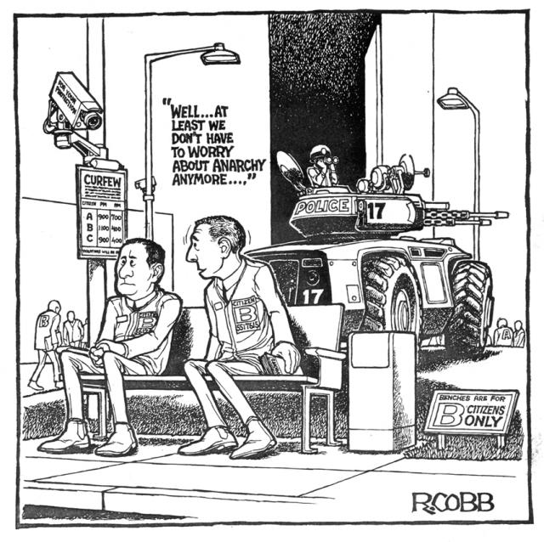
Anarchy

Slide 22
Anarchy
At this time the nations of Europe began to pursue policies without consulting their neighbors
Problem?
If a crisis arose there was no international organization to monitor it…

