Slide 1
The Turning Point
The United States Enters,
Russia Exits

Slide 2
Early US Policy
When World War I began, the US remained neutral
Believed that World War I was a “European affair” (isolationist)

Slide 3
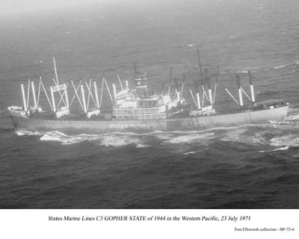
Early US Policy
Supplied food, raw materials, weapons & money to belligerent (warring) nations
Insisted on free trade & travel

Slide 4
What changed to bring the U.S. into the War?

Slide 5
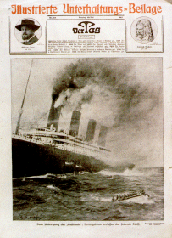
The Lusitania: May1915
Germany sunk a British passenger ship
Had been carrying supplies & 128 Americans

Slide 6
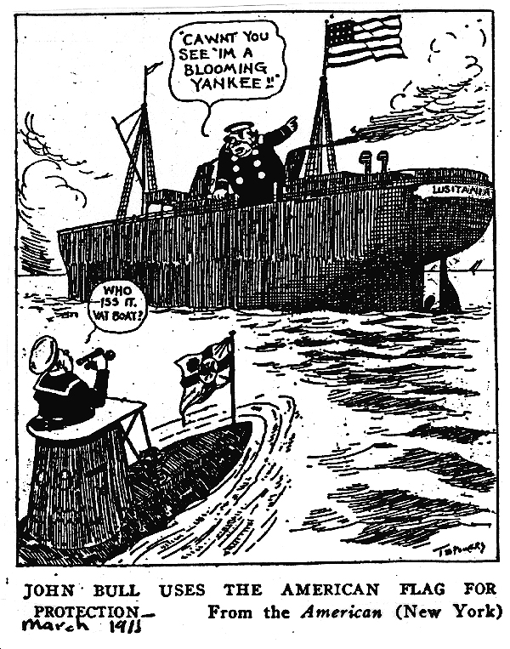
The Lusitania: May 1915
The US warned Germany to back off
Germany temporarily ended unrestricted sub warfare

Slide 7
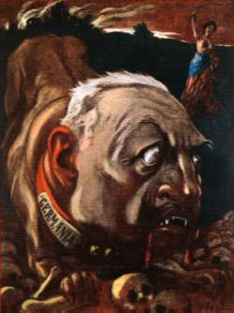
British Propaganda
In the US most news about the war came from GB

Slide 8
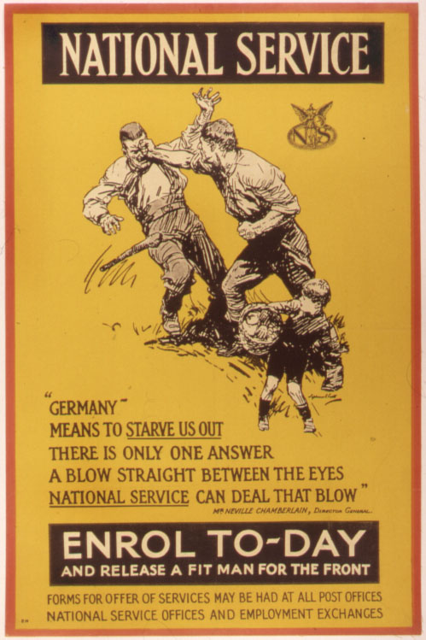
British Propaganda
Exaggerated German atrocities against British citizens
Affected US public opinion

Slide 9
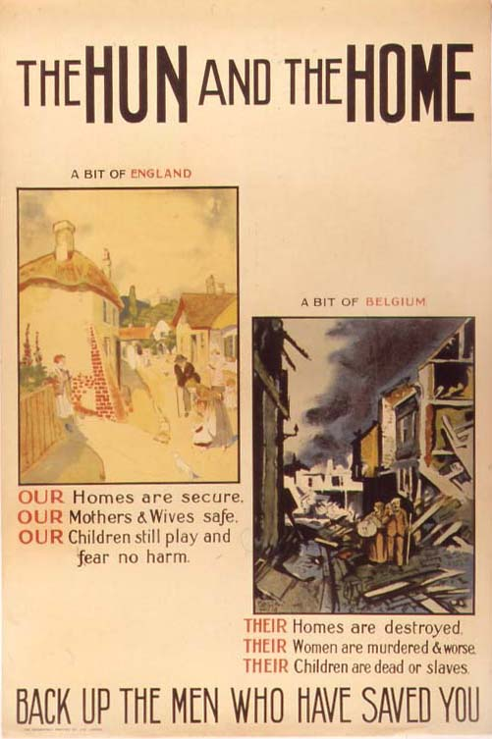
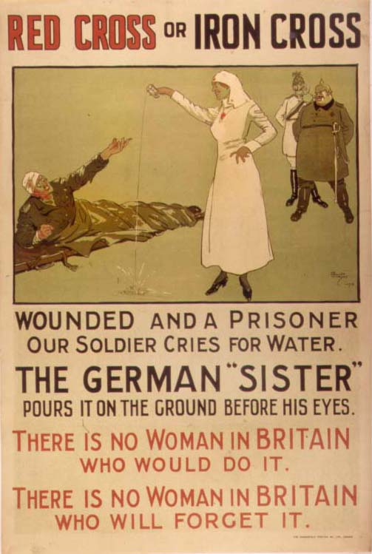

Slide 10
Zimmermann Telegram
Message from German foreign minister to German ambassador to Mexico

Slide 11
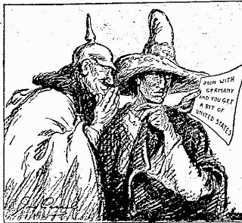
Zimmermann Telegram
Promised Mexico the return of New Mexico, Texas & Arizona in exchange for attacking US
The British intercepted the telegram & shared with US

Slide 12
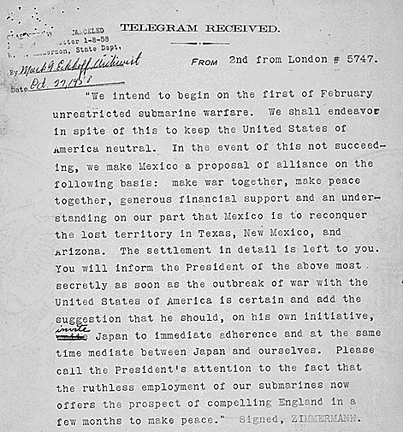
Zimmermann Telegram
The British intercept the message in January 1917, but wait until Feb 24 to present to U.S.
WHY?

Slide 13
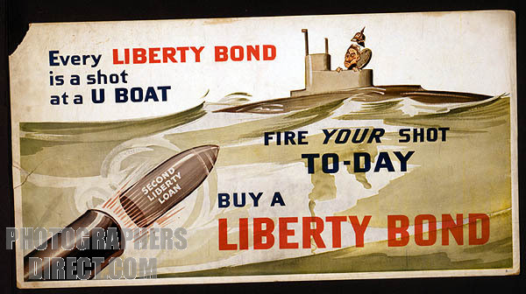
German Submarine Warfare
Germany resumed unrestricted submarine warfare
Germany sank 4 US merchant ships during the winter of 1917

Slide 14
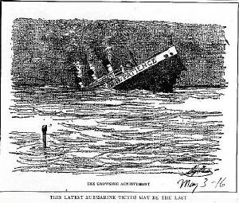
The “Sinking” of the U.S. Patience

Slide 15
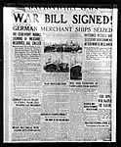
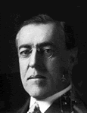
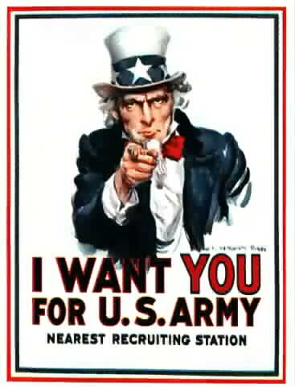
4/2/1917 –Wilson asked Congress for a declaration of war
4/6/1917 – Congress voted to enter war on the side of Allies

Slide 16
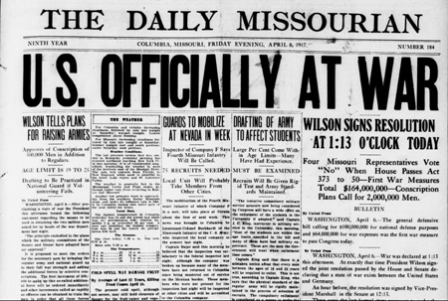
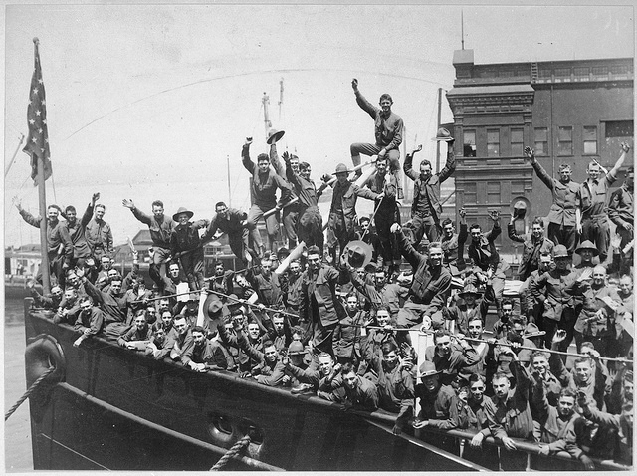
THE YANKS ARE COMING!

Slide 17
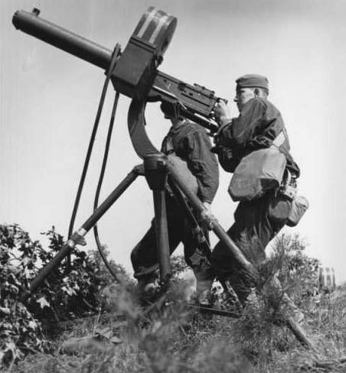
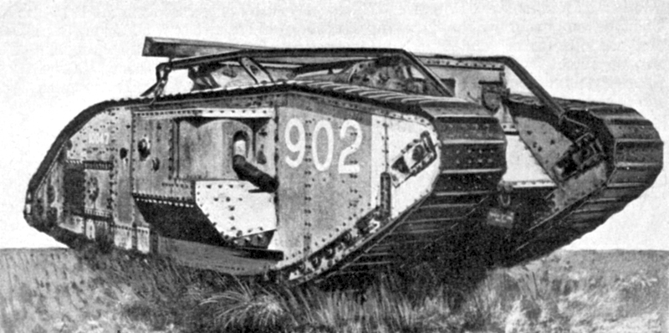
A New Kind of War
War of the Industrial Revolution – warfare relies on machines

Slide 18
A New Kind of War
TOTAL WAR: Nations devoted all resources to war
Governments took control of economy to produce war goods
Factories produced munitions (military weapons, ammunition, equipment, etc)
Citizens put to work

Slide 19
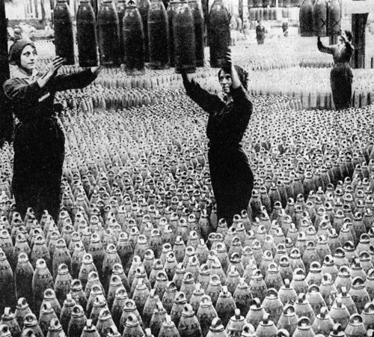
A New Kind of War
Women replaced men in factories
Built tanks and munitions, plowed fields, paved streets, ran hospitals, supplied troops

Slide 20
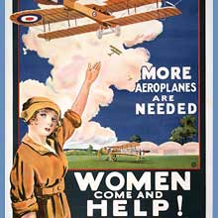
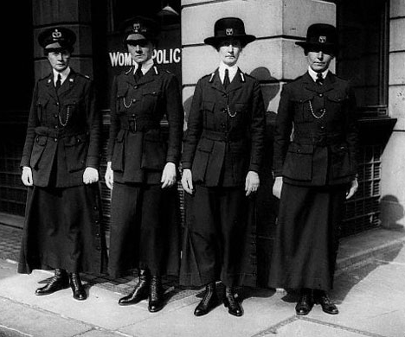
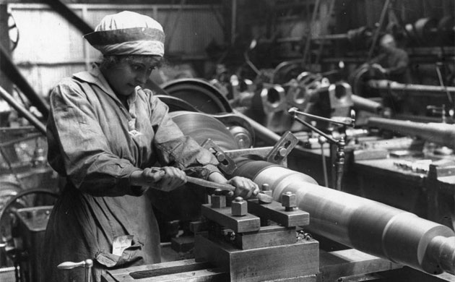

Slide 21
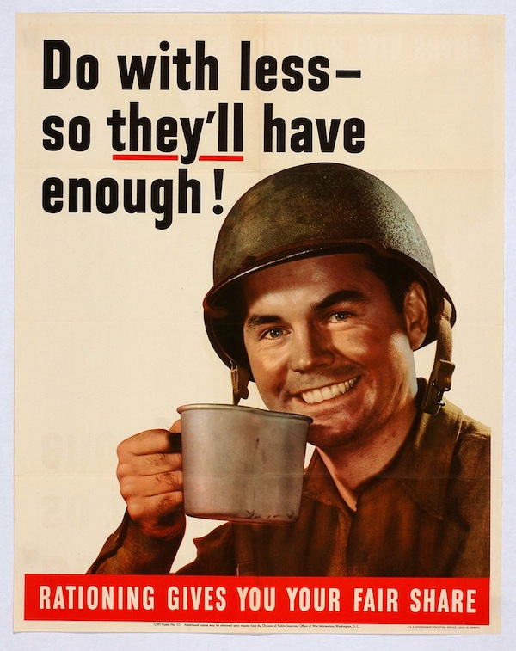
A New Kind of War
Rationing: Since goods were in short supply, governments asked people to only buy small amounts of items
Everyone did their part!

Slide 22
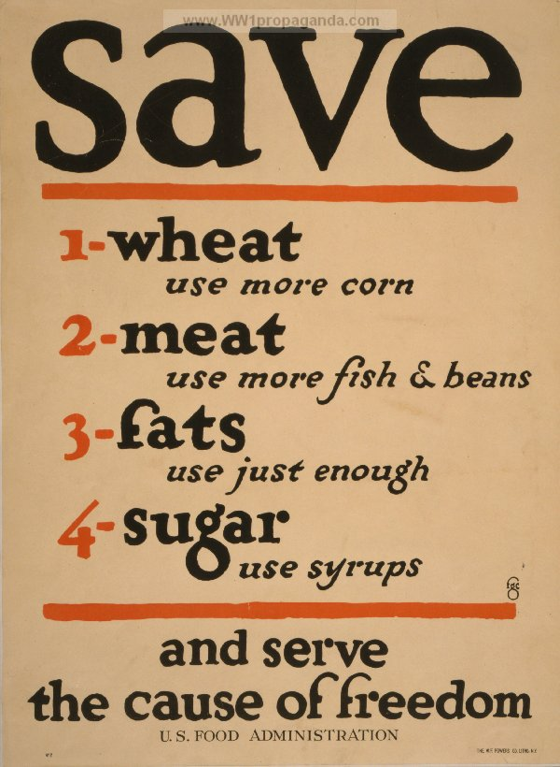
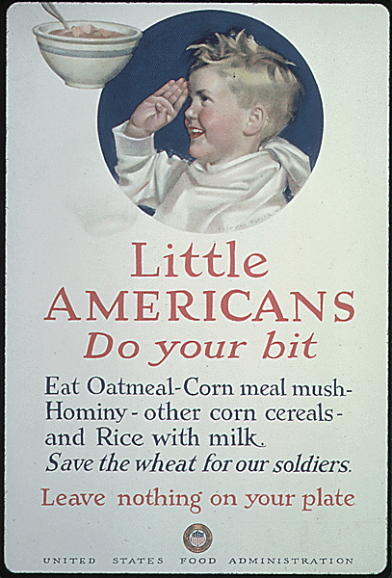

Slide 23
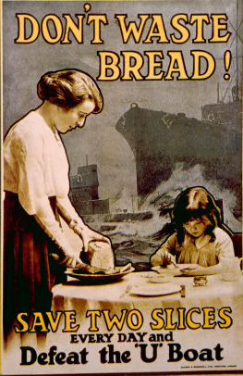
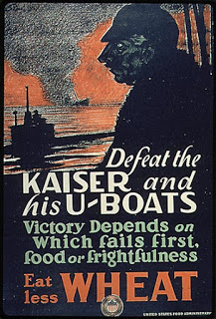
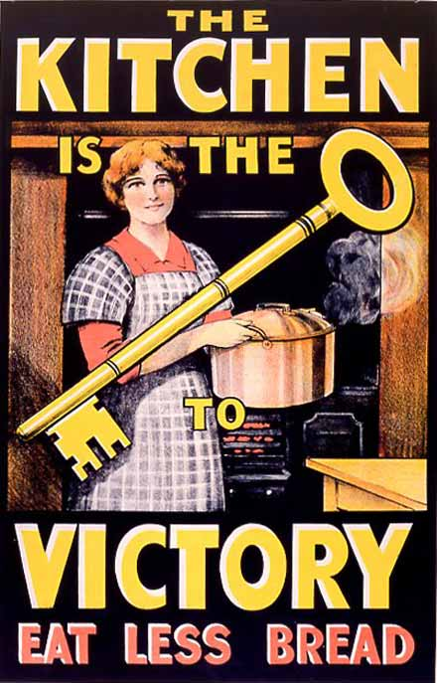

Slide 24
Meanwhile...
In Russia…

Slide 25
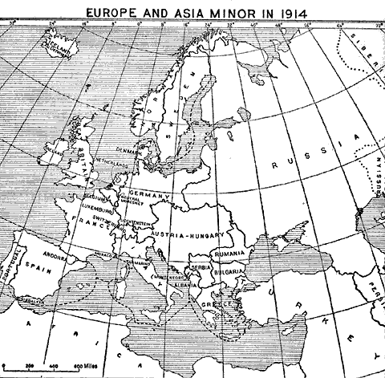
Russia Before World War I
Autocratic empire
Great poverty
Limited industry

Slide 26
Russia During World War I
Cut off from all supplies & allies…
However, Russia greatly aided the war effort by diverting German troops from attacking France & Great Britain

Slide 27
Russia During WWI
Problems: Morale was VERY LOW
Over ¾ of soldiers had no gun; had to retrieve guns from dead soldiers
Inadequate transportation
Food shortages in the cities

Slide 28
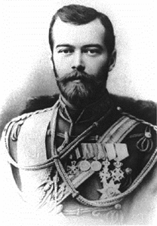
1st Russian Revolution: March 1917
Problems lead to civil unrest in Russia
Czar Nicholas II:
Unpopular & incompetent
Relied on mystic healer Rasputin
Chose NOT to reform the government

Slide 29
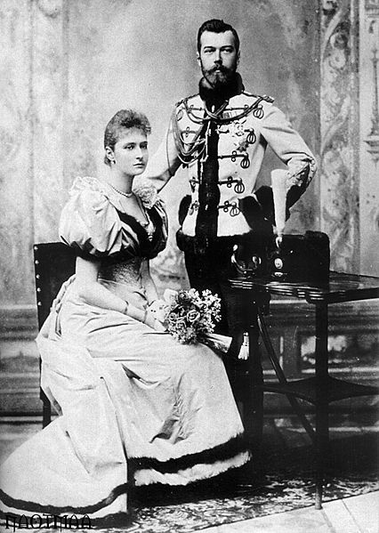
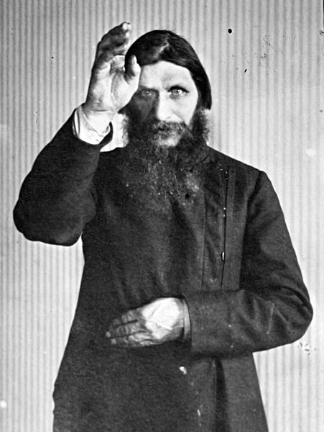
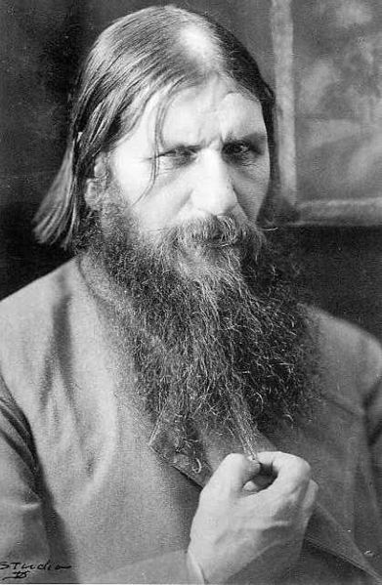

Slide 30
1st Russian Revolution: March 1917
Nicholas II was overthrown – end of Romanov Dynasty!
Revolutionaries set up a provisional (temporary) government
Notes:
A year later revolutionaries executed Nicholas and his family. The 3-century czarist rule of the Romanovs finally collapsed.

Slide 31
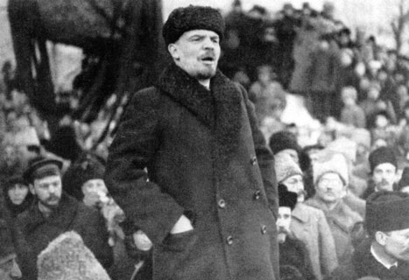
The Provisional Government
Provisional government pledged to continue to fight in the war, BUT…

Slide 32
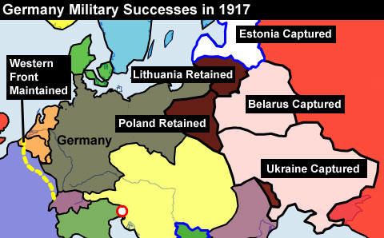
1st Russian Revolution: March 1917
By 1917 Russian soldiers refused to fight!
(nearly 5.5 million Russian soldiers had been wounded, killed, or taken prisoner)

Slide 33
1st Russian Revolution: March 1917
Provisional government lost its support
Opens the door for socialism!
Rival groups emerged – Soviets (socialist workers councils) to fill the role of the gov’t

Slide 34
2nd Russian Revolution: November 1917
Bolsheviks:
Radical group that wanted to introduce a socialist society by force
Promised the people “Peace, land and bread”

Slide 35
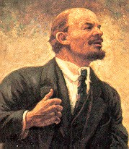
2nd Russian Revolution:
Vladimir Lenin:
Leader of the Bolsheviks (communists) who had been in exile
Germany aided Lenin in returning to Russia…why?

Slide 36
2nd Russian Revolution
November 1917:
Lenin/Bolsheviks staged a coup d’etat
Established a communist state
Ended private property
Distributed land among peasants

Slide 37
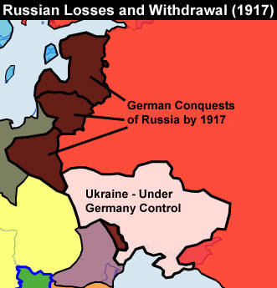
Russia Withdraws From War
MARCH 1918:
RUSSIA WITHDREW FROM WWI!
Treaty of Brest-Litovsk:
Russia lost much of its western territory; 33% of its population
(Estonia, Latvia, Lithuania, Poland, Ukraine)

Slide 38
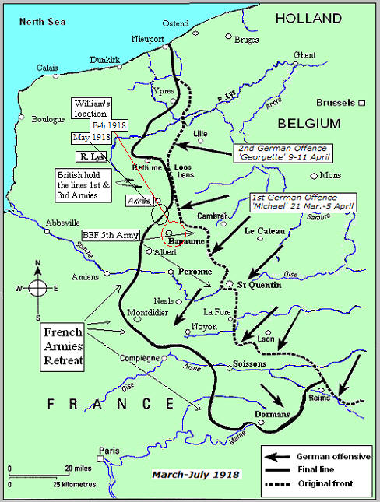
The End of the War
After Russia withdrew from the war, Germany only had to deal with a single-front war

Slide 39
The End of the War
Germany hoped to launch a final offensive on the Western Front in order to force peace before the US became too involved

Slide 40
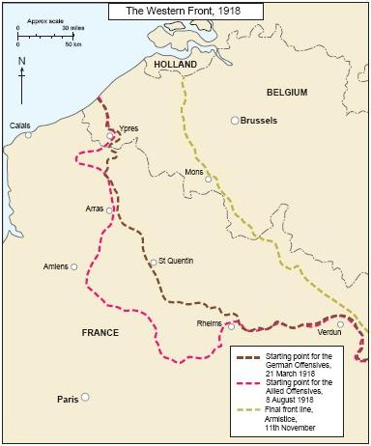
The End of the War
Spring 1918:
Last German offensive - fails!

Slide 41
The End of the War
Central Powers collapse!:
Bulgarians & Ottoman Turks surrender
Revolution in A-H
German soldiers mutinied
Nov. 9, 1918, Kaiser Wilhelm II stepped down

Slide 42
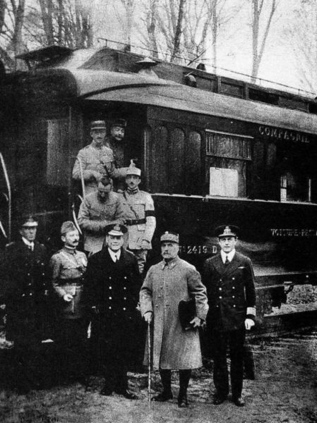
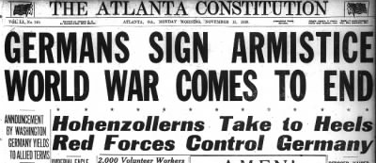
The End of the War
Armistice (agreement to stop fighting) was signed on November 11, 1918 @ 11am

Slide 43
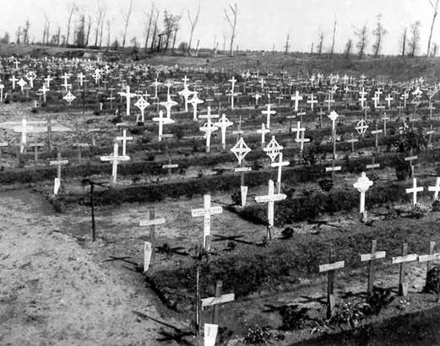
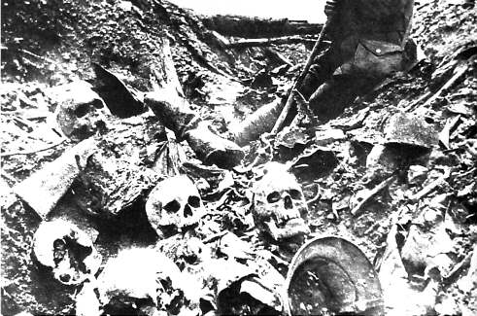
Legacy of War
8.5 million soldiers dead; 21 million wounded

Slide 44
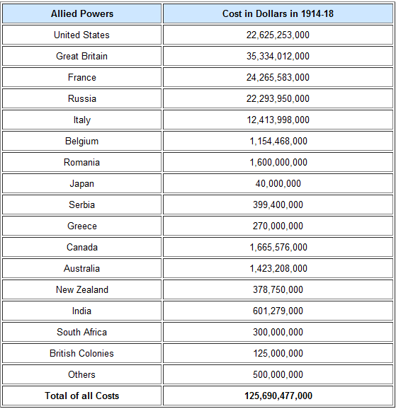
Legacy of War
Devastated European economies; drained national treasuries

Slide 45
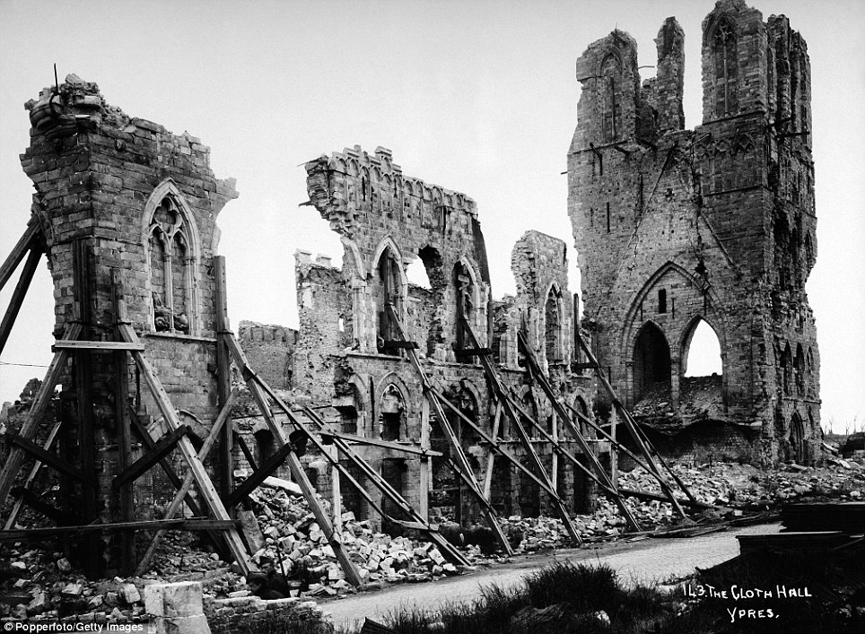
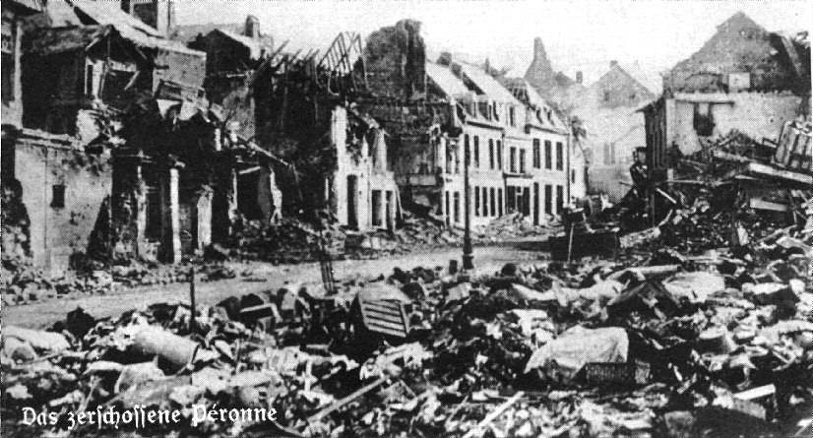
Legacy of War
Destroyed acres of farmland & towns

