Slide 1
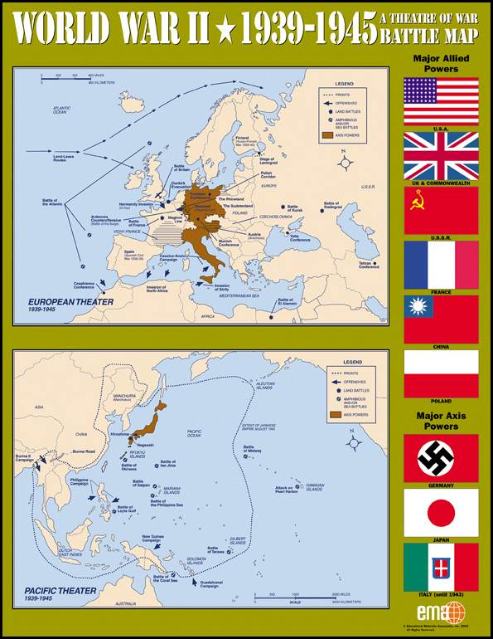
WORLD WAR II Setting the Stage

Slide 2
What was WWII?
Largest war in human history
Involved countries, colonies, & territories around the entire world
By the end, over 70 million were dead
It last from 1939 until 1945

Slide 3
Causes of WWII
WWI & the Treaty of Versailles
Appeasement
Rise of Totalitarianism

Slide 4
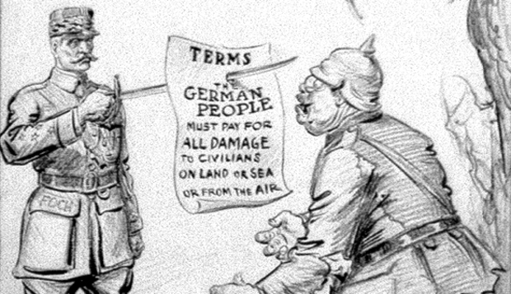
WWI & Treaty of Versailles
Germany lost land to surrounding nations
War reparations:
Allies collect $ to pay back war debts to U.S.
Germany pays $57 trillion (modern day equivalent)

Slide 5
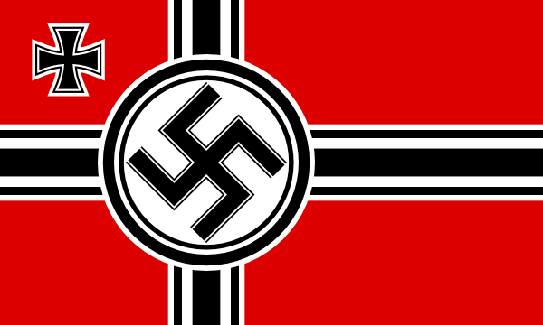
WWI & Treaty of Versailles
Germans are bankrupt, embarrassed, guilt ridden, and angry!
Desperate people turn to desperate leaders!!!!

Slide 6
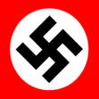
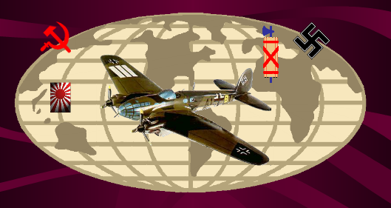
The Rise of Totalitarianism

Slide 7
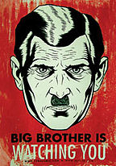
Totalitarianism
Government that takes TOTAL control over every aspect of life...public & private
Led by charismatic dictators!

Slide 8
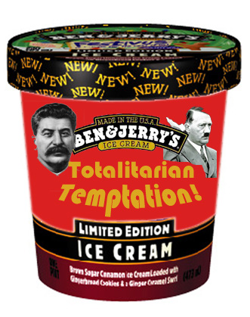
Totalitarianism
Economic problems & political unrest opened the door for totalitarian regimes to gain power…

Slide 9
Totalitarianism
Fascism: Italy, Germany (Nazism) & Spain
Communism: Soviet Union
Militarism: Japan

Slide 10
FASCISM

Slide 11
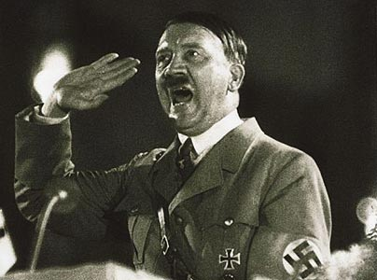
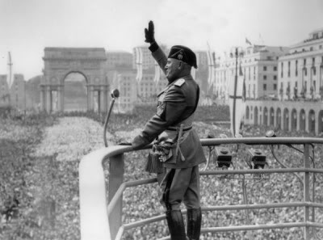
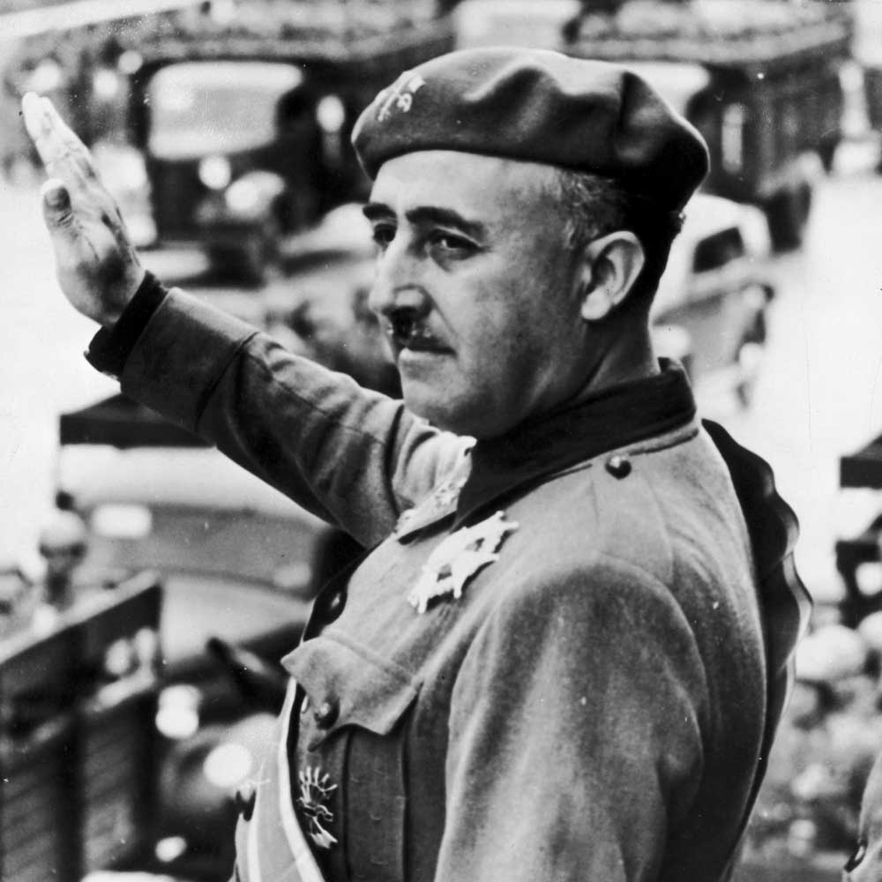
Fascism
Political movement that emphasizes loyalty to the state and obedience to its leader
Individual serves the state

Slide 12
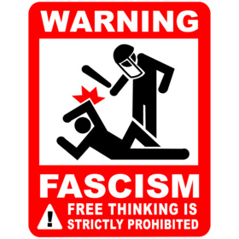
Fascism
Extreme nationalism (all others are inferior)
Extreme militarism

Slide 13
Fascism
One Party (opposition banned!)
Anti-democratic (democracy is for the weak)
Anti-communist: support private property & distinct classes

Slide 14
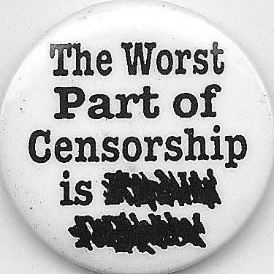
Fascism
Fascist leaders maintain control through…
Heavy censorship
Secret Police
Propaganda & youth indoctrination
Racism

Slide 15
How & Why Did Fascists Rise to Power?

Slide 16
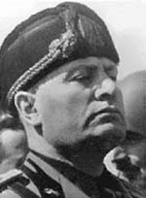
Fascism in Italy
Mussolini
“Il Duce”
1922-1943

Slide 17
In Italy…
Constitutional monarchy (democratic!)
Major economic problems, resentment & social unrest
Mussolini founded Fascist Party & vowed to give Italy strong leadership

Slide 18
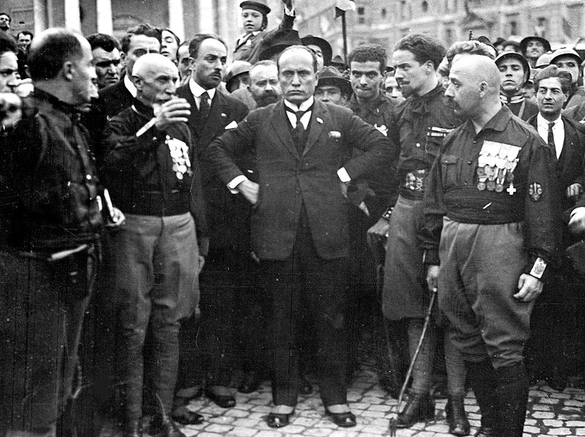
In Italy…
Gained support from middle class who feared a communist revolution would take place
October 1922, 30,000 fascists marched on Rome
King handed over power to Mussolini

Slide 19
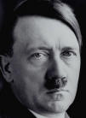
Fascism in Germany
Hitler
“der Fuhrer”
1933-1945

Slide 20
In Germany…
Weimar Republic (democratic!)
Major economic problems, resentment & social unrest
National Socialist German Workers Party (Nazi Party) begins to grow and gain support

Slide 21
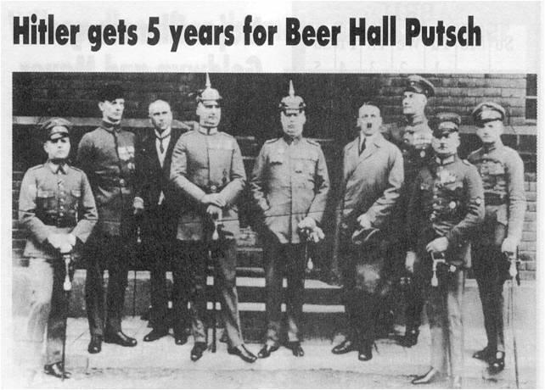
In Germany…
1923 – Tries to seize power in Munich – fails!

Slide 22
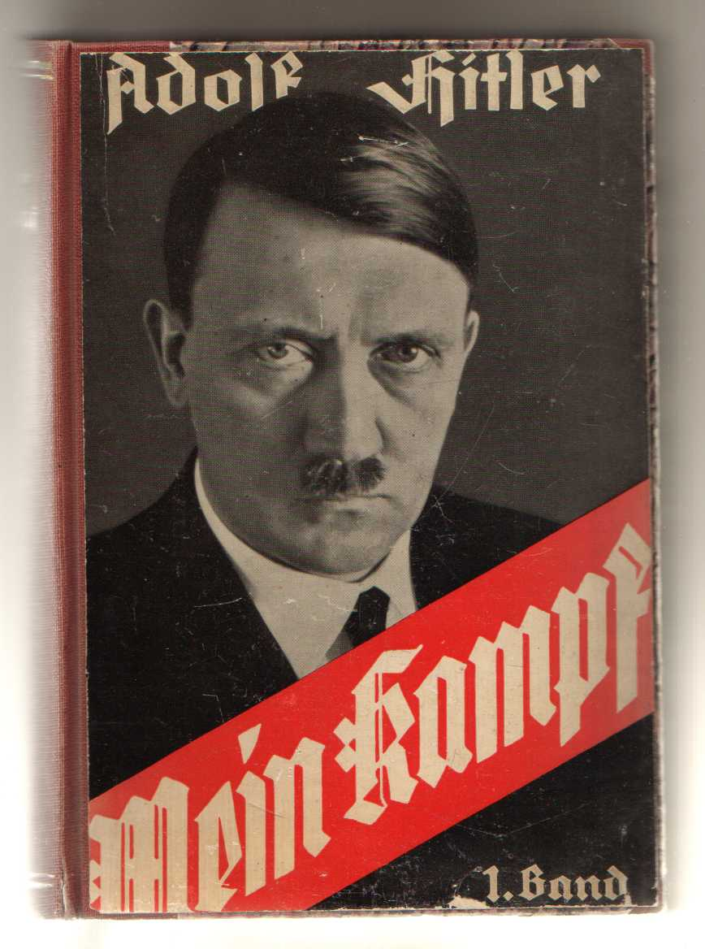
In Germany…
While in jail, writes Mein Kampf (My Struggle)
Germans “Aryans” were master race
Called Treaty of Versailles an outrage
Germany needed lebensraum – “living space”

Slide 23
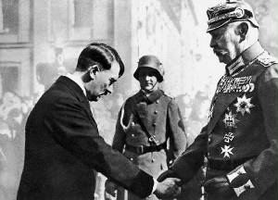
In Germany…
Growing support from middle class for fascism
1932 - Nazis were the largest political party
1933 – Hitler appointed chancellor by President Hindenburg

Slide 24
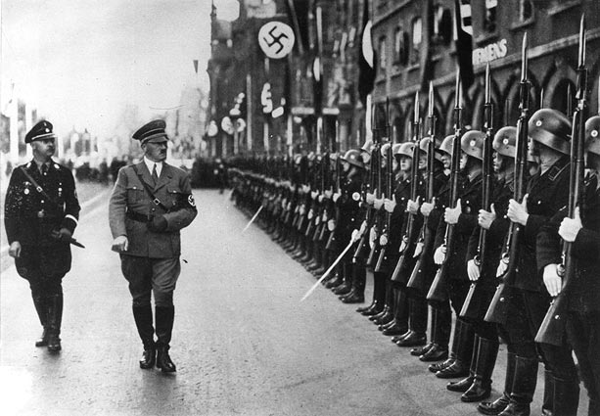
In Germany…
Used secret police to eliminate opposition
Dictator – 1934
Creates a totalitarian fascist state

Slide 25
COMMUNISM: A Different Political Ideology…BUT similar results!

Slide 26
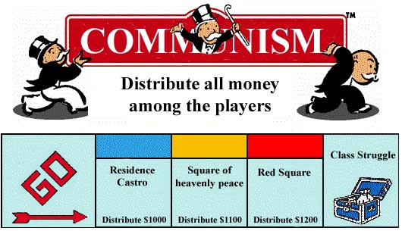
Communism
A quick review of theory…
Workers overthrow bourgeois capitalism
Eliminate private property
Collective ownership of means of production
Classless society – everyone is equal

Slide 27
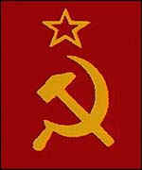
Communism
Eventual Goal: no gov’t because everyone is equal
But in practice, results were much different…

Slide 28
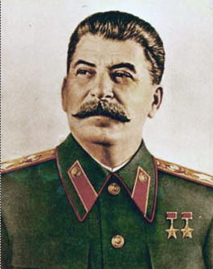
Communism in the Soviet Union
Joseph Stalin
1929-1953

Slide 29
Communism – Under Stalin
Under Stalin, government controlled all aspects of citizens lives
Five Year Plans – to industrialize & develop Soviet Union’s economy
Seized property & created collective farms

Slide 30
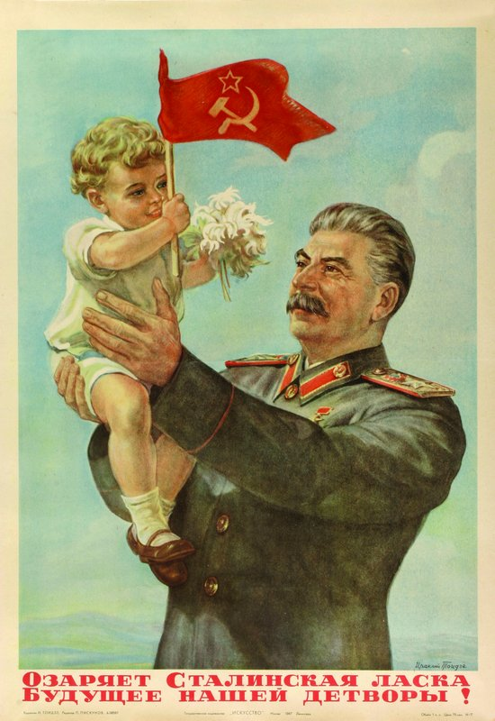
Communism – Under Stalin
ALSO…strong nationalism
Youth indoctrination
Secret police
Censorship & loss of civil liberties
Purges of opposition
Religious persecution

Slide 31
Communism – Under Stalin
Hey – that sounds a lot like fascism!
In theory, fascism & communism are on opposite ends of political spectrum
In practice, they are VERY similar!

Slide 32
Communism – Under Stalin
Major differences?
Fascism = private property & social classes
Communism = no private property and no social classes

Slide 33
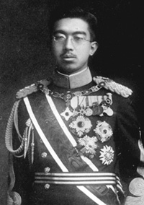
Militarism in Japan
Emperor Hirohito
1926-1989

Slide 34
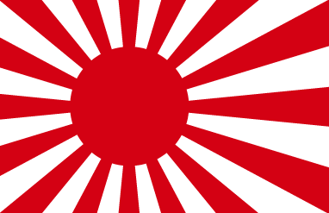
Militarism in Japan
Emperor was a symbol of state power
Influenced by militarists (military leaders)
Extreme nationalists

Slide 35
Militarism in Japan
Wanted to solve Japan’s economic problems by foreign expansion
GOAL = Pacific Empire (included a conquered China)

